Slide 1
Regional Economic Integration
8
  CYCU
  Prof. CK Farn
mailto: ckfarn@gmail.com
http://www.mgt.ncu.edu.tw/~ckfarn/cycu
  2022.11

Slide 2
Assignment
Do a research on the Internet, and finish a report in teams
  Prepare a presentation with PowerPoint, no more than 8 pages
  Due Dec 2
Try to understand the Presidential election system in the USA, including and not limited to: primaries and the nominating process, concepts of Electoral College and indirect elections, generation of electors in each state, tie breaking, etc.
Give examples of any ONE previous election, where the candidate with more popular votes lost the election.

Slide 3
Introduction:
Regional Economic Integration
Past two decades brought in many regional trade blocs, whose goal is to reduce or remove tariff and nontariff barriers for goods, services, and factors of production.
As of 2020, there were 303 regional trade agreements in force.
  Most ambitious movement toward integration has been in the European Union.
  United States–Mexico–Canada Agreement (USMCA) has replaced NAFTA.
  Attempts at integration in South America and Africa.
  Regional Comprehensive Economic Partnership (RCEP) is close to being finalized by 15 nations.
Notes:
Consistent with the predictions of international trade theory and particularly the theory of comparative advantage, agreements designed to promote freer trade within regions are believed by economists to produce gains from trade for all member countries. The General Agreement on Tariffs and Trade (GATT) and its successor, the World Trade Organization, also seek to reduce trade barriers.

Slide 4
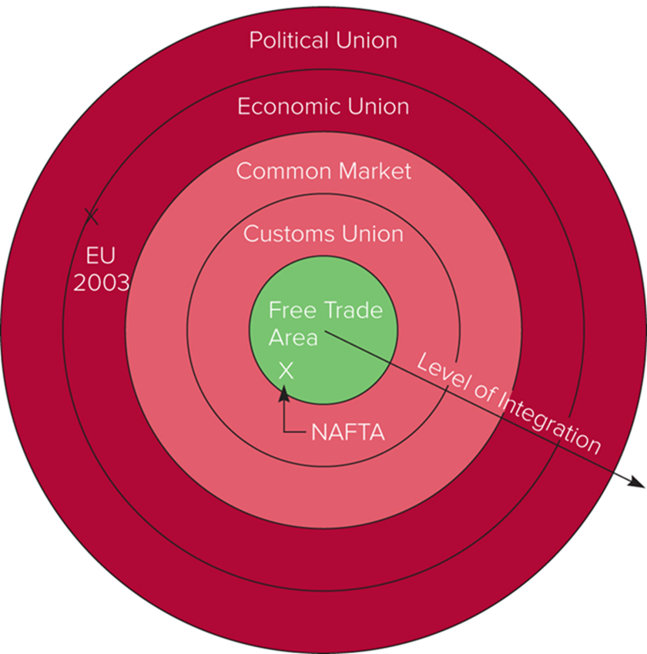
Figure 9.1 Levels of Economic Integration

Slide 5
Levels of Economic Integration ₁
Free Trade Area
  All barriers to the trade of goods and services among member countries are removed, but members determine own trade policies with nonmembers.
  Accounts for almost 90 percent of regional agreements.
  European Free Trade Association (EFTA) between Norway, Iceland, Liechtenstein, and Switzerland began in 1960.
  Other free trade areas include NAFTA, now replaced by the United States Mexico–Canada Agreement (U S M C A).
Notes:
LO 9-1 Describe the different levels of regional economic integration.
The most enduring free trade area in the world is the European Free Trade Association (EFTA). Established in January 1960, the EFTA currently joins four countries—Norway, Iceland, Liechtenstein, and Switzerland—down from seven in 1995 (three EFTA members—Austria, Finland, and Sweden—joined the EU on January 1, 1996). The EFTA was founded by those western European countries that initially decided not to be part of the European Community (the forerunner of the EU).

Slide 6
Levels of Economic Integration ₂
Customs Union
  Eliminates trade barriers between member countries and adopts a common external trade policy.
  Most countries that enter a customs union desire further integration in the future.
  Andean Community established free trade between Bolivia, Columbia, Ecuador, and Peru.
Notes:
The current version of the Andean Community (formerly known as the Andean Pact) is a free trade area that includes Bolivia, Colombia, Ecuador, and Peru, and that aspires to be a customs union, but that so far has been imperfectly implemented. The Andean Community established free trade among member countries, and in theory imposes a common tariff of 5 to 20 percent on products imported from outside.

Slide 7
Levels of Economic Integration ₃
Common Market
  No barriers to trade between member countries, a common external trade policy, and the free movement of the factors of production.
  Requires significant harmony among members in fiscal, monetary, and employment policies.
  Mercosur (between Brazil, Argentina, Paraguay, and Uruguay) hopes to achieve this status.
Notes:
Venezuela was accepted as a full member of Mercosur, but then was indefinitely suspended from the group in December 2016 due to its undemocratic policies.

Slide 8
Levels of Economic Integration ₄
Economic Union
  Countries committed to the free flow of products and factors of production between members, adoption of a common currency, harmonization of tax rates, and pursuit of a common external trade policy.
  Involves sacrificing a significant amount of national sovereignty.
  European Union (EU).
Notes:
The EU is an economic union, although an imperfect one because not all members of the EU have adopted the euro, the currency of the EU; differences in tax rates and regulations across countries still remain; and some markets, such as the market for energy, are still not fully deregulated.

Slide 9
Levels of Economic Integration ₅
Political Union
  Independent states combined into single union.
  Requires that a central political apparatus coordinate economic, social, and foreign policy for member states.
  The EU is headed toward at least partial political union.
  The United States is an example of even closer political union.
Notes:
The European Parliament, which plays an important role in the EU, has been directly elected by citizens of the EU countries since the late 1970s.

Slide 10
The Economic Case for Integration
  Regional economic integration attempts to achieve additional gains from the free flow of trade and investment between countries beyond those attainable under international agreements such as the WTO.
  Since it is easier to form an agreement with a few countries than across all nations, there has been a push toward regional economic integration.
    The more countries involved, the more perspectives that must be reconciled, and the harder it is to reach agreement.
Notes:
LO 9-2 Understand the economic and political arguments for regional economic integration.
The theoretical ideal is an absence of barriers to the free flow of goods, services, and factors of production among nations.

Slide 11
The Political Case for Integration
  By linking countries together, making them more dependent on each other, and forming a structure where they regularly interact, the likelihood of violent conflict and war will decrease.
  By linking countries together, they have greater clout and are politically much stronger in dealing with other nations.
Notes:
These considerations underlay the 1957 establishment of the European Community (EC), the forerunner of the EU. Europe had suffered two devastating wars in the first half of the twentieth century, both arising out of the unbridled ambitions of nation-states. Those who have sought a united Europe have always had a desire to make another war in Europe unthinkable.

Slide 12
Impediments to Integration
  It can be costly—while a nation may benefit from a regional free trade agreement, certain groups may lose.
  It results in a loss of national sovereignty.
This was the major concern of Great Britain, leading to a referendum on membership in the E U, and its subsequent withdrawal.
Notes:
Due to the establishment of NAFTA, some Canadian and U.S. workers in such industries as textiles—which employ low-cost, low-skilled labor—lost their jobs as Canadian and U.S. firms moved production to Mexico. The promise of significant net benefits to the Canadian and U.S. economies as a whole is little comfort to those who lose as a result of NAFTA. Such groups have been at the forefront of opposition to NAFTA and will continue to oppose any widening of the agreement.

Slide 13
Regional Economic Integration
  Only makes sense when the amount of trade it creates exceeds the amount it diverts, according to some economists.
  Trade creation occurs when low-cost producers within the free trade area replace high-cost domestic producers.
  Trade diversion occurs when higher-cost suppliers within the free trade area replace lower-cost external suppliers.
Notes:
LO 9-3 Understand the economic and political arguments against regional economic integration.
Suppose the United States and Mexico imposed tariffs on imports from all countries, and then they set up a free trade area, scrapping all trade barriers between themselves but maintaining tariffs on imports from the rest of the world. If the United States began to import textiles from Mexico, would this change be for the better? If the United States previously produced all its own textiles at a higher cost than Mexico, then the free trade agreement has shifted production to the cheaper source.
In theory, WTO rules should ensure that a free trade agreement does not result in trade diversion. These rules allow free trade areas to be formed only if the members set tariffs that are not higher or more restrictive to outsiders than the ones previously in effect. However, as we saw in Chapter 7, GATT and the WTO do not cover some nontariff barriers.

Slide 14
Europe Has Two Trade Blocs
  European Union with 27 members (Britain has exited).
  European Free Trade Association with 4 members.
  European Union is expected to become a superpower like the United States.
Notes:
LO 9-4 Explain the history, current scope, and future prospects of the world's most important regional economic agreements.

Slide 15
Evolution of the European Union
  European Union (EU) is the result of:
    Devastation of western Europe during two world wars and desire for lasting peace.
    Desire by European nations to hold their own on the world’s political and economic stage.
  Forerunner of EU was the European Coal and Steel Community (formed in 1951).
  Treaty of Rome established the European Economic Community in 1957.
    Name changed to the E U in 19 93.
    Number of members fell to 27 in early 2020 when Britain exited the E U.
Notes:
The Treaty of Rome provided for the creation of a common market. Article 3 of the treaty laid down the key objectives of the new community, calling for the elimination of internal trade barriers and the creation of a common external tariff and requiring member states to abolish obstacles to the free movement of factors of production among the members. To facilitate the free movement of goods, services, and factors of production, the treaty provided for any necessary harmonization of the member states’ laws. Furthermore, the treaty committed the EC to establish common policies in agriculture and transportation.

Slide 16
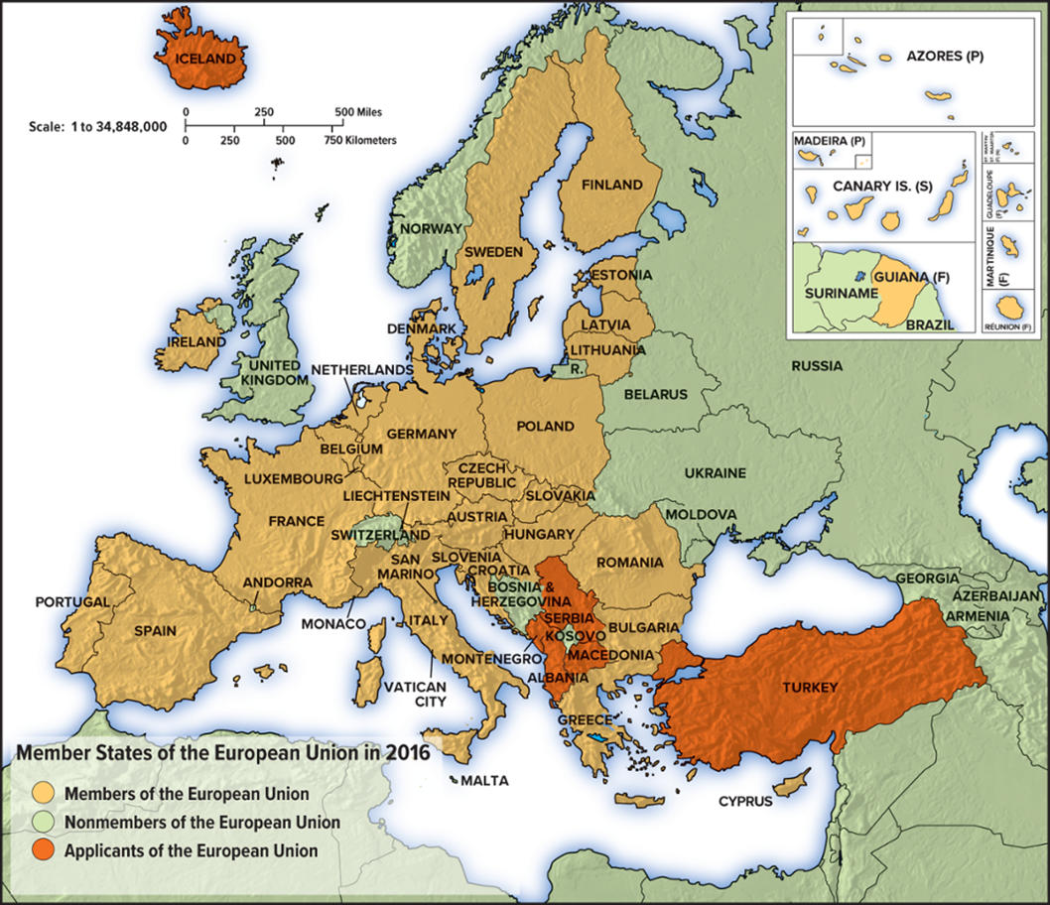
Map 9.1 Member States of the European Union in 2020
Source: European Union, 1995–2020.

Slide 17
Political Structure of the European Union
  European Commission: proposes EU legislation, implements it, and monitors compliance.
  European Council: the ultimate controlling authority within the EU.
  European Parliament: debates legislation proposed by the commission and forwarded to it by the council.
  Court of Justice: the supreme appeals court for EU.
Notes:
After significant debate, in December 2007, the member states signed a new treaty, the Treaty of Lisbon, under which the power of the European Parliament was increased. When it took effect in December 2009, for the first time in history the European Parliament was the co-equal legislator for almost all European laws. The Treaty of Lisbon also created a new position, a president of the European Council, who serves a 30-month term and represents the nation-states that make up the EU.

Slide 18
The Single European Act
Committed EC countries to work toward establishment of a single market by 19 92.
Objectives of the Act:
  Remove all frontier controls between E C countries.
  Apply the principle of mutual recognition to product standards.
  Institute open procurement to nonnational suppliers.
  Lift barriers to competition in retail banking and insurance.
  Remove all restrictions on foreign exchange transactions between member countries.
  Abolish restrictions on cabotage.
Notes:
Cabotage—the right of foreign truckers to pick up and deliver goods within another member state’s borders.
All those changes were expected to lower the costs of doing business in the EC, but the single-market program was also expected to have more complicated supply-side effects. For example, the expanded market was predicted to give EC firms greater opportunities to exploit economies of scale. In addition, it was thought that the increase in competitive intensity brought about by removing internal barriers to trade and investment would force EC firms to become more efficient. To signify the importance of the Single European Act, the European Community also decided to change its name to the European Union once the act took effect.

Slide 19
The Single European Act _{continued}
Impact of the Act:
  Helped restructure large segments of European industry via production and distribution systems.
  Faster economic growth: raised GDP by between 2 and 5 percent in its first 15 years.
Reality, however, still falls short of the ideal.
Notes:
Many firms have shifted from national to pan-European production and distribution systems in an attempt to realize scale economies and better compete in a single market. The results have included faster economic growth than would otherwise have been the case. However, more than a quarter of a century after the formation of a single market, there is little doubt that the reality still falls short of the ideal. Although the EU is undoubtedly moving toward a single marketplace, long-established legal, cultural, and language differences among nations mean that implementation has been uneven.

Slide 20
The Establishment of the Euro
In 1992, the Maastricht Treaty committed EU members to adopt a single currency, the euro.
  The euro is used by 19 of the member states.
  Created the euro zone, encompassing 330 million E U citizens.
  Countries that participate have agreed to give up control of their monetary policy.
  Britain, Denmark, and Sweden opted out.
Notes:
Many of the countries that joined the EU on May 1, 2004, and the two that joined in 2007 originally planned to adopt the euro when they fulfilled certain economic criteria—a high degree of price stability, a sound fiscal situation, stable exchange rates, and converged long term interest rates (the current members had to meet the same criteria). However, the events surrounding the EU sovereign debt crisis of 2010–2012 persuaded many of these countries to put their plans on hold, at least for the time being.

Slide 21
The Establishment of the Euro continued
Benefits of the Euro.
  Handling one currency, rather than many.
  Easier to compare prices across Europe.
  Increased competition promotes greater efficiencies in production.
  The pan-European capital market should further develop.
  Range of investment options open both to individuals and institutions should increase.
Costs of the euro.
  Membership implies a loss of control over monetary policy.
  The EU is not an optimal currency area: an area where similarities in the underlying structure of economic activities make it feasible to adopt a single currency and use a single exchange rate as an instrument of macro-economic policy.
  Countries may react differently to changes in the euro.
Notes:
Perhaps more important, the adoption of a common currency makes it easier to compare prices across Europe. This has been increasing competition because it has become easier for consumers to shop around. For example, if a German finds that cars sell for less in France than Germany, he may be tempted to purchase from a French car dealer rather than his local car dealer. Alternatively, traders may engage in arbitrage to exploit such price differentials, buying cars in France and reselling them in Germany. The only way that German car dealers will be able to hold onto business in the face of such competitive pressures will be to reduce the prices they charge for cars. As a consequence of such pressures, the introduction of a common currency has led to lower prices, which translates into substantial gains for European consumers.

Slide 22
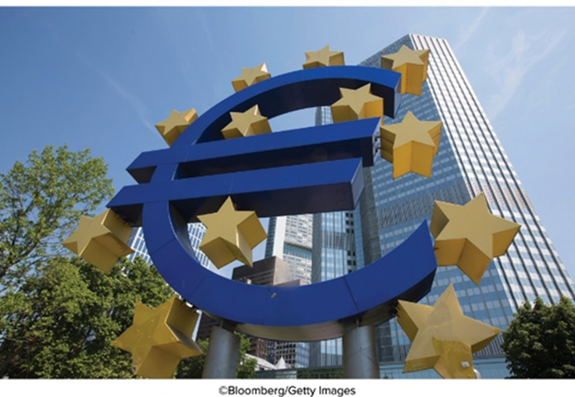
The Euro Experience
Since its establishment, the euro has had a volatile trading history with the U.S. dollar.
  Initially, the euro was valued at $1.17, then fell in value relative to the dollar, but strengthened to an all-time high of $1.54 in March 2008.
  By early 2020, the exchange rate was €1 = $1.12.
  Nov 2022 €1 = $1.03
Notes:
More troubling perhaps for the long-run success of the euro, many of the newer EU nations that had committed to adopting the euro put their plans on hold. Countries like Poland and the Czech Republic had no desire to join the euro zone and then have their taxpayers help bail out the profligate governments of countries like Italy and Greece. To compound matters, the sovereign debt crisis had exposed a deep flaw in the euro zone: it was difficult for fiscally more conservative nations like Germany to limit profligate spending by the governments of other nations that might subsequently create strains and impose costs on the entire euro zone.

Slide 23
Enlargement of the European Union
Many countries, particularly from eastern Europe, have applied for membership.
  Ten countries joined in 2004, expanding the E U to 25 states.
  In 2007, Bulgaria and Romania joined.
  Croatia joined in 2013, bringing membership to 28.
    Turkey has also applied for membership, but it is not clear whether it will be accepted.
Notes:
Left standing at the door is Turkey. Turkey, which has long lobbied to join the union, presents the EU with some difficult issues. The country has had a customs union with the EU since 1995, and about half its international trade is already with the EU. However, full membership has been denied because of concerns over human rights issues (particularly Turkish policies toward its Kurdish minority).

Slide 24
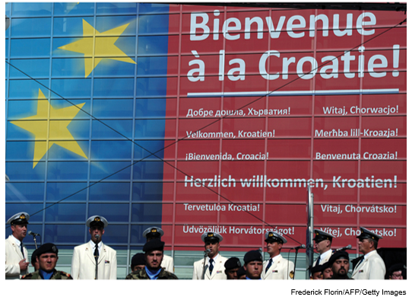
Croatia Joins the E U
Welcome sign to Croatia when the country joined the European Union.
Frederick Florin/AFP/Getty Images

Slide 25
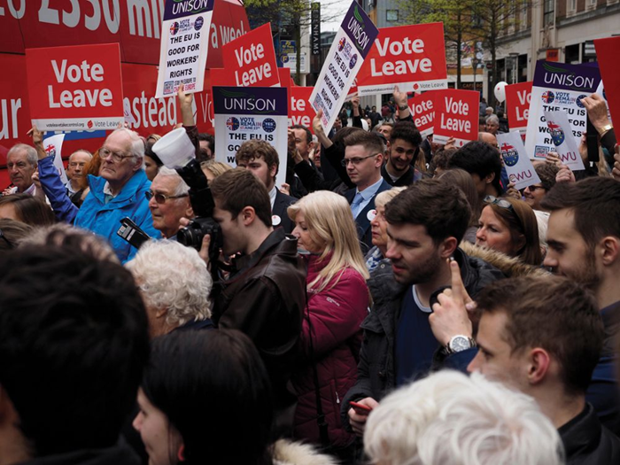
British Exit from the European Union (Brexit)
Voted to leave on June 23, 2016; officially left January 31, 2020.
  Great Britain was uncomfortable with loss of national sovereignty; immigration also became a key issue.
  Britain was E U’s second largest economy and seen as a counterweight to Germany.
  Most experts predict Great Britain will see significant short- to medium-term costs based on exit.
Anthony Collins/Alamy Stock Photo
Notes:
In the long run, whether Britain benefits from exit depends on its ability to negotiate trade deals with the EU and other major economic powers—including the United States, Japan, and China—to replace the benefits it will lose by exiting from the EU.

Slide 26
Regional Economic Integration in the Americas
The North American Free Trade Agreement
NAFTA’s contents:
  Abolished tariffs on 99 percent of goods traded among Mexico, Canada, and United States.
  Removed barriers on the cross-border flow of services.
  Protected intellectual property rights.
  Removed most restrictions on F D I among members.
  Applied national environmental standards.
  Established two commissions to impose fines and remove trade privileges when environmental standards or legislation involving health and safety, minimum wages, or child labor are ignored.
Notes:
LO 9-4 Explain the history, current scope, and future prospects of the world's most important regional economic agreements.
North American Free Trade Agreement (NAFTA): Free trade area among Canada, Mexico, and the United States.

Slide 27
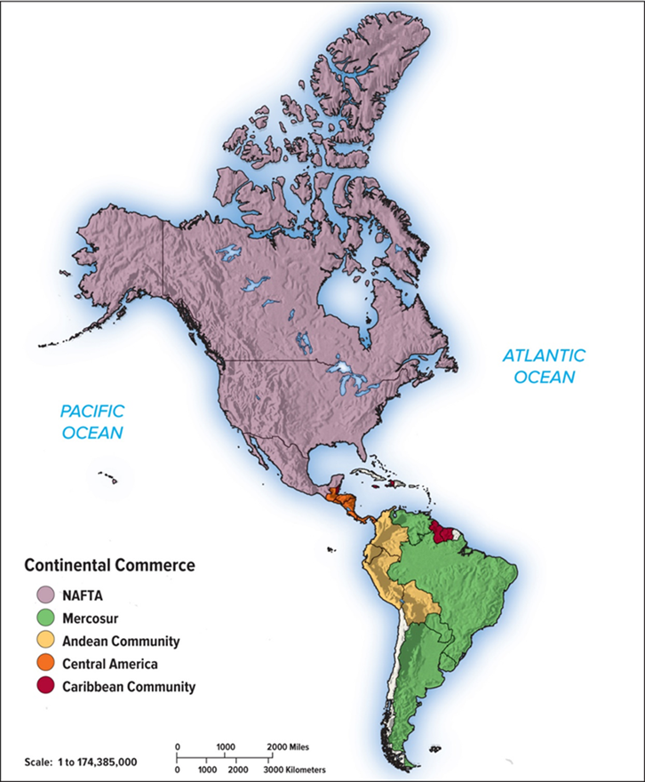
Map 9.2 Economic Integration in the Americas
Notes:
In addition to NAFTA/USMCA, several other trade blocs exist in the Americas (see Map 9.2), the most significant of which appear to be the Andean Community and Mercosur.

Slide 28
Regional Economic Integration in the Americas 2
The Case for N A F T A
  Mexico:
    Increased jobs as low-cost production moves south and more rapid economic growth.
  U.S. and Canada:
    Access to a large and increasingly prosperous market and lower prices for consumers from goods produced in Mexico.
    U.S. and Canadian firms with production sites in Mexico are more competitive in world markets.
The Case against N A F T A
  U.S. and Canada:
    Job loss and wage levels could decline.
  Mexico:
    Pollution may increase due to Mexico's more lax standards.
    Mexico feared its loss of sovereignty.
Notes:
Proponents of NAFTA have argued that the free trade area should be viewed as an opportunity to create an enlarged and more efficient productive base for the entire region.
As most economists repeatedly stressed, NAFTA would have a small impact on both Canada and the United States. It could hardly be any other way, because the Mexican economy was only 5 percent of the size of the U.S. economy. Signing NAFTA required the largest leap of economic faith from Mexico rather than Canada or the United States. Falling trade barriers would expose Mexican firms to highly efficient U.S. and Canadian competitors that, when compared to the average Mexican firm, had far greater capital resources, access to highly educated and skilled workforces, and much greater technological sophistication. The short-run outcome was likely to be painful economic restructuring and unemployment in Mexico. But advocates of NAFTA claimed there would be long-run dynamic gains in the efficiency of Mexican firms as they adjusted to the rigors of a more competitive marketplace.

Slide 29
The Andean Community
  Largely based on E U model; failed by mid-19 80s.
  In late 19 80s, Latin American governments began to adopt free market economic policies.
  In 19 90s, the Andean Pact was relaunched as the Andean Community, and now operates as a customs union.
  In 2003, it signed an agreement with Mercosur to restart negotiations towards the creation of a free trade area.
  Andean Community now operates as a partial customs union.
Notes:
Andean Community: A 1969 agreement among Bolivia, Chile, Ecuador, Colombia, and Peru to establish a customs union.

Slide 30
Mercosur
Originated as free trade pact between Brazil and Argentina.
  Expanded to include Paraguay and Uruguay in 1990.
  Venezuela joined in 2012 but was suspended in 2016 for human rights violations.
Has been successful at reducing trade barriers between member states.
  Critics worry that Mercosur may be diverting trade rather than creating trade, and local firms are investing in industries that are not competitive on a worldwide basis.
Notes:
Mercosur: Pact among Argentina, Brazil, Paraguay, and Uruguay to establish a free trade area.
In 2010, the members of Mercosur did agree on a common customs code to avoid outside goods having to pay tariffs more than once, an important step toward achieving a full customs union. Since 2010, however, Mercosur has made little forward progress, and the jury is still out on whether it will become a fully functioning customs union.

Slide 31
Association of Southeast Asian Nations (ASEAN)
Fosters freer trade between member countries and cooperation in their industrial policies.
  Brunei, Cambodia, Indonesia, Laos, Malaysia, Myanmar, Philippines, Singapore, Thailand, and Vietnam.
  Laos, Myanmar, Vietnam, and Cambodia joined recently.
ASEAN Free Trade Area (AFTA) (2003) between the six original members of ASEAN came into full effect to reduce import tariffs among members.
  In 2010, ASEAN signed a free trade agreement with China to remove tariffs on 90 percent of all traded goods.
Notes:
ASEAN signed a free trade agreement with China that removes tariffs on 90 percent of traded goods. This went into effect January 1, 2010. Trade between China and ASEAN members more than tripled during the first decade of the twenty-first century, and this agreement should spur further growth.

Slide 32
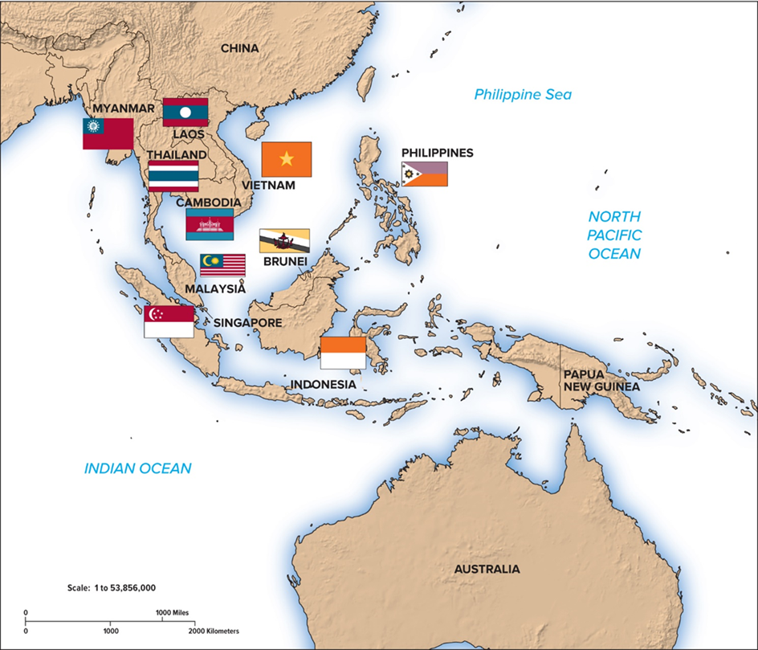
Map 9.3 ASEAN Countries

Slide 33
Other Trade Agreements
  Under President Obama: U.S. pursed Trans-Pacific Partnership with 11 other Pacific Rim countries and Transatlantic Trade and Investment Partnership (TTIP) with the European Union.
  Under President Trump: U.S. pulled out of TPP and negotiations on hold for TTIP.
  Remaining TPP members renegotiated a new deal: Comprehensive and Progressive Trans-Pacific Partnership (CPTPP).
    China still excluded.
  Accelerated negotiations for the Comprehensive Economic Partnership (RCEP).
    Comprises members of ASEAN plus Australia, China, Japan, New Zealand, and South Korea.
Notes:
Following the American exit from the TPP, two things happened. First, the remaining 11 TPP members decided to press ahead with a revamped deal. Renamed the Comprehensive and Progressive Trans-Pacific Partnership (CPTPP)—or TPP for short—the deal signed in Chile on March 8, 2018, will significantly lower tariffs and other trade barriers between the 11 nations. The revised agreement, which still excludes China, covers 500 million people in nations that produce more than 13 percent of global gross domestic product.

Slide 34
360° View: Managerial Implications ₁
Regional Economic Integration Opportunities
  Formerly protected markets are now open to exports and direct investment.
  The free movement of goods across borders, harmonization of product standards, and simplification of tax regimes means firms can realize potentially enormous cost economies.
  Enduring differences in culture and competitive practices might limit companies.
Notes:
LO 9-5 Understand the implications for management practice that are inherent in regional economic integration agreements.

Slide 35
360° View: Managerial Implications ₂
Regional Economic Integration Threats
  Lower trade and investment barriers could lead to increased price competition within the EU and NAFTA.
  Firms outside the blocs risk being shut out of the single market by the creation of a “trade fortress.”
  Limits in mergers and acquisition abilities.
  Growing opposition to free trade areas.
Notes:
The emerging role of the European Commission in competition policy suggests the EU is increasingly willing and able to intervene and impose conditions on companies proposing mergers and acquisitions. This is a threat insofar as it limits the ability of firms to pursue the corporate strategy of their choice.
If the EU and NAFTA/UMSCA are diminished, some of the gains from trade will be lost, and many of the benefits that businesses enjoyed will disappear as well.

