Slide 1
Project Management _{(Ch.17)}
12
  CYCU
  Prof. CK Farn
mailto: ckfarn@gmail.com
http://www.mgt.ncu.edu.tw/~ckfarn/cycu
  2022.12

Slide 2
Projects
Projects
  Unique, one-time operations designed to accomplish a specific set of objectives in a limited time frame
  Examples:
    The Olympic Games
    Producing a movie
    Software development
    Product development
    ERP implementation

Slide 3
The Nature of Projects
Projects go through a series of stages – a life cycle
Projects bring together people with a diversity of knowledge and skills, most of whom remain associated with the project for less than its full life
Organizational structure affects how projects are managed

Slide 4
Project Life Cycle 1
Initiating
Planning
Executing
Monitoring and Controlling
Closing

Slide 5
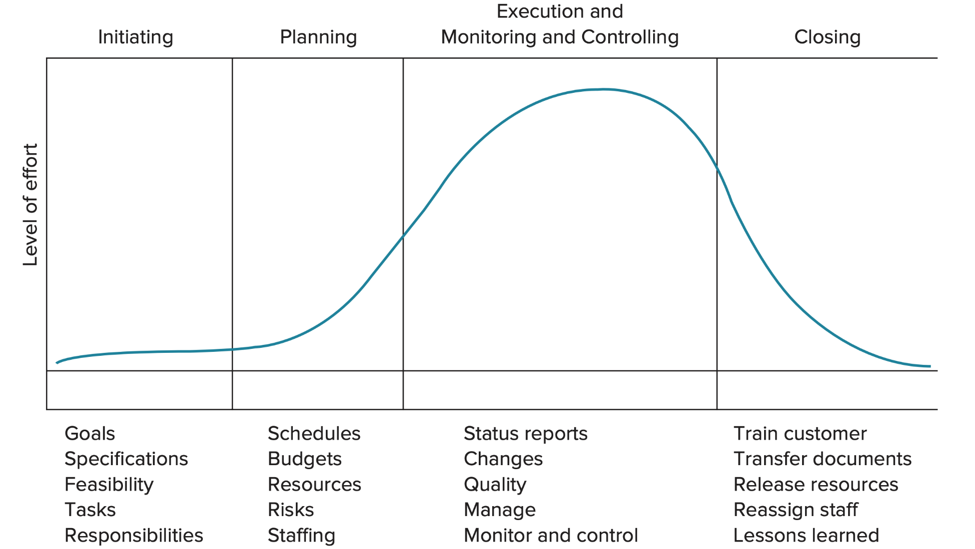
Project Life Cycle ₂
FIGURE 17.1 Project life cycle

Slide 6
Project Management Decisions
Project success depends upon making key managerial decisions over a sequence of steps:
  Deciding which projects to implement
  Selecting the project manager
  Selecting the project team
  Planning and designing the project
  Managing and controlling project resources
  Deciding if and when a project should be terminated

Slide 7
Project Manager
The project manager is ultimately responsible for the success or failure of the project
The project manager must effectively manage:
  The work
  The human resources
  Communications
  Quality
  Time
  Costs

Slide 8
Project Management Body of Knowledge
The Project Management Institute (PMI) has developed a list of 10 areas of knowledge:
  Managing integration
  Managing scope
  Managing time/schedule
  Managing costs
  Managing quality
  Managing human resources
  Managing communication
  Managing risk
  Managing procurement
  Managing stakeholders

Slide 9
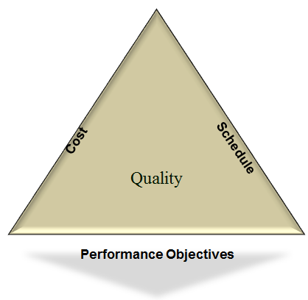
The Project Management Triangle

Slide 10
Behavioral Issues
Behavioral problems can be created or exacerbated by
  Decentralized decision making
  Stress of achieving project milestones on time and within budget
  Surprises
The team must be able to function as a unit
  Interpersonal and coping skills are very important
  Conflict resolution and negotiation can be an important part of a project manager’s job

Slide 11
Avoiding Problems
Many problems can be avoided or mitigated by:
  Effective team selection
  Leadership
  Motivation
  Maintaining an environment of
    Integrity
    Trust
    Professionalism
  Being supportive of team efforts

Slide 12
Project Champion
Project champion
  A person who promotes and supports a project
    Usually resides within the organization
    Facilitate the work of the project by ‘talking up’ the project to other managers who might be asked to share resources with the project team as well as employees who might be asked to work on parts of the project
    The project champion can be critical to the success of a project

Slide 13
Work Breakdown Structure (WBS)
WBS
  A hierarchical listing of what must be done during a project
  Establishes a logical framework for identifying the required activities for the project
    Identify the major elements of the project
    Identify the major supporting activities for each of the major elements
    Break down each major supporting activity into a list of the activities that will be needed to accomplish it
  Precedence Constraints
    Limiting the earliest start date of an activity

Slide 14
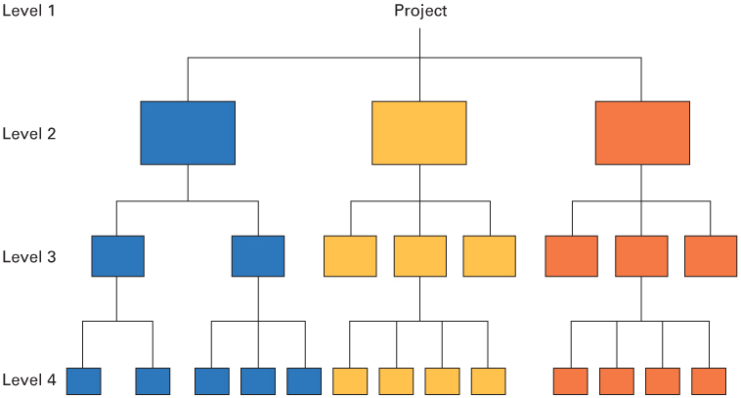
WBS1

Slide 15
WBS: Working with Gantt Charts 2
FIGURE 17.3 Gantt chart for bank example

Slide 16
PERT and CPM
PERT (program evaluation and review technique) and CPM (critical path method) are two techniques used to manage large-scale projects
By using PERT or CPM managers can obtain:
  A graphical display of project activities
  An estimate of how long the project will take
  An indication of which activities are most critical to timely project completion
  An indication of how long any activity can be delayed without delaying the project

Slide 17
Network Diagram
Network diagram
  Diagram of project activities that shows sequential relationships by use of arrows and nodes
  Activity on arrow (AOA)
    Network diagram convention in which arrows designate activities
  Activity on node (AON)
    Network convention in which nodes designate activities
      Activities
        Project steps that consume resources and/or time
      Events
        The starting and finishing of activities

Slide 18
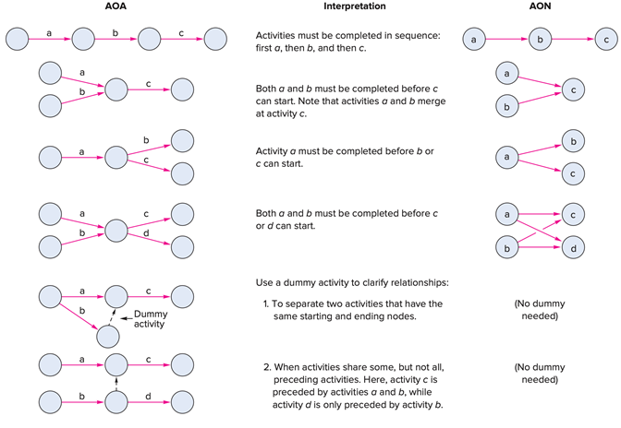
Network Conventions
TABLE 17.2 Network conventions

Slide 19
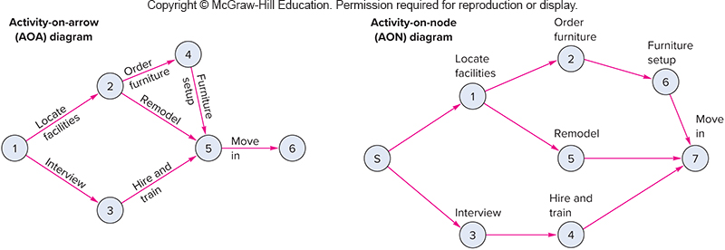
Network Diagram ₁

Slide 20
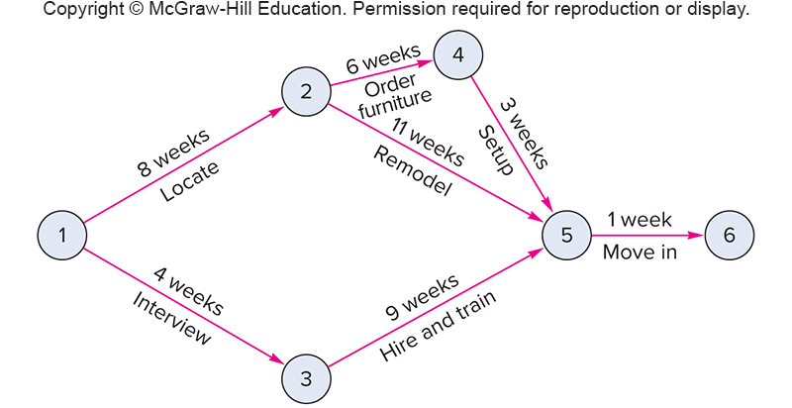
Network Diagram ₂

Slide 21
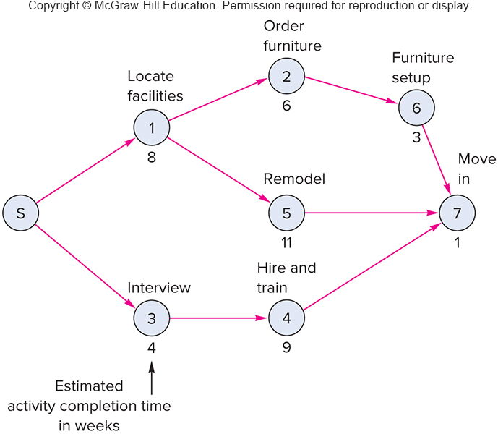
Network Diagram ₃

Slide 22
Deterministic Time Estimates
Deterministic
  Time estimates that are fairly certain
Probabilistic
  Time estimates that allow for variation

Slide 23
Early Start, Early Finish
Finding ES and EF involves a forward pass through the network diagram
  Early start (ES)
    The earliest time an activity can start
    Assumes all preceding activities start as early as possible
      For nodes with one entering arrow
        ES = EF of the entering arrow
      For activities leaving nodes with multiple entering arrows
        ES = the largest of the largest entering EF
  Early finish (EF)
    The earliest time an activity can finish
      EF = ES + t

Slide 24
Late Start, Late Finish
Finding LS and LF involves a backward pass through the network diagram
  Late Start (LS)
    The latest time the activity can start and not delay the project
      The latest starting time for each activity is equal to its latest finishing time minus its expected duration:
        LS = LF − t
  Late Finish (LF)
    The latest time the activity can finish and not delay the project
      For nodes with one leaving arrow, LF for nodes entering that node equals the LS of the leaving arrow
      For nodes with multiple leaving arrows, LF for arrows entering node equals the smallest of the leaving arrows

Slide 25
Slack and the Critical Path
Slack can be computed one of two ways:
  Slack = LS – ES
  Slack = LF – EF
Critical path
  The critical path is indicated by the activities with zero slack

Slide 26
Network Diagram ₃

Slide 27
1
3
4
2
5
6
7

Slide 28
1
3
4
2
5
6
7

Slide 29
Using Slack Times
Knowledge of slack times provides managers with information for planning allocation of scarce resources
  Control efforts will be directed toward those activities that might be most susceptible to delaying the project
  Activity slack times are based on the assumption that all of the activities on the same path will be started as early as possible and not exceed their expected time
  If two activities are on the same path and have the same slack, this will be the total slack available to both

Slide 30
Project Completion Time
A project is not complete until all project activities are complete
It is risky to only consider the critical path when assessing the probability of completing a project within a specified time
  To determine the probability of completing the project within a particular time frame
    Calculate the probability that each path in the project will be completed within the specified time
    Multiply these probabilities
  The result is the probability that the project will be completed within the specified time

