Slide 1
MIS Research
-- Research Philosophy and Paradigms
2
  Department of Information Management
  CYCU
  CK Farn
mailto: ckfarn@gmail.com
  2023.09
Reference:

Slide 2
Scientific Research Philosophy
Objectives of Scientific Research
  Describe and Explain phenomena
  Predict phenomena
  Manipulate phenomena
Knowledge develop in a spiral fashion
How to decide on a researchable issue

Slide 3
Research Spiral
observation
Explain
Phenomena
Law
Theory
Derive
Empirical
evidence
Conclusion
Hypothesis
Spiral up
Objectives: describe, explain, predict, manipulate

Slide 4

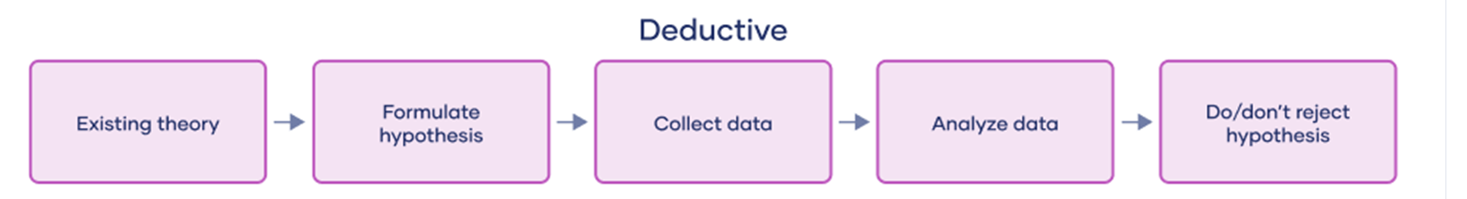
Inductive and Deductive Reasoning ₁
Inductive reasoning aims at developing a theory
Deductive reasoning aims at testing an existing theory

Slide 5
Inductive and Deductive Reasoning ₂
Inductive
Theory
Deductive
Confirmation
Hypothesis
Observation

Slide 6
What is a Researchable Issue?
What are the general issues in MIS?
  “The study of the effective design, delivery and usage of information systems in organizations.”
    --The MIS field as defined by Keen(1980)
  What is your dependent variable?
Three questions to answer when setting an issue
  Why is it important (practically: relevance)?
  Why is it interesting (academically: elegance)?
  How do you contribute?

Slide 7
The magic word for Elegance:
Parsimony
Parsimony
Frugal, stingy, 吝嗇
Principle of parsimony
  … that things are usually connected or behave in the simplest or most economical way
  the simplest of two competing theories is to be preferred
The law of parsimony
  A problem-solving principle: the simplest explanation for something is typically the most likely
Making use of simple concept to explain complicated things
  e.g. means, standard deviation, …

Slide 8
Research Issue?
The key to social science development is to explain some variables in real-world phenomena
  With few variables
Why the variable changes in different context? What are other factors that may affect it? (to explain) What are other factors that may co-exist with it? (to predict)
  The focus is call dependent variable Y
  The determinants are independent variables X
Examples
  System success, resistance
  System reliability
  Purchase behavior

Slide 9
Some things to think about
Clarify what you are trying to answer
  What—fact finding, natural laws
  How—events, process
  Why—theory
Research is a cumulative process
  Do not expect an independent research to have a earth shaking break-through
  Base you research on previous results
  Build on top of a cumulative tradition

Slide 10
Descriptive and Normative Models
Descriptive model
  Describe how people actually behave
  what? how? why?
  e.g. In a traffic accident involving motorcycles, does wearing helmet affect mortality rate?
Normative (prescriptive) model
  prescribe how one should behave; that is, they set ideal norms
  e.g. Should we enforce wearing helmet when riding motorcycles?
Differences
  Descriptive model reflect the real world
  Normative model involve judgement, and one’s value systems, is a matter of decision analysis, and cannot be a good research topic
Only descriptive modes are researchable

Slide 11
Research Paradigm
MIS Research
Social Science
Research
Engineering Research
Pioneering
Empirical
Research
Theoretical
Research
Incremental
Improvement
Qualitative
Research
Variance
(Quantitative)
Research

Slide 12

Social Science Research 1:
Theoretical Research
Based on inductive reasoning
  Logical derivation
  Mathematical inferencing
Making sense, pattern recognition
  It is a zig-saw puzzle: only if this is the case, these observations can fit
Meta analysis of past researches
  e.g. Periodic Table of Elements

Slide 13
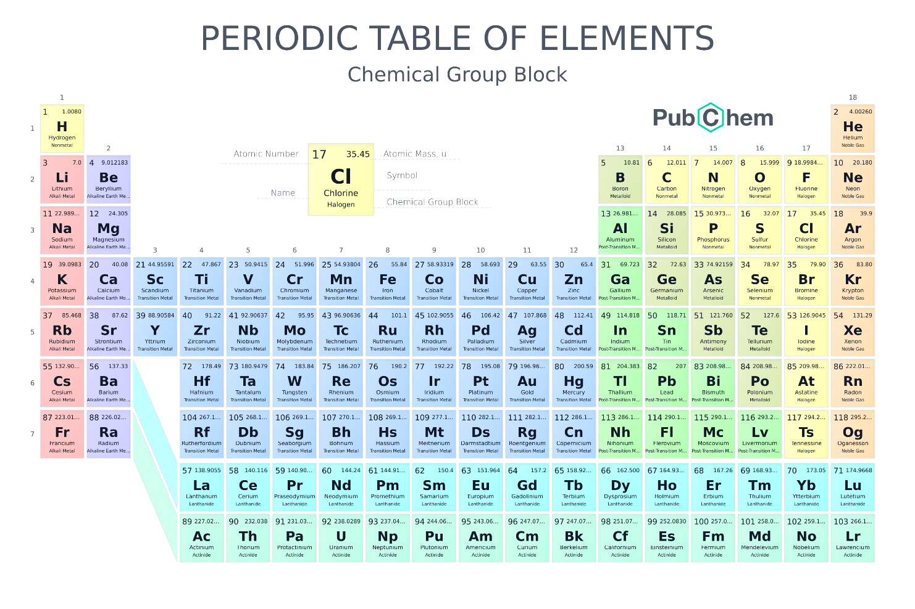
Periodic Table of Elements

Slide 14

Social Science Research 2:
Empirical Research 實徵性研究
Analysis of real-world observations and data
  Observations of active/passive objects
  Information by informants (Q&A)
  Data collected by others, data banks
  Making sense out of the data
  Data can be quantitative of qualitative
Deductive reasoning

Slide 15
Types of Empirical Research
By stages
  Exploratory (探索) research, Theory/ Hypothesis building
    Darwinian theory of evolution (The origin of species)
  Positivism, Confirmatory (驗證) research, Hypothesis testing
    Galileo’s gravity experiment
By data collection and analysis methods
  Quantitative (variance) research
  Qualitative research
The research question determines the “right” methodlogy
  Many methodologies beyond survey

Slide 16
Empirical Research
Quantitative (variance) research
  Experiment, Quasi-experimentation
  Observation
  Survey
  Content analysis
Qualitative research
  Anthropology, historical research …
  Ethnography
  Participant observation
  Case study
  …

Slide 17
Statistical analysis
Descriptive statistics
Correlational analysis
Multivariate analysis
  Time series analysis
  Regression analysis
  Causal analysis
  Factor analysis, cluster analysis
  SEM: Structural Equation Analysis
….

Slide 18
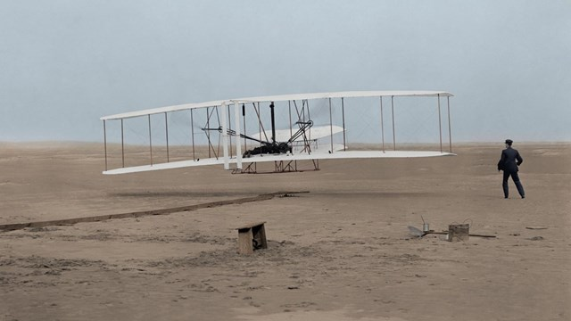
Engineering Paradigm 1: Pioneering
Imagine it is now Dec 17, 1903. You were invited to an event at Outer banks, North Carolina by the Wright brothers
They showcased their first ever airplane flight in the world
Is a “Research?”
How do one justify it?

Slide 19
Engineering Paradigm 2:
Incremental Improvement
Imagine it is now September 2023, you work for an AI research organization
You come out with a new approach of achieving generative AI reasoning, and claim to be “better” than ChatGPT
Is it a good research?
Better in what sense?
  Faster?
  More accurate?
  More responsive? ….
How do one justify it?

Slide 20
Justifying improvement
One have to rely on social science research to justify the results
  Example: the MYCIN expert system
  Prof Ed Feigenbaum of Stanford University in 1965
  Diagnosing infectious (blood) diseases
  Making use of lab experiments to justify its performance in comparison to human doctors
Even Engineering research has a “Y”

Slide 21
In setting a research issue…
What is the major dependent variable (Y)?
What are the related reference disciplines
  At what stage this variable have been studied?
  What knowledge have been accumulated?
What is the stage of application of the target technology
  If you want to study the adoption of 5G communications, it is too early!

Slide 22
Some of the possible frameworks…
Theoretical
Development
Systems
Building
Field
Studies
Lab
Experiments
Empirical Research

Slide 23
Assignment #2: pose a Research Question
Pick a topic you like, which is specific and focused enough
Pick a “term” or “construct” that you are interested
Look into Google Scholar, and briefly browse through what previous researchers have accomplished
Determine a “Y”
Provide a statement in Question form
Prepare a ONE page ppt document
File name: HW2_SID_Name.ppt
Upload your ppt file to https://mega.linkin.tw/index.php/s/pYxAcPeW5NeoxQn

