Slide 1
Phenomena-based Research
2
Department of Information Management
CYCU
CK Farn
mailto: ckfarn@gmail.com
2023.09

Slide 2
Curiosity Drives Research
“We keep moving forward, opening new doors, and doing new things, because we’re curious and curiosity keeps leading us down new paths.”
Walt Disney

Slide 3
The beginning of modern science -- 16th and 17th Century
The fathers of modern astronomy, the scientific method and natural science
Theories all based on observation of the real world
Nicolaus Copernicus 哥白尼
Heliocentrism (地動說) based on planetary observations
Galilei Galileo 加利略
Johannes Kepler 克卜勒
Laws of planetary motion
Sir Isaac Newton 牛頓

Slide 4
Research and the real-world
Current state of research
… a growing share of our research contributions tend to be incremental, marginal, highly theory- and methods-driven, and often detached from real-world phenomenon (Doh, 2015)
Phenomena-based research
… capture, describe and document, as well as conceptualize, a phenomenon so that appropriate theorizing and the development of research designs can proceed (Von Krogh, Rossi-Lamastra, and Haefliger, 2012)
Good research has to relate to the real world

Slide 5
Some example of “unreal” research 1
20 years ago, I was consulted by a PhD student regarding a research
A survey research on WAP (Wireless Application Protocol) targeted to cell phone users
Model based on TAM
R² less than 3% (explained less than 3% variance)
How to improve?

Slide 6
TAM: Technology Acceptance Model

Slide 7
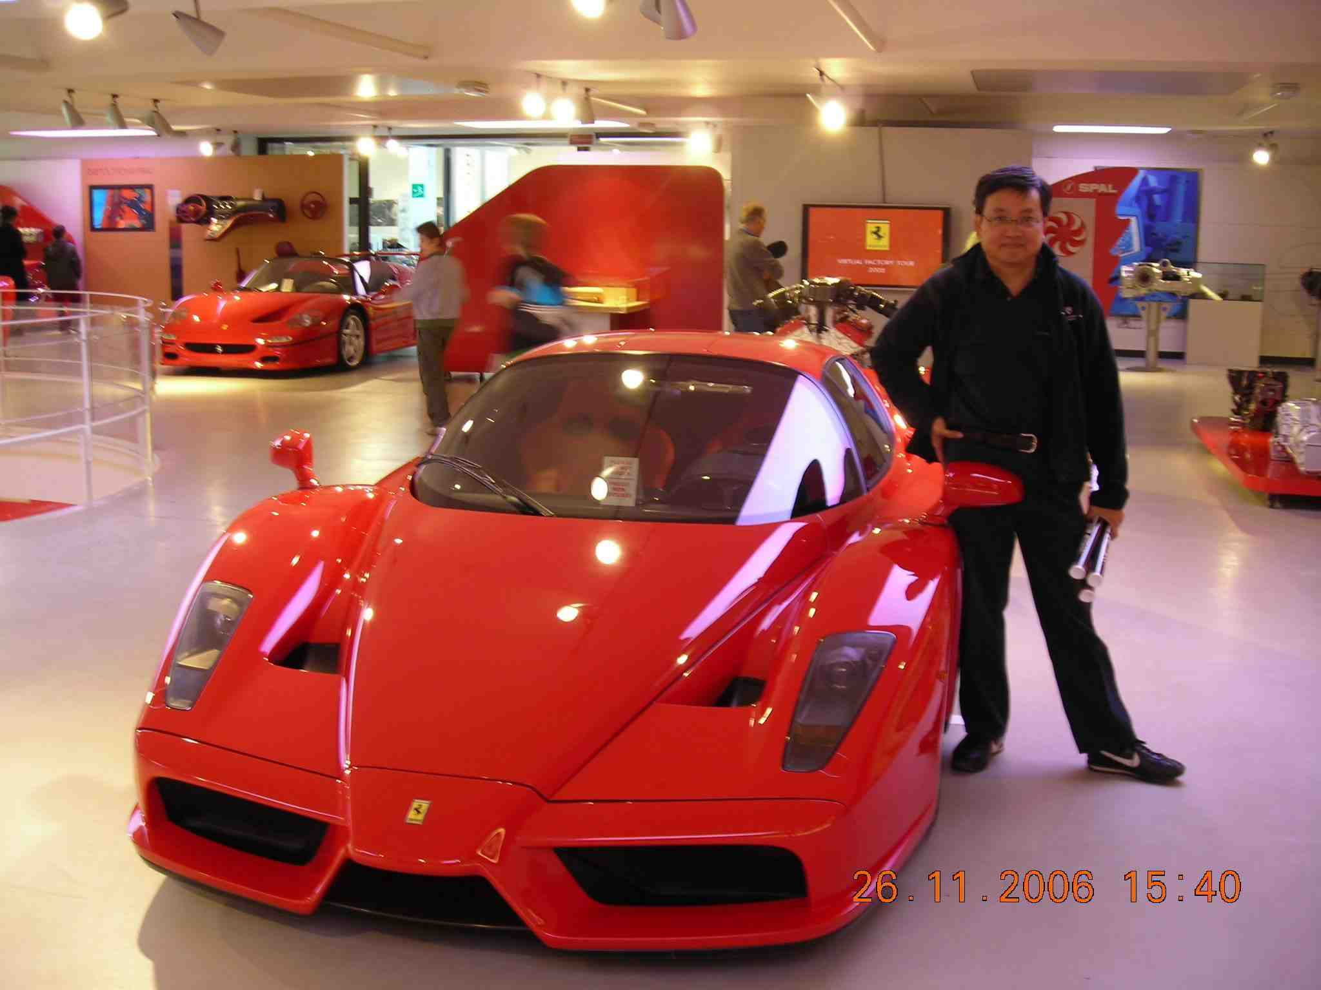
Ferrari Enzo!!
What car will I buy, based on TAM?

Slide 8
Problem with the research
Choice of theoretical model without:
Basic understanding of the model
Common sense on the real world situations
If one has to pay for the usage of something, does money/budget matter?

Slide 9
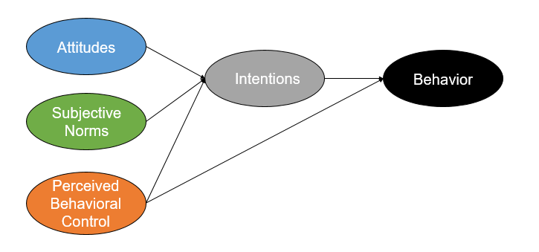
Alternate theories
TAM was derived from TRA (Theory of reasoned action)
The author of TRA latter proposed TPB (Theory of Planned Behavior)

Slide 10
Problem with the research 2
TAM was a variation of TRA
Adoption of IS within organization
Equipment, training and usage fees are paid by the company
In a social setting
Availability of the right cell phone, usage fees has to be paid by users
Differences in behavioral norm

Slide 11
Broken Research cycle
observation
Explain
Phenomena
Law
Theory
Derive
Empirical
evidence
Conclusion
Hypothesis

Slide 12
Human Nature: Inertia
n^{th}-degree
Virtual
Question
Reflect on research
Departure from real world
Spiral down
Virtual
Research
Question
Real-world Problem
Research
Question
Research
Publication
Observation Conceptualize
Analysis

Slide 13
Research Question
Research is decision- and dilemma-centered
A clarified research question is the result of careful exploration and analysis and sets the direction for the research project
What phenomenon does it relates to?

Slide 14
Business decision related questions
Most business decision related questions are “normative”
Translate it into “descriptive” question
Based on real world descriptive data
Should we raise the rate for Health Insurance
Financial
Legal (media, public opinion)
Technical
…. Multi-faceted

Slide 15
Academic research questions
Descriptive model
Theoretical contributions
Accumulation of knowledge
Relevance vs elegance

Slide 16
Funnel management
Funnel management
A common used technique in sales
The process of optimizing the customer journey from first contact to purchase
If you do not have a “pet issue,” use the funnel management approach to derived at a researchable question

Slide 17
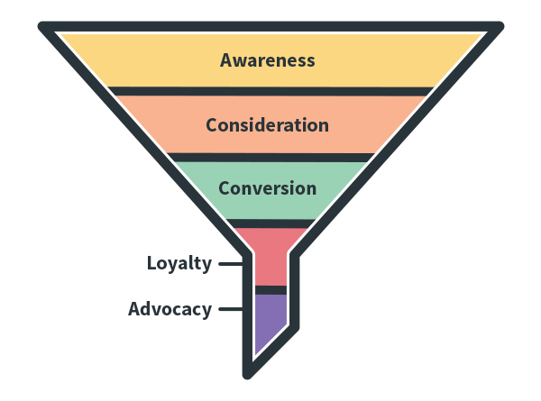
Sales Funnel
Universal
Suspect
Prospect
Best Few
Client
Delivery
Services

Slide 18
Research funnel
Understand the general state of the area
Understand the specific topic
Possible alternatives
Decide on a question
Conduct research
Search with a vague idea
Read the title page of a few hundred papers
Title, authors, journal, keywords, affiliation
Universal
Suspect
Browse through several dozens related papers
Methodology, theory/model
Prospect
Research gap
Mapping to real phenomena
Major researchers, key papers
Major theories
In depth reading
Best Few
Key reference paper
Theoretical foundation
Methodology
Client
Delivery
Research design
Collect data
Analysis
Services

Slide 19
Resource Considerations
Human ressources
Budget
Time
Time constraints is a major consideration if you are pursuing a degree, or you rely on it for a promotion
Availability of data or informants
Can you have access?
Stage of technology application (IS research)

Slide 20
Assignment #3: pose a Research Question
Redo Assignment #2
Prepare a ONE page ppt document
File name: HW3_SID_Name.ppt
Upload your ppt file to https://mega.linkin.tw/index.php/s/QdzoWCmcNGeod6t

