Slide 1
Measurement and Operationalization of Constructs
（構念的操作化）
9
  Department of Information Management
  CYCU
  CK Farn
mailto: ckfarn@gmail.com
  2023.11

Slide 2
Why Measurement Is Important
“If you can’t measure it, you can’t
manage it.”
Bob Donath,
Bob Donath and Co, Inc
Notes:
This note relates to why we must understand the issues around measurement. Students can be asked to relate to their own jobs or business experiences as to what they observed being measured and why management needed to measure the things they did--the consequences of not measuring adequately and accurately. They are bound to have war stories of their own which will make the concept become more real to them.

Slide 3
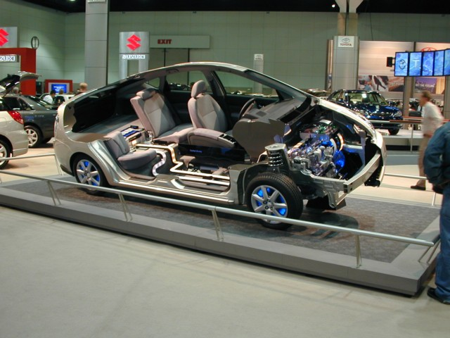
Measurement
Selecting
measurable phenomena
Developing a set of
mapping rules
Applying the mapping rule
to each phenomenon
Notes:
Measurement in research consists of assigning numbers to empirical events, objects or properties, or activities in compliance with a set of rules. This slide illustrates the three-part process of measurement.
Text uses an example of auto show attendance.
A mapping rule is a scheme for assigning numbers to aspects of an empirical event.

Slide 4
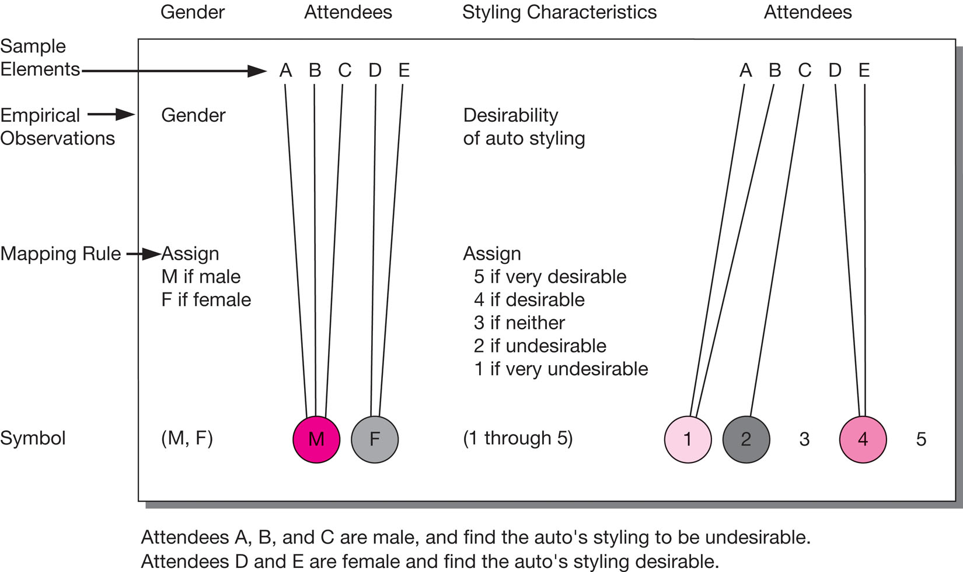
Characteristics of Measurement
Notes:
Exhibit 11-1.
The goal of measurement – of assigning numbers to empirical events in compliance with a set of rules – is to provide the highest-quality, lowest-error data for testing hypotheses, estimation or prediction, or description.
The object of measurement is a concept, the symbols we attach to bundles of meaning that we hold and share with others. Higher-level concepts, constructs, are for specialized scientific explanatory purposes that are not directly observable and for thinking about and communicating abstractions. Concepts and constructs are used at theoretical levels while variables are used at the empirical level. Variables accept numerals or values for the purpose of testing and measurement.
An operational definition defines a variable in terms of specific measurement and testing criteria. These are further reviewed in Exhibit 11-2 on page 341 of the text.

Slide 5
Types of Scales
Nominal
Categorical: e.g. gender
（男、女）；（製造業、服務業）
Ordinal
Rank order: e.g. big, medium, small
（大、中、小）
interval
Equi-distant: e.g. temperature
（溫度）
Ratio
Equi-distant with absolute zero: e.g. length
（長度； 速度）
Notes:
Students will be building their measurement questions from different types of scales. They need to know the difference in order to choose the appropriate type. Each scale type has its own characteristics.

Slide 6
Levels of Measurement
Nominal
Classification
Ordinal
interval
Ratio
Notes:
This is a good time to ask students to develop a question they could ask that would provide only classification of the person answering it.
Classification means that numbers are used to group or sort responses.
Consider asking students if a number of anything is always an indication of ratio data. For example, what if we ask people how many cookies they eat a day? What if a business calls themselves the “number 1” pizza in town? These questions lead up to the next slide. Does the fact that James wears 23 mean he shoots better or plays better defense than the player donning jersey number 18?
In measuring, one devises some mapping rule and then translates the observation of property indicants using this rule.
Mapping rules have four characteristics and these are named in the slide.
Classification means that numbers are used to group or sort responses.
Order means that the numbers are ordered. One number is greater than, less than, or equal to another number.
Distance means that differences between numbers can be measured.
Origin means that the number series has a unique origin indicated by the number zero.
Combinations of these characteristics provide four widely used classifications of measurement scales: nominal, ordinal, interval, and ratio.

Slide 7

Nominal Scales
Mutually exclusive and collectively exhaustive categories
Exhibits the classification characteristic only
Notes:
Nominal scales collect information on a variable that can be grouped into categories that are mutually exclusive and collectively exhaustive. For example, symphony patrons could be classified by whether or not they had attended prior performances.
The counting of members in each group is the only possible arithmetic operation when a nominal scale is employed. If we use numerical symbols within our mapping rule to identify categories, these numbers are recognized as labels only and have no quantitative value.
Nominal scales are the least powerful of the four data types. They suggest no order or distance relationship and have no arithmetic origin. The researcher is restricted to use of the mode as a measure of central tendency. The mode is the most frequently occurring value. There is no generally used measure of dispersion for nominal scales. Dispersion describes how scores cluster or scatter in a distribution.
Even though LeBron James wears #23, it doesn’t mean that he is better player than #24 or a worse player than #22. The number has no meaning other than identifying James for someone who doesn’t follow the Cavs.

Slide 8
Levels of Measurement
Nominal
Classification
Ordinal
Classification
Order
interval
Ratio
Notes:
Order means that the numbers are ordered. One number is greater than, less than, or equal to another number.
You can ask students to develop a question that allows them to order the responses as well as group them. This is the perfect place to talk about the possible confusion that may exist when people order objects but the order may be the only consistent criteria. For instance, if two people tell them that Pizza Hut is better than Papa Johns, they are not necessarily thinking precisely the same. One could really favor Pizza Hut and never considering eating another Papa John’s pizza, which another could consider them almost interchangeable with only a slight preference for Pizza Hut. This discussion is a perfect lead in to the ever confusing ‘terror alert’ scale (shown on the next slide)…or the ‘weather warning’ system used in some states to keep drivers off the roads during poor weather. Students can probably come up with numerous other ordinal scales used in their environment.

Slide 9
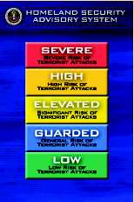
Ordinal Scales
Characteristics of nominal scale plus an indication of order
Implies statement of greater than and less than
Notes:
Ordinal data require conformity to a logical postulate, which states:
If a is greater than b, and
b is greater than c, then
a is greater than c.
Rankings are examples of ordinal scales. Attitude and preference scales are also ordinal.
The appropriate measure of central tendency is the median. The median is the midpoint of a distribution. A percentile or quartile reveals the dispersion.
Nonparametric tests should be used with nominal and ordinal data. This is due to their simplicity, statistical power, and lack of requirements to accept the assumptions of parametric testing.

Slide 10
Levels of Measurement
Nominal
Classification
Ordinal
Classification
Order
interval
Classification
Distance
Order
Ratio
Notes:
In measuring, one devises some mapping rule and then translates the observation of property indicants using this rule.
Mapping rules have four characteristics and these are named in the slide.
Classification means that numbers are used to group or sort responses.
Order means that the numbers are ordered. One number is greater than, less than, or equal to another number.
Distance means that differences between numbers can be measured.
Origin means that the number series has a unique origin indicated by the number zero.
Combinations of these characteristics provide four widely used classifications of measurement scales: nominal, ordinal, interval, and ratio.

Slide 11
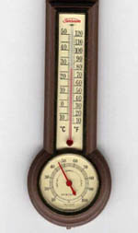
Interval Scales
Characteristics of nominal and ordinal scales plus the concept of equality of interval.
Equal distance exists between numbers
Notes:
Researchers treat many attitude scales as interval (this will be illustrated in the next chapter).
When a scale is interval and the data are relatively symmetric with one mode, one can use the arithmetic mean as the measure of central tendency. The standard deviation is the measure of dispersion.
The product-moment correlation, t-tests, F-tests, and other parametric tests are the statistical procedures of choice for interval data.

Slide 12
Levels of Measurement
Nominal
Classification
Ordinal
Classification
Order
interval
Classification
Distance
Order
Ratio
Classification
Distance
Order
Natural Origin
Notes:
In measuring, one devises some mapping rule and then translates the observation of property indicants using this rule.
Mapping rules have four characteristics and these are named in the slide.
Classification means that numbers are used to group or sort responses.
Order means that the numbers are ordered. One number is greater than, less than, or equal to another number.
Distance means that differences between numbers can be measured.
Origin means that the number series has a unique origin indicated by the number zero.
Combinations of these characteristics provide four widely used classifications of measurement scales: nominal, ordinal, interval, and ratio.

Slide 13

Ratio Scales
Characteristics of previous scales plus an absolute zero point
Examples
  Weight
  Height
  Number of children
Notes:
Ratio data represent the actual amounts of a variable.
In business research, there are many examples such as monetary values, population counts, distances, return rates, and amounts of time.
All statistical techniques mentioned up to this point are usable with ratio scales. Geometric and harmonic means are measures of central tendency and coefficients of variation may also be calculated.
Higher levels of measurement generally yield more information and are appropriate for more powerful statistical procedures.

Slide 14
Moving from Investigative to
Measurement Questions
What do I plan to do with the data
What scale do I need
  Distribution
  Sample size
  Groups to compare
  Relationships among groups
What measurement scale do I need?
Notes:
Exhibit 11-4
While Exhibit 11-3 summarized the characteristics of all the measurement scales.
Exhibit 11-4, shown in the slide, illustrates the process of deciding which type of data is appropriate for one’s research needs.

Slide 15
Sources of Error
Respondent
Situation
Measurer
Instrument
Notes:
The ideal study should be designed and controlled for precise and unambiguous measurement of the variables. Since complete control is unattainable, error does occur. Much error is systematic (results from bias), while the remainder is random (occurs erratically).
Four major error sources may contaminate results and these are listed in the slide.
Opinion differences that affect measurement come from relatively stable characteristics of the respondent such as employee status, ethnic group membership, social class, and gender. Respondents may also suffer from temporary factors like fatigue and boredom.
Any condition that places a strain on the interview or measurement session can have serious effects on the interviewer-respondent rapport.
The interviewer can distort responses by rewording, paraphrasing, or reordering questions. Stereotypes in appearance and action also introduce bias. Careless mechanical processing will distort findings and can also introduce problems in the data analysis stage through incorrect coding, careless tabulation, and faulty statistical calculation.
A defective instrument can cause distortion in two ways. First, it can be too confusing and ambiguous. Second, it may not explore all the potentially important issues.

Slide 16
Evaluating Measurement Tools
Validity
Criteria
Practicality
Reliability
Notes:
What are the characteristics of a good measurement tool? A tool should be an accurate indicator of what one needs to measure. It should be easy and efficient to use. There are three major criteria for evaluating a measurement tool.
Validity is the extent to which a test measures what we actually wish to measure.
Reliability refers to the accuracy and precision of a measurement procedure.
Practicality is concerned with a wide range of factors of economy, convenience, and interpretability.
These criteria are discussed further on the following slides.

Slide 17
Validity in Social Science Research
Conceptual Level
Alternate
effects
X
External Validity
Y
Construct
Validity
Construct
Validity
Operationalization
Operationalization
Internal Validity
x
y
Causal relationship
Manipulation,
Observation
Association
Measurement
Statistical Conclusion Validity
error
error
Operational Level
Cook & Campbell (1979) Quasi-Experimentation, Houghton Miffin, Boston

Slide 18
Some concepts in measurements
Surrogate variable
  A variable that can be measured (or is easy to measure) that is used in place of one that cannot be measured (or is difficult to measure).
  For example, whereas it may be difficult to assess the wealth of a household, it is relatively easy to assess the value of a house.
Real X and Perceived X

Slide 19
Some concepts in measurements ₂
Perception
  One’s perception of something, is one’s own view or interpretation of something
Real X and Perceived X
  E.g. Temperature is the value measured with thermometer; apparent temperature (體感溫度) is as felt by our body
  Perceived X can be a surrogate for X, but they are different
  If real X can be measured, avoid using perceived X as a surrogate
  For example, room brightness can be scientifically measured, and it is different from perceived room brightness
  Perceived X or Y are sometimes the real focus

Slide 20
Construct Validity
A construct that is represented by various manifest variables, has the following major validities
Face
Content
Criterion,
Predictive
Convergent,
Discriminant
Notes:
There are three major forms of validity: content, construct, and criterion. Students need to know that they are in control of the level of validity of their own measurement.
Content validity refers to the extent to which measurement scales provide adequate coverage of the investigative questions. If the instrument contains a representative sample of the universe of subject matter of interest, then content validity is good. To evaluate content validity, one must first agree on what elements constitute adequate coverage. To determine content validity, one may use one’s own judgment and the judgment of a panel of experts.
Criterion-related validity reflects the success of measures used for prediction or estimation. There are two types of criterion-related validity: concurrent and predictive. These differ only on the time perspective. An attitude scale that correctly forecasts the outcome of a purchase decision has predictive validity. An observational method that correctly categorizes families by current income class has concurrent validity. Criterion validity is discussed further on the following slide.
Construct validity is a measurement scale that demonstrates both convergent validity and discriminant validity. In attempting to evaluate construct validity, one considers both the theory and measurement instrument being used. For instance, suppose we wanted to measure the effect of trust in relationship marketing. We would begin by correlating results obtained from our measure with those obtained from an established measure of trust. To the extent that the results were correlated, we would have indications of convergent validity. We could then correlate our results with the results of known measures of similar, but different measures such as empathy and reciprocity. To the extent that the results are not correlated, we can say we have shown discriminant validity.

Slide 21
Types of Construct Validity
Construct Validity 構念效度
  The operationalization reflect the theoretical construct
Face Validity 表面效度
  Each and every manifest item is related to the construct
Content Validity 內容效度
  The entire set of manifest items reflect the construct
Convergent Validity 收斂效度
  Results using different measurement tools of the same construct should converge
Discriminant validity區別效度
  Results using the same measurement tool of different constructs should be different

Slide 22
Multi-trait Multi-method Matrix
Correlations Matrix
Mono-method: using same method to measure
Hetero-method: using different methods to measure
Convergent and Discriminant
  Diagonal: reliability, Cronbach’s alpha (ca)
  Internal consistency (ca) should be higher than Hetero-method Mono-trait (hm)
  hm should be higher than mh/hh
  mh and hh triangulat pattern should match
 | M1T1 | M1T2 | M1T3 | M2T1 | M2T2 | M2T3
M1T1 | ca
M1T2 | mh | ca
M1T3 | mh | mh | ca
M2T1 | hm | hh | hh | ca
M2T2 | hh | hm | hh | mh | ca
M2T3 | hh | hh | hm | mh | mh | ca

Slide 23
Types of Construct Validity₂
Nomological Validity 法理效度
  The degree to which a construct behaves as it should within a system of related constructs called a nomological set.
Criterion validity 效標效度
  If a previous research confirmed X causes Y, then a new measurement tool for X should be able to predict Y.
Concurrent validity同步效度
  The result of a new measurement tool should associate with the results of a previous tool
Predictive validity 預測效度
  The result of the new tools should be able to predict the result of a confirmed tool

Slide 24
Increasing Content Validity
Content
Literature Search
Etc.
Expert Interviews
Question Database
Group Interviews
Notes:
Content validity refers to the extent to which measurement scales provide adequate coverage of the investigative questions.
If the instrument contains a representative sample of the universe of subject matter of interest, then content validity is good.
To evaluate content validity, one must first agree on what elements constitute adequate coverage.
To determine content validity, one may use one’s own judgment and the judgment of a panel of experts.
Using the example of trust in relationship marketing, what would need to be included as measures of trust? Ask the students for their own ideas. To extend the questions included and to check for representativeness, students could check the literature on trust, conduct interviews with experts, conduct group interviews, check a database of questions, and so on.

Slide 25

Increasing Construct Validity
New measure of trust
Known measure of trust
Empathy
Credibility
Notes:
Again, for a measure to illustrate construct validity, it must have both convergent validity and discriminant validity.
Continuing with the trust in relationship marketing example, to show convergent validity, we must show that our measure correlates with a known and trusted measure.
To show discriminant validity, our measure must be able to discriminate from other similar, but different measures.
This means we would begin by conducting a pilot test to gather data using both the new and known measures of trust and the similar variables such as empathy and credibility.
We would then run a correlation analysis to determine if the measures are correlated.
To the extent that the new and known measures of trust are correlated, we have demonstrated convergent validity.
To the extent that the new trust measure and the measures of empathy and credibility are not correlated, we have shown discriminant validity.

Slide 26
Validity Determinants
Content
Criterion
Construct
Notes:
Criterion-related validity reflects the success of measures used for prediction or estimation.
There are two types of criterion-related validity: concurrent and predictive. These differ only on the time perspective.
An attitude scale that correctly forecasts the outcome of a purchase decision has predictive validity.
An observational method that correctly categorizes families by current income class has concurrent validity.
Criterion validity is discussed further on the following slide.

Slide 27
Judging Criterion Validity
Relevance
Criterion
Freedom from bias
Reliability
Availability
Notes:
The researcher must ensure that the validity criterion used is itself valid. Any criterion measure must be judged in terms of the four qualities named in the slide.
A criterion is relevant if it is defined and scored in the terms the researchers judge to be the proper measures.
Freedom from bias is attained when the criterion gives each unit of interest an opportunity to score well.
A reliable criterion is stable or reproducible.
Finally, the information specified by the criterion must be available.

Slide 28
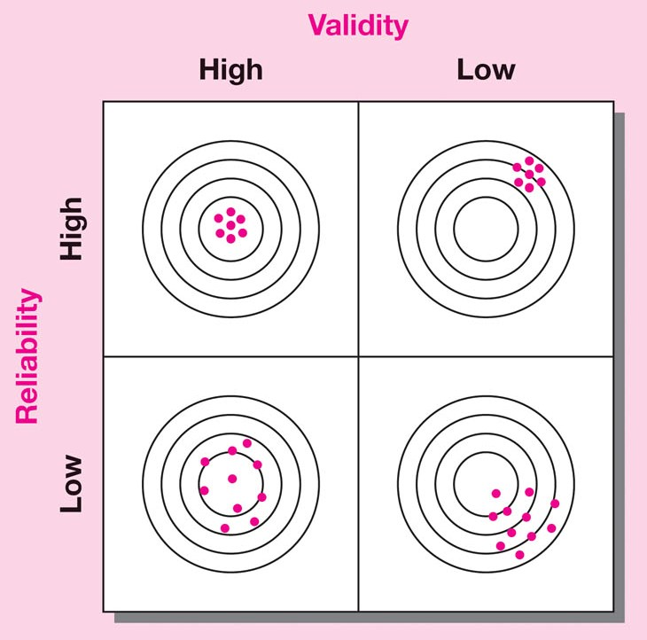
Understanding Validity and Reliability
Notes:
Exhibit 11-6
Exhibit 11-6 illustrates reliability and validity by using an archer’s bow and target as an analogy.
High reliability means that repeated arrows shot from the same bow would hit the target in essentially the same place.
If we had a bow with high validity as well, then every arrow would hit the bull’s eye.
If reliability is low, arrows would be more scattered.
High validity means that the bow would shoot true every time. It would not pull right or send an arrow careening into the woods.
Arrows shot from a high-validity bow will be clustered around a central point even when they are dispersed by reduced reliability.

Slide 29
Reliability Estimates
Stability
Internal
Consistency
Equivalence
Notes:
A measure is reliable to the degree that it supplies consistent results.
Reliability is a necessary contributor to validity but is not a sufficient condition for validity.
It is concerned with estimates of the degree to which a measurement is free of random or unstable error.
Reliable instruments are robust and work well at different times under different conditions. This distinction of time and condition is the basis for three perspectives on reliability – stability, equivalence, and internal consistency (see Exhibit 11-7).
These are discussed further on the following slide.

Slide 30
Reliability 信度
The stability and trustworthiness of a measure
  Test retest reliability, split-half reliability, alternate-form reliability
Internal consistency of a measurement tool
  e.g. Cronbach α
Internal consistency of different raters
  Inter-rater reliability
  Truncated scores

Slide 31
Practicality
Economy
Convenience
Interpretability
Notes:
The scientific requirements of a project call for the measurement process to be reliable and valid, while the operational requirements call for it to be practical.
Practicality has been defined as economy, convenience, and interpretability. There is generally a trade-off between the ideal research project and the budget.
A measuring device passes the convenience test if it is easy to administer.
The interpretability aspect of practicality is relevant when persons other than the test designers must interpret the results. In such cases, the designer of the data collection instrument provides several key pieces of information to make interpretation possible.
A statement of the functions the instrument was designed to measure and the procedures by which it was developed;
Detailed instructions for administration;
Scoring keys and instructions;
Norms for appropriate reference groups;
Evidence of reliability;
Evidence regarding the intercorrelations of subscores;
Evidence regarding the relationship of the test to other measures; and
Guides for test use.

Slide 32
Measurement Theory 測量理論
The mere-measurement effect
  Measurement drives our behavior
  A phenomenon in behavioral psychology
  It explains that merely measuring or questioning an individual’s intentions or anticipated regret changes his or her subsequent behavior

Slide 33
Assignment #7
Do a brief survey of the concepts “service quality” using Google Scholar, and read the relevant papers related to the development and usage of the measurement instrument (or scale)
Briefly describe its development process (or history)
What are the dimensions of the instrument, and what are the items
Discuss the scale from the perspectives of
  1. Construct validity
  2. Reliability
  3. REAL and PERCEIVED quality
How widely has it been adopted in academic research?
Prepare a short ppt document, no more that SIX pages
File name: HW7_SID_Name.ppt
Upload your ppt file to https://mega.linkin.tw/index.php/s/ZpxGfstBCeTtCLb

