Slide 1
Supply Chain and the Bullwhip Effects
5
  CYCU
  Prof. CK Farn
mailto: ckfarn@gmail.com
http://www.mgt.ncu.edu.tw/~ckfarn/cycu
  2023.03

Slide 2
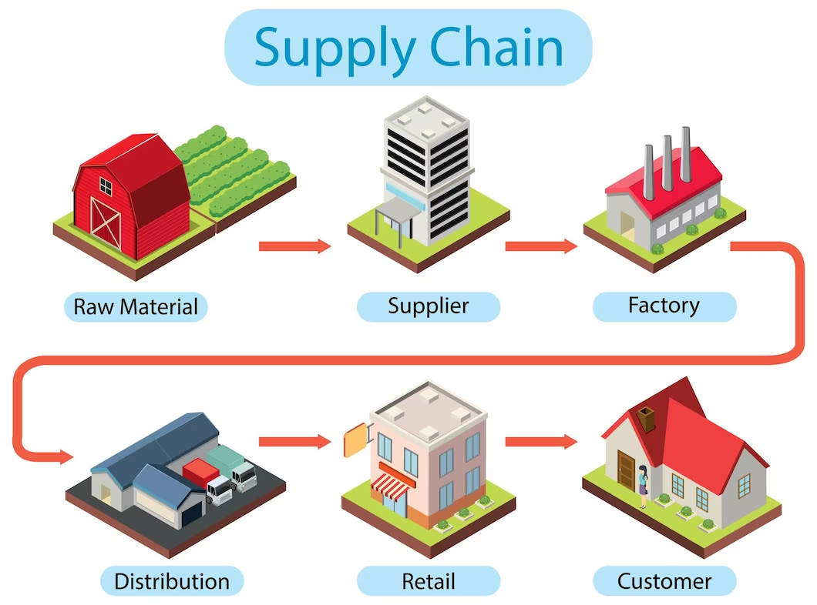
Supply Chain

Slide 3
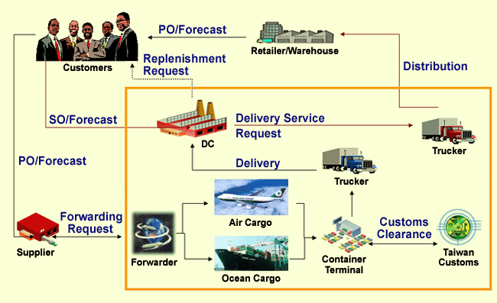
Supply Chain: Logistics

Slide 4
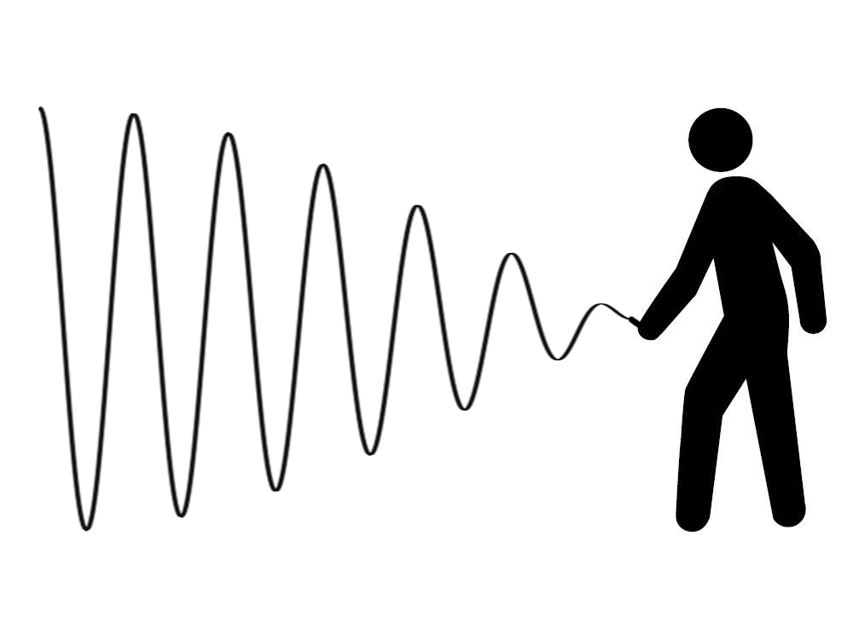
Bullwhip Effects
A supply chain phenomenon
  Small fluctuations in demand at the retail level can cause progressively larger fluctuations in demand up stream: wholesale, distributor, manufacturer and raw material supplier levels.

Slide 5
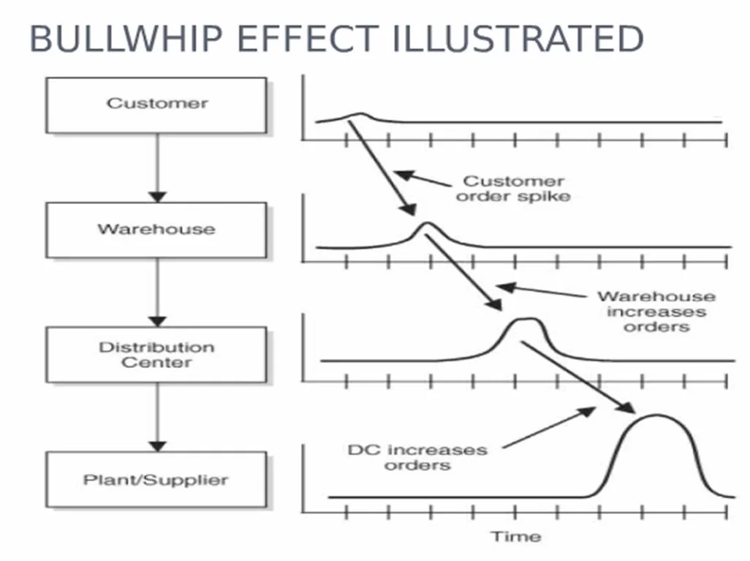
Larger fluctuations up stream

Slide 6
Supply chain dynamics
WH Order
Order Qty
Retailer Order
Customer
Demand
Production
Plan
Time
Source: Tom Mc Guffry, Electronic Commerce and Value Chain Management, 1998
Notes:
What is shown here is how divergent these various forecasts are in relation to real demand.
Why?? Because they are developed independently from each other and are dated, and unconnected to each other and the daily fluctuations in the market

Slide 7
Factors resulting in bullwhip effects
Disorganisation
Lack of communication
Free return policies
Order batching
Price variations
Demand information
Simply human greed and exaggeration
Long supply chain
Long lead-time

Slide 8
Counter measures
Reduce lead-time
Information sharing across the supply chain
Order smoothing
Strategic partnership
Coordinate with retailers to spread deliveries evenly
Reduce minimum batch sizes
Smaller and more frequent replenishments

Slide 9
Information systems
Information sharing through information systems
  “See through” the POS data
  Demand based replenishment
  Better forecasts, rolling forecasts
  CPFR: Continuous Planning, Forecast and Replenishment
Automation of order processing
  Frequent orders with smaller quantity
  Smaller orders quantity

Slide 10
Supply chain
Evolution
  https://www.youtube.com/watch?v=uDrQv8Z7owU
  https://www.youtube.com/watch?v=B9OSy-JM8mQ
Value Chain
  https://www.youtube.com/watch?v=MC_hByD8nBY
Logistics
  https://www.youtube.com/watch?v=YugqpSfG87Y

