Slide 1
Business Model
6
  CYCU
  Prof. CK Farn
mailto: ckfarn@gmail.com
http://www.mgt.ncu.edu.tw/~ckfarn/cycu
  2023.03

Slide 2
Business Model
A company's core strategy for profitably doing business. Include:
  Products or services the business plans to sell
  Target markets
  Any anticipated expenses
Different models for different types of business
  e.g. retailer, manufacturing, OEM, ….
When evaluating a business model as an investor, consider whether the product being offer matches a true need in the market

Slide 3
Confusion in Business Models
  * Industrialization of services business model
  * Low-cost carrier business model
  * Loyalty business models
  * Monopolistic business model
  * Multi-level marketing business model
  * Network effects business model
  * Online auction business model
  * Auction business model
  * Bricks and clicks business model
  * Collective business models
  * Cutting out the middleman model
  * Direct sales model
  * Distribution business models, various
  * Franchise
  * Freemium business model
Different people talking about different things
  Levels, domains, …
Many specific models
  * Online content business model
  * Premium business model
  * Professional open-source model
  * Pyramid scheme business model
  * Razor and blades business model (bait and hook)
  * Servitization of products business model
  * Subscription business model
  * Value Added Reseller model

Slide 4
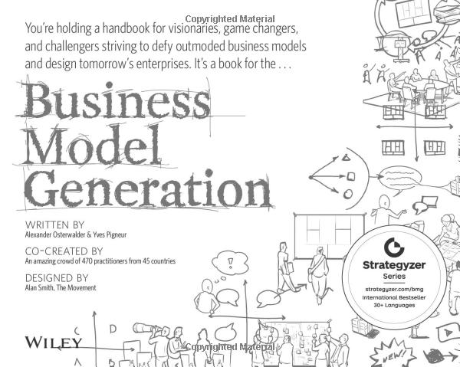
Business Model Canvas

Slide 5
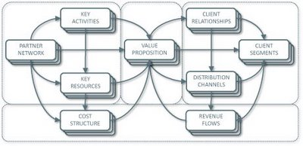
商業模式
Business model design template: Nine building blocks and their relationships,
Osterwalder 2004.
A business model is nothing else than a representation of how an organization makes (or intends to make) money. This can be nicely described through the 9 building blocks illustrated in the graphic below, which we call "business model canvas".

Slide 6
Target of business
Identify the target the business plans to sell
  Products
  Services
Multiple targets?

Slide 7
Business model canvas
Product/
Service
Foundation
Customer
Key
Partners
Key
Activities
Value
Propositions
Customer
Relationships
Customer
Segments
Key
Resources
Channels
Cost
Structure
Revenue
Streams
Finance

Slide 8
Value Propositions
What are the values provided to the customers
Q:
  What are the differences between Sogo and 7-11
  What are the differences Apple and Xiaomi
Different value propositions in the same industry

Slide 9


What does Perrier sell?
Water?
  Can water be that expansive?
Life Style!!

Slide 10
What are the values for Giant Bike?
Transportation
Health
Leisure
Life Style
Value for U-Bike?

Slide 11
Key Partners
Who are your suppliers
  Producer? intermediary/agent?
What is your relationship with the supplier?
  Stranger
  Co-opetition (competition and cooperation)
    Apple and Samsung
  Long term cooperation
    Apple and FoxConn

Slide 12
商業伙伴網路
Supplier
Arm length relationship
Customer
Focal
Supplier
Supplier
Supplier
Strategic partners

Slide 13
Key Resources
What special resources do you have?
  Human relationships
  Brands
  Human resources
  Technology, pattern
  Money reserve
  Special market
  Physical resources

Slide 14
Key Activities
Value Chain
  A business has to decide which activities to pursue
  Leaving others to its partners
System
Integration
Channel
Management
Market
Requirements
Procurement
After Sales
Service
Logistics
Product
Design
Production
Process
Marketing
Production
Sales

Slide 15
Customer Segments
The Target audience of the value propositions
TA
  Business customer (to B)
  Consumer (to C)
  Specific segments (e.g. education, military, …)
  First-time users or replacement market

Slide 16
Many types of customers
Who are the customers of Google Search?
Easy to identify customers in a two-way transaction, but what if there are multi-way exchange?
All customers must me treated well

Slide 17
Multi-way value exchange：Google Search
Info release
Exposure
Web
Sites
使用者
Users
Info sources
Knowledge
Google
Info exposure
Head
counts
Ads exposure
$$
$$
Product
Info
廣告商/
業者
Advertisers/
Brand owner

Slide 18
Customer relationship
Do you know your customers
  Why and why not?
Single transactions (may repeat)
  7-11
  How to increase loyalty
Long term customers
  Repeated sales to known members
  Costco

Slide 19
Channels
How do you sale your products or services?
  By yourself
  Agents
  Networks
The values of channels?

Slide 20
Customes and Channels
Think about the scenario
  Airlines
  Travel agents
  Consumers
Channel conflict
  If you are an airline, are the travel agents your competitors?

Slide 21
The Airline case
Membership, VIP cards
Accumulate milage, upgrades, free tickets
Airline
Designate
airline
Travel
Agents
Ticket
Agents

Slide 22
Financial aspects
Revenue sources
cost driver
Investment scale
Success factors
Estimate revenue scale, cash flow
Estimate expenditure scale, cash flow
Project investment to achieve positive case flow
Cash flow curve
Sensitivity analysis

Slide 23
Cost driver and structure
Personnel costs (direct)
Personnel costs (indirect)
Inventory
Space / rents
Marketing / advertising
Fixed costs
Variable costs
Semi variable costs

Slide 24
Cost structure
Cost structure: pure types
  Small capital operations
  Economy of scale
  Economy of scope
Example
  Producing handmade handicraft
  Mass production of specific handicraft
  Machine made customized handicraft

Slide 25
Cost structure: operations leverage
$
$
Revenue
Total Cost
Total Cost
Fixed cost
Revenue
Fixed cost
Break even
Volume
Break
even
Volume
Small Capital operations
Large scale operations

Slide 26
Unit cost
Total cost =
Fixed cost + variable cost
High
Fixed cost
Cost
Unit cost decreases
as volume increase
Low
Low
Volume
High

Slide 27
Economy of Scale and Scope
$
$
Total Cost
Total Cost
Fixed cost
Fixed cost
Revenue
Revenue
Unit cost
Unit cost
Volume
Scope
Economy of Scale
Economy of Scope

Slide 28
Assembly line production and
Flexible manufacturing
Assembly Line
  Fixed workstation, each accomplish one task
  Jig, fixture, measurement tools
  Large batch size
  Every change of product: stop production for setup
FMS
  Making use of generic tools
  Automated job shop operations, customized products
  Batch size can be as small as one
Which is better?

Slide 29
Revenue stream
How do you make profit?
How do you collect money?
  One time? Every month? Pay as you use?
Who pays (Consumer? Other parties?)
  Multi-party income: television programs, free hand phones

Slide 30
Revenue streams
Who pays (Consumer? Other parties?)
  Single stream
  Multiple streams
  Hybrid
  Cross subsidies
    Freemium
    Laser printers
    Razor/Shaver

Slide 31
Payments
Membership
Licensing
Pay as you use
Advertising
  Cost per exposure? Cost per impression? CPI, CPM
  Cost per click? CPC
  Cost per action? Cost per Sales? CPA, CPS
Transaction fee

Slide 32
Inventory cost
Assuming: a company with 1 billion revenue, and the raw material cost is 60%
If inventory (raw material, WIP and finished goods) cycle time is 120 days
  Total average inventory 200 million
If inventory cycle time is 30 days
  Total average inventory 50 million
Inventory cycle 120→ 30 days
  Inventory reduction 150 million
Assuming 5% cost of capital, savings amounts to 7.5 million!

Slide 33
CCC: Cash Conversion Cycle
Inventory cycle + Accounts receivable – Accounts payable
Cash Rich Operations
  Negative CCC
Cash Poor Operations
  Positive CCC

Slide 34
Financial considerations
Cost structure and revenue streams
Operations leverage
  Economy of scale
  Economy of scope
Cash rich/Cash poor operations
Value propositions to generate income

Slide 35
Summary: Business Models
A hybrid of the nine factors
What business are you in
  Take department stores as an example
    Buy and sell
    Consign for sale on commission
    Property rental

