Slide 1
National Difference in Political, Economic and Legal Systems
3
CYCU
Prof. CK Farn
mailto: ckfarn@gmail.com
http://www.mgt.ncu.edu.tw/~ckfarn/cycu
2024.10

Slide 2
Assignment #3
With the help of tools, and finish a report in teams
Prepare a presentation with PowerPoint, no more than 8 pages
Due Oct. 31
File name: IBC_HW3_GroupID.pdf
Explain the Presidential election system in the USA, including and not limited to: primaries and the nominating process, concepts of Electoral College and indirect elections, generation of electors in each state, tie breaking, etc.
Give examples of any ONE previous election, where the candidate with more popular votes lost the election.

Slide 3
Introduction: International Business
More complicated than domestic.
Differing political, legal, and economic systems; vary in economic development and growth trajectories.
Cultural, education, and skill levels vary.
The political, economic, and legal systems are known as the political economy.
Systems are interdependent.
Societal culture affects political economy, and political economy shapes societal culture.
Notes:
The opening case illustrates some of the issues discussed in this chapter. One of the most dramatic economic developments of the last 40 years has been the rise of China. China operates with a mixed economy in which the state is actively involved in production, both directly through ownership of the means of production and indirectly when it uses state-owned banks to provide strategic support to private enterprises. This is a different economic system than that found in many Western democracies, where the role of the state in economic activity is much more limited. One cannot understand how business is done in China without taking these differences into consideration.

Slide 4
Political Systems
System of government in a nation.
Assessed according to
the degree to which the country emphasizes collectivism.
the degree to which the country is democratic or Totalitarian.
Notes:
LO 2-1 Understand how the political systems of countries differ.
These dimensions are interrelated; systems that emphasize collectivism tend to lean toward totalitarianism, whereas those that place a high value on individualism tend to be democratic. However, a large gray area exists in the middle. It is possible to have democratic societies that emphasize a mix of collectivism and individualism. Similarly, it is possible to have totalitarian societies that are not collectivist.

Slide 5
Political Systems: Collectivism
Collectivism: system that stresses the primacy of collective goals over individual goals.
Traced to Greek philosopher Plato.
Society should be stratified into classes.
Property should be owned in common.
When collectivism is emphasized, needs of society are generally viewed as being more important than individual freedoms.
Notes:
Advocacy of collectivism can be traced to the ancient Greek philosopher Plato (427–347 B.C.), who, in The Republic, argued that individual rights should be sacrificed for the good of the majority and that property should be owned in common.

Slide 6
Political Systems: Socialism
Socialists: those who believe in public ownership of the means of production for the common good of society.
Modern socialists trace roots to Karl Marx.
Advocates state ownership of basic means of production, distribution, and exchange.
State then manages enterprises to benefit society as a whole.
Notes:
According to Marx, the pay of workers does not reflect the full value of their labor. To correct this perceived wrong, Marx advocated state ownership of the basic means of production, distribution, and exchange (i.e., businesses). His logic was that if the state owned the means of production, the state could ensure that workers were fully compensated for their labor.

Slide 7
Political Systems: Socialism Evolves
In the early 20th century, socialism split into:
Communists: believed socialism could only be achieved though violent revolution and totalitarian dictatorship.
In retreat worldwide by mid-1990s.
Social democrats, who worked to achieve same goals by democratic means.
Many state-owned enterprises failed to succeed, and many nations implemented privatization programs.
Sale of state-owned enterprises to private investors.
Notes:
Social democracy also seems to have passed a high-water mark, although the ideology may prove to be more enduring than communism. Social democracy has had perhaps its greatest influence in a number of democratic Western nations, including Australia, Denmark, Finland, France, Germany, Great Britain, Norway, Spain, and Sweden, where social democratic parties have often held political power. Other countries where social democracy has had an important influence include India and Brazil.

Slide 8
Political Systems: Individualism
Individualism.
Suggests individuals should have freedom over economic and political pursuits.
Traced to Aristotle, who argued that individual diversity and private ownership are desirable.
Refined in work of David Hume, Adam Smith, and John Stuart Mill.
Individualism stresses:
Individual freedom and self-expression.
Letting people pursue self-interests to achieve the best overall good for society.
Democratic systems and free markets.
Notes:
The central message of individualism, therefore, is that individual economic and political freedoms are the ground rules on which a society should be based. This puts individualism in conflict with collectivism. Collectivism asserts the primacy of the collective over the individual; individualism asserts the opposite.

Slide 9
Political Systems: Democracy and Totalitarianism
Democracy.
Political system in which government is by the people, exercised either directly or through elected representatives.
Most common form today is representative democracy: elected representatives vote on behalf of constituents.
Main issues:
Freedom of expression, opinion, and organization; free media; regular elections; universal adult suffrage; limited terms for elected officials; fair court system; nonpolitical state bureaucracy; nonpolitical police force and armed services; free access to state information.
Notes:
The United States, for example, is a constitutional republic that operates as a representative democracy. In a representative democracy, citizens periodically elect individuals to represent them. These elected representatives then form a government whose function is to make decisions on behalf of the electorate. In a representative democracy, elected representatives who fail to perform this job adequately will be voted out of office at the next election.

Slide 10
Political Systems: Totalitarianism
Form of government in which one person or political party exercises absolute control over all spheres of human life, and opposing political parties are prohibited.
In most totalitarian regimes:
There is widespread political repression.
There are no free and fair elections.
Media is censored.
Basic civil liberties are denied.
Challenges to regime are prohibited.
Notes:
In a totalitarian country, all the constitutional guarantees on which representative democracies are built—an individual’s right to freedom of expression and organization, a free media, and regular elections—are denied to the citizens. In most totalitarian states, political repression is widespread, free and fair elections are lacking, media are heavily censored, basic civil liberties are denied, and those who question the right of the rulers to rule find themselves imprisoned or worse.

Slide 11
Political Systems: 4 Major forms of Totalitarianism
Communist totalitarianism (China)
advocates achieving socialism through totalitarian dictatorship.
Theocratic totalitarianism (Iran)
political power is monopolized by a party, group, or individual that governs according to religious principles.
Tribal totalitarianism (Zimbabwe)
where a political party that represents the interests of a particular tribe monopolizes power.
Right-wing totalitarianism (Military dictatorship, Myanmar)
individual economic freedom is allowed but individual political freedom is restricted because it could lead to communism.
Notes:
Four major forms of totalitarianism exist in the world today. Until recently, the most widespread was communist totalitarianism. Communism, however, is in decline worldwide, and most of the Communist Party dictatorships have collapsed since 1989.

Slide 12
Economic Systems
Political Ideology and Economic Systems Are Connected
Three types of economic systems
market economy
command economy
mixed economy
Notes:
LO 2-2 Understand how the economic systems of countries differ.
We can identify three broad types of economic systems: a market economy, a command economy, and a mixed economy.

Slide 13
Market Economy
Goods and services a country produces and the quantity in which they are produced is determined by supply and demand.
Supply must not be restricted by monopolies.
Government encourages free and fair competition between private producers.
Constant incentive to improve products and processes.
Notes:
Given the dangers inherent in monopoly, one role of government in a market economy is to encourage vigorous free and fair competition between private producers.

Slide 14
Command Economy
Goods and services a country produces, the quantity in which they are produced, and the price at which they are sold are planned by government.
All businesses are state-owned and have little incentive to control costs and be efficient.
Because there is no private ownership, there is little incentive to better serve consumer needs.
Dynamism and innovation are absent.
Notes:
Since the demise of communism in the late 1980s, the number of command economies has fallen dramatically. Some elements of a command economy were also evident in a number of democratic nations led by socialist-inclined governments. France and India both experimented with extensive government planning and state ownership, although government planning has fallen into disfavor in both countries.
While the objective of a command economy is to mobilize economic resources for the public good, the opposite often seems to have occurred.

Slide 15
Mixed Economy
Includes some elements of market economies and some elements of command economies.
Governments take over troubled firms considered vital to national interests.
Number of mixed economies becoming less common.
Notes:
China currently operates with a mixed economy. Mixed economies were once common throughout much of the developed world, although they are becoming less so. Until the 1980s, Great Britain, France, and Sweden were mixed economies, but extensive privatization has reduced state ownership of businesses in all three nations. A similar trend occurred in many other countries where there was once a large state-owned sector, such as Brazil, Italy, and India (although there are still state-owned enterprises in all of these nations).

Slide 16
Legal Systems
Refers to rules, or laws, that regulate behavior, along with processes by which laws are enforced and through which redress for grievances is obtained.
A country’s legal system is important because laws:
Regulate business practice.
Define manner in which business transactions are executed.
Set rights and obligations of those involved in business transactions.
Notes:
LO 2-3 Understand how the legal systems of countries differ.
Like the economic system of a country, the legal system is influenced by the prevailing political system (although it is also strongly influenced by historical tradition). The government of a country defines the legal framework within which firms do business, and often the laws that regulate business reflect the rulers’ dominant political ideology.

Slide 17
Different Legal Systems
Common law
Based on tradition, precedent, and custom.
Found in most of Great Britain’s former colonies, including the U.S.
Civil law
Based on detailed set of laws organized into codes.
Found in more than 80 countries, including Germany, France, Japan, and Russia.
Theocratic law
Based on religious teachings.
Islamic law is most widely practiced.
Notes:
In common law, tradition refers to a country’s legal history, precedent to cases that have come before the courts in the past, and custom to the ways in which laws are applied in specific situations.
A civil law system tends to be less adversarial than a common law system because the judges rely on detailed legal codes rather than interpreting tradition, precedent, and custom.
In practice, Islamic jurists and scholars are constantly debating the application of Islamic law to the modern world. In reality, many Muslim countries have legal systems that are a blend of Islamic law and a common or civil law system.

Slide 18
Property Rights
Property rights
legal rights over the use to which a resource is put and over the use made of any income derived from that resource.
Property rights can be violated through:
Private action, e.g. theft, piracy, blackmail, and the like by private individuals or groups.
Public action
legally - ex. excessive taxation
illegally - ex. bribes or blackmailing
high levels of corruption reduce foreign direct investment, the level of international trade, and the economic growth rate in a country
Notes:
There are systematic differences in the extent of corruption. In some countries, the rule of law minimizes corruption. Corruption is seen and treated as illegal, and when discovered, violators are punished by the full force of the law. In other countries, the rule of law is weak and corruption by bureaucrats and politicians is rife. Corruption is so endemic in some countries that politicians and bureaucrats regard it as a perk of office and openly flout laws against corruption.

Slide 19
Corruption
Corruption is present in all countries to some degree
Countries with a high level of corruption face:
Foreign direct investment falls.
International trade falls.
Economic growth falls.
Notes:
By siphoning off profits, corrupt politicians and bureaucrats reduce the returns to business investment and, hence, reduce the incentive of both domestic and foreign businesses to invest in that country. The lower level of investment that results hurts economic growth. Thus, we would expect countries with high levels of corruption such as Indonesia, Nigeria, and Russia to have a lower rate of economic growth than might otherwise have been the case.

Slide 20
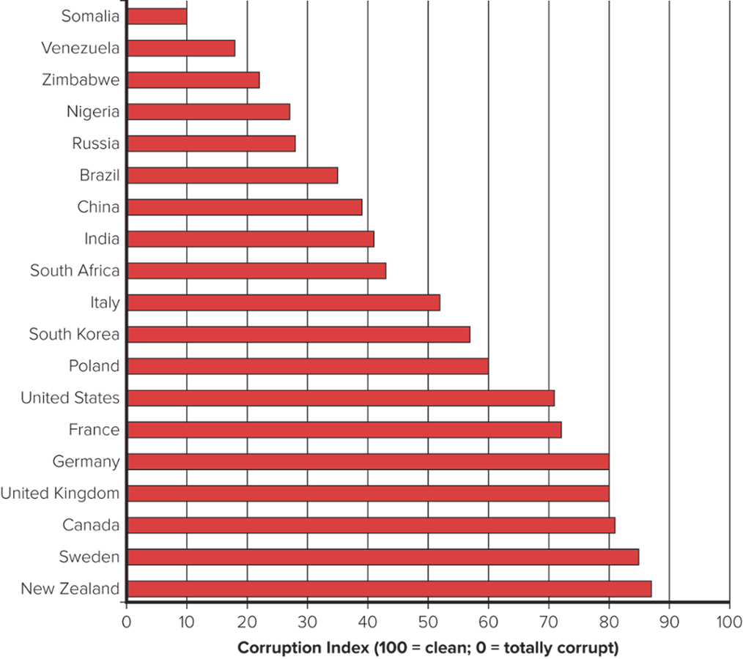
Figure 2.1 Rankings of Corruption by Country, 2019
Source: Constructed by the author from raw data from Transparency International, Corruption Perceptions Index 2019..
Notes:
As can be seen in Figure 2.1, the organization rated countries such as New Zealand and Sweden as clean; it rated others, such as Russia, Zimbabwe, and Venezuela, as corrupt. Somalia ranked last out of all 180 countries in the survey (the country is often described as a “failed state”).

Slide 21
Countering Corruption
Foreign Corrupt Practices Act (FCPA).
Makes it illegal to bribe a foreign government official in order to obtain or maintain business over which the foreign official has authority.
All publicly traded companies must keep detailed records so it is clear whether a violation has occurred.
Facilitating or expediting payments to secure performance of routine government actions are permitted.
Notes:
In 1997, trade and finance ministers from the member states of the Organisation for Economic Co-operation and Development (OECD), an association of 34 major economies including most Western economies (but not Russia, India, or China), adopted the Convention on Combating Bribery of Foreign Public Officials in International Business Transactions obliging member-states to make the bribery of foreign public officials a criminal offense.

Slide 22
Intellectual Property
Intellectual property
property that is the product of intellectual activity.
The Protection of Intellectual Property
Patents: give inventor exclusive rights to the manufacture, use, or sale of that invention.
Copyrights: exclusive legal rights of authors, composers, playwrights, artists, and publishers to publish and dispose of their work as they see fit.
Trademarks: designs and names, often officially registered, by which merchants or manufacturers designate and differentiate their products.
Notes:
The philosophy behind intellectual property laws is to reward the originator of a new invention, book, musical record, clothes design, restaurant chain, and the like for his or her idea and effort. Such laws stimulate innovation and creative work. They provide an incentive for people to search for novel ways of doing things, and they reward creativity.

Slide 23
Product Safety and Product Liability
Product safety laws
set certain safety standards to which a product must adhere.
Product liability
holds a firm and its officers responsible when a product causes injury, death, or damage.
Liability laws are usually least extensive in less developed countries.
Firms must decide whether to adhere to standards of home country or host country.
Notes:
While the ethical thing to do is undoubtedly to adhere to home-country standards, firms have been known to take advantage of lax safety and liability laws to do business in a manner that would not be allowed at home.

Slide 24
360° View: Managerial Implications
The Macro Environment Influences Market Attractiveness
Political, economic, and legal systems of a country raise important ethical issues that have implications for practicing international business.
Political, economic, and legal environments of a country clearly influence attractiveness of country as a market and/or investment site.
A democratic country with a market-based economy, protection of property rights, and limited corruption is a more attractive place to do business.
Notes:
LO 2-4 Explain the implications for management practice of national differences in political economy.
For now, other things being equal, a nation with democratic political institutions, a market-based economic system, and strong legal system that protects property rights and limits corruption is clearly more attractive as a place in which to do business than a nation that lacks democratic institutions, where economic activity is heavily regulated by the state, and where corruption is rampant and the rule of law is not respected. On this basis, for example, a country like Canada is a better place in which to do business than the Russia of Vladimir Putin.

