Slide 1
CSR: Ethics, Corporate Social Responsibility, and Sustainability ESG: Environment, Social and Governance
5
CYCU
Prof. CK Farn
mailto: ckfarn@gmail.com
http://www.mgt.ncu.edu.tw/~ckfarn/cycu
2024.10

Slide 2
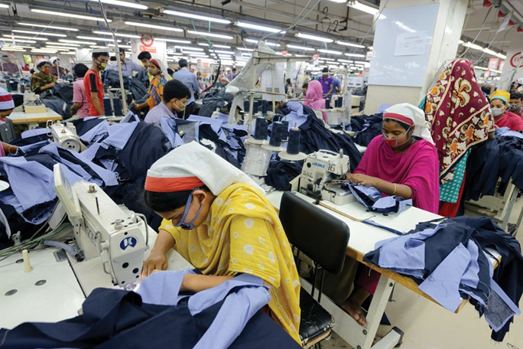
Opening Case
Soltan Frédéric/Getty Images
Who Stitched Your Designer Jeans?
Densely populated Bangladesh is now world’s second largest exporter of readymade garments.
Accounts for 20 percent of its GDP and 80% of its exports.
Lifted country out of the ranks of poorest nations in the world.
Success rests on low labor costs and lax regulations.
Questionable practices regarding child labor and safe working environments.
Notes:
The success of its textile industry has helped Bangladesh achieve very high levels of economic growth, which are lifting the country out of the ranks of the world’s poorest nations. Over the past decade, Bangladesh’s economy has grown almost 200 percent, one of the best performances in the world.
Research suggests that child labor in Bangladesh is still widespread, with as many as 4 million children under 14 working. In theory, regulations in Bangladesh outlaw the employment of child labor in garment factories, but as studies have found, labor laws are widely ignored.
Sources: Hannah Abdulla, “Bangladesh RMG Exports Slip in Q1,” Just-Style, November 12, 2019; Jason Beaubien, “Child Laborers in Bangldesh Are Working 64 Hours a Week,” National Public Radio, December 7, 2016; S. Butler, “Why Are Wages So Low for Garment Workers in Bangladesh?” The Guardian, January 21, 2019; H. A. Hye, “Sustaining Bangladesh’s Economic Miracle,” Financial Express, February 17, 2020; M. Nonkes, “A Look at Child Labor inside a Garment Factory in Bangladesh,” World Vision, June 10, 2015.

Slide 3
Introduction: Ethics
Ethics
accepted principles of right or wrong that govern conduct of a person, members of a profession, or actions of an organization.
Business ethics:
accepted principles of right or wrong governing conduct of business people.
Ethical strategy
strategy, or course of action, that does not violate these accepted principles.
Notes:
Ethics, corporate social responsibility, and sustainability are intertwined issues facing countries, companies, and societies. These "social" issues arise frequently in international business, often because business practices and regulations differ from nation to nation.

Slide 4
Ethics and International Business 1
Common Ethical Issues in Business
Employment practices
Human rights
Environmental regulations
Moral obligations
Notes:
LO 5-1 Understand the ethical, corporate social responsibility, and sustainability issues faced by international businesses.

Slide 5
Ethics and International Business 2
Employment Practices
What practices should be used when work conditions are inferior in host nation?
Human Rights
What is the responsibility of a foreign multinational when operating in a country where basic human rights are not respected?
South Africa and apartheid.
Sullivan principles adopted by G M.
Many oppressive regimes still exist around the world.
Notes:
Sullivan argued that it was ethically justified for GM to operate in South Africa so long as two conditions were fulfilled. First, the company should not obey the apartheid laws in its own South African operations (a form of passive resistance). Second, the company should do everything within its power to promote the abolition of apartheid laws.
Although change has come in South Africa, many repressive regimes still exist in the world. In fact, according to the Freedom House, only about 45 percent of the world’s population of 7.6 billion people are living in free democratic countries (30 percent are partly free and 25 percent are not free). People in countries that are not considered free by the Freedom House typically face severe consequences if they try to exercise their most basic rights, such as expressing their views, assembling peacefully, and organizing independently of the countries in which they live.

Slide 6
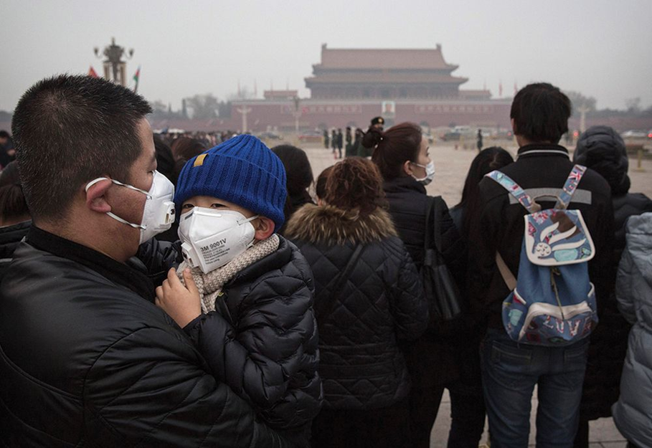
Ethics and International Business 3
Environmental Pollution
Should a multinational feel free to pollute in a developing nation if doing so does not violate laws?
Tragedy of the commons.
May be legal, but is it ethical?
People wearing breathing masks at Tian’anmen Square in China’s capital city, Beijing.
Kevin Frayer/Getty Images
Notes:
The atmosphere and oceans can be viewed as a global commons from which everyone benefits but for which no one is specifically responsible. In such cases, a phenomenon known as the tragedy of the commons becomes applicable. The tragedy of the commons occurs when a resource held in common by all but owned by no one is overused by individuals, resulting in its degradation.
Corporations can contribute to the global tragedy of the commons by moving production to locations where they are free to pump pollutants into the atmosphere or dump them in oceans or rivers, thereby harming these valuable global commons.

Slide 7
Ethics and International Business 4
Corruption
Is it ethical to make payments to government officials to secure business?
Foreign Corrupt Practices Act (F C P A).
Convention on Combating Bribery of Foreign Public Officials in International Business Transactions.
Facilitating payments, or speed money, excluded.
Some argue paying bribes might be price of doing greater good.
Others argue that corruption reduces returns on business investment and leads to low economic growth.
Many multinationals have adopted a zero-tolerance policy.
Notes:
The Lockheed case was the impetus for the 1977 passage of the Foreign Corrupt Practices Act (FCPA) in the United States, discussed in Chapter 2. The act outlawed the paying of bribes to foreign government officials to gain business.
In 1997, the trade and finance ministers from the member states of the Organization for Economic Cooperation and Development (OECD) followed the U.S. lead and adopted the Convention on Combating Bribery of Foreign Public Officials in International Business Transactions. The convention, which went into force in 1999, obliges member states and other signatories to make the bribery of foreign public officials a criminal offense. The convention excludes facilitating payments made to expedite routine government action from the convention.

Slide 8
Ethical Dilemmas
Situations in which no available alternative seems ethically acceptable.
Exist because real-world decisions are complex, difficult to frame, and involve various consequences that are difficult to quantify.
No universal worldwide agreement about what constitutes accepted ethical principles.
Cultural perspectives vary considerably.
International managers often face situations where appropriate course of action is not clear.
Notes:
LO 5-2 Recognize an ethical, corporate social responsibility, and/or sustainability dilemma.
The ethical obligations of a multinational corporation toward employment conditions, human rights, corruption, and environmental pollution are not always clear-cut. However, what is becoming clear-cut is that managers and their companies are feeling more of the marketplace pressures from customers and other stakeholders to be transparent in their ethical decision making.

Slide 9
Child Labor
A young girl making cigarettes in Bagan, Myanmar.
Angela N Perryman/Shutterstock

Slide 10
Roots of Unethical Behavior 1
Managerial Behavior Influences
Personal ethics.
Decision-making processes.
Organizational culture.
Unrealistic performance goals.
Leadership.
Societal culture.
Notes:
LO 5-3 Identify the causes of unethical behavior by managers as they relate to business, corporate social responsibility, or sustainability.

Slide 11
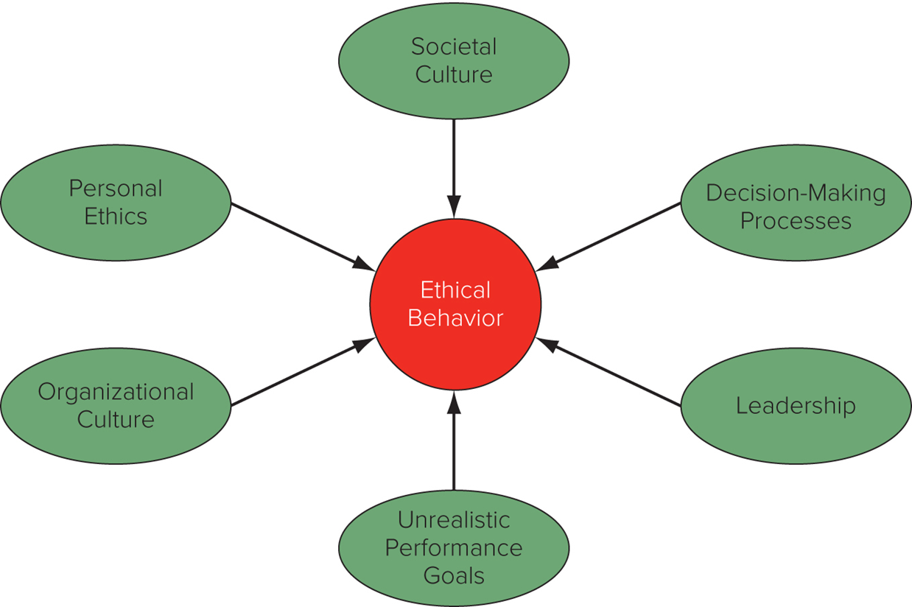
Figure 5.1 Determinants of Ethical Behavior

Slide 12
Roots of Unethical Behavior 2
Personal Ethics
Business ethics reflect personal ethics.
Expatriates may face pressure to violate personal ethics.
Away from ordinary social context and supporting culture.
Psychologically and geographically distant from parent company.
Decision-Making Processes
Businesspeople may behave unethically because they fail to ask relevant questions.
Decisions made based on economic logic.
Notes:
Personal ethics refer to the generally accepted principles of right and wrong governing the conduct of individuals.
To improve ethical decision making in a multinational firm, the best starting point is to better understand how individuals make decisions that can be considered ethical or unethical in an organizational environment. Two assumptions must be taken into account. First, too often it is assumed that individuals in the workplace make ethical decisions in the same way as they would if they were home. Second, too often it is assumed that people from different cultures make ethical decisions following a similar process. Both of these assumptions are problematic. First, within an organization, there are very few individuals who have the freedom (for example, power) to decide ethical issues independent of pressures that may exist in an organizational setting (for example, should we make a facilitating payment or resort to bribery?). Second, while the process for making an ethical decision may largely be the same in many countries, the relative emphasis on certain issues is unlikely to be the same.

Slide 13
Roots of Unethical Behavior 3
Organizational Culture
Unethical behavior may exist in firms with an organizational culture that does not emphasize business ethics.
Values and norms shape the culture of a firm, and that culture influences decision making.
Unrealistic Performance Goals
Pressure from parent company to meet goals that are unrealistic and can only be attained by acting in an unethical manner.
Notes:
The term organizational culture refers to the values and norms that are shared among employees of an organization.
The combination of an organizational culture that legitimizes unethical behavior, or at least turns a blind eye to such behavior, and unrealistic performance goals may be particularly toxic.

Slide 14
Roots of Unethical Behavior 4
Leadership
Leaders establish the culture of the organization and set the example.
Actions speak louder than words.
Societal Culture
Ethical policies differ by country.
M N Es located in countries with strong individualism and uncertainty avoidance are more likely to emphasize ethical behavior.
M N Es located in countries with high masculinity and high power distance are less likely to promote ethical behavior.
Notes:
Employees often operate and work within a defined structure with a mindset very much similar to the overall culture of the organization that employs them.

Slide 15
Universal Declaration of Human Rights
Everyone has the right to work, to free choice of employment, to just and favorable conditions of work, and to protection against unemployment.
Everyone, without any discrimination, has the right to equal pay for equal work.
Everyone who works has the right to just and favorable remuneration ensuring for himself and his family an existence worthy of human dignity, and supplemented, if necessary, by other means of social protection.
Everyone has the right to form and to join trade unions for the protection of his interests.
Notes:
This excerpt is from Article 23, which relates directly to employment.

Slide 16
Philosophical Approaches to Ethics: Justice Theories
Focus on attainment of just distribution—one that is considered fair and equitable—of economic goods and services.
John Rawls: all economic goods and services should be distributed equally except when unequal distribution would work to everyone’s advantage.
Impartiality is guaranteed by veil of ignorance—everyone is imagined to be ignorant of all their particular characteristics.
Race, sex, intelligence, etc.
Notes:
Rawls’ veil of ignorance is a conceptual tool that contributes to the moral compass that managers can use to help them navigate through difficult ethical dilemmas.

Slide 17
360° View: Managerial Implications
Making Ethical Decisions Internationally
Favor hiring and promoting people with well-grounded sense of personal ethics.
Build organizational culture that places high value on ethical behavior.
Put decision making processes in place that require people to consider ethical dimensions of business decisions.
Institute ethical officers in organization.
Develop moral courage.
Make corporate social responsibility cornerstone of enterprise policy.
Pursue sustainable strategies.
Notes:
LO 5-5 Explain how global managers can incorporate ethical considerations into their decision making in general, as well as corporate social responsibility and sustainability initiatives.

Slide 18
Decision-Making Processes
If manager answers “yes” to following questions, the decision is ethically acceptable:
Does my decision fall within the accepted values or standards that typically apply in the organizational environment (as articulated in a code of ethics or some other corporate statement)?
Am I willing to see the decision communicated to all stakeholders affected by it—for example, by having it reported in newspapers, on television, or via social media?
Would the people with whom I have a significant personal relationship, such as family members, friends, or even managers in other businesses, approve of the decision?
Notes:
A moral compass can help determine whether a decision is ethical.

Slide 19
360° View: Managerial Implications 4
Five-step process helps managers think through ethical issues:
Internal stakeholders.
External stakeholders.
How would a decision affect stakeholders?
Judge ethics of proposed strategic decision.
Establish moral intent.
Engage in ethical behavior.
Audit decisions.
Notes:
A moral compass can help determine whether a decision is ethical.
Stakeholder analysis involves a certain amount of what has been called moral imagination. This means standing in the shoes of a stakeholder and asking how a proposed decision might impact that stakeholder. For example, when considering outsourcing to subcontractors, managers might need to ask themselves how it might feel to be working under substandard health conditions for long hours.
Internal stakeholders: People who work for or own the business such as employees, directors, and stockholders.
External stakeholders: Individuals or groups that have some claim on a firm such as customers, suppliers, and unions.

Slide 20
Corporate Social Responsibility (CSR)
Multinationals need to give something back to the societies that enable them to prosper and grow.
Businesses should consider social consequences of economic actions.
There should be a presumption in favor of decisions that have both good economic and good social consequences.
Noblesse oblige.
the unwritten obligation of people from a noble ancestry to act honorably and generously to others.
Notes:
Advocates of this approach argue that businesses, particularly large successful businesses, need to recognize their noblesse oblige and give something back to the societies that have made their success possible. Noblesse oblige is a French term that refers to honorable and benevolent behavior considered the responsibility of people of high (noble) birth. In a business setting, it is taken to mean benevolent behavior that is the responsibility of successful enterprises.

Slide 21
four main types of CSR
Environmental responsibility
Ethical responsibility
Philanthropic responsibility
seeking to promote the welfare of others
Similar to Altruism
Economic responsibility

Slide 22
Sustainability
Sustainable strategies
strategies that help MNEs make profits without harming the environment, while ensuring company operates in a socially responsible manner with regard to its stakeholders.
Good for shareholders, environment, local communities, employees, and customers.
Notes:
A company pursuing a sustainable strategy would not adopt business practices that degrade the environment for short-term economic gain because doing so would impose a cost on future generations. In other words, international businesses that pursue sustainable strategies try to ensure that they do not precipitate or participate in a situation that results in a tragedy of the commons.

Slide 23
Related concepts
ESG: The dimensions of CSR
Environment, Social, Governance
Commitment
SDG: Sustainable Development Goals
17 dimensions
DJSI

Slide 24
SDG
1.消除貧窮 No Poverty
2.消除飢餓 Zero Hunger
3.良好健康與福祉Good Health And Well Being
4.優質教育 Quality Education
5.性別平等 Gender Equality
6.潔淨飲水與衛生 Clean Water And Sanitation
7.乾淨能源Affordable And Clean Energy
8.全人職場及經濟成長 Decent Work And Economic Growth
9.產業創新與基礎建設 Industry, Innovation And Infrastructure
10.促進均等 Reduce Inequalities
11.永續城市與社區 Sustainable Cities And Communities
12.責任的消費與生產 Responsible Consumption And Production
13.氣候行動 Climate Action
14.海洋生態 Life Below Water
15.陸域生態 Life On Land
16.和平正義與健全制度 Peace, Justice And Strong Institutions
17.夥伴關係 Partnerships For The Goals

Slide 25
DJSI
The Dow Jones Sustainability Indices (DJSI)
Launched in 1999
A family of indices evaluating the sustainability performance of thousands of companies
To be incorporated in the DJSI, companies are assessed and selected based on their long-term economic, social and environmental asset management plans
Those selected are leaders in ESG

Slide 26
Summary
In this chapter, we have
Explored ethical, corporate social responsibility, and sustainability issues faced by international businesses.
Recognized ethical, corporate social responsibility, and/or sustainability dilemma.
Identified causes of unethical behavior by managers as they relate to business, corporate social responsibility, or sustainability.
Described different philosophical approaches to business ethics that apply globally.
Explained how managers can incorporate ethical considerations into their decision making.

