Slide 1
The Foreign Exchange Market (Forex)
9
  CYCU
  Prof. CK Farn
mailto: ckfarn@gmail.com
http://www.mgt.ncu.edu.tw/~ckfarn/cycu
  2024.12

Slide 2

Opening Case
Exchange Rates and the Profitability of Korean Airlines
  South Korea’s two major airlines hit by significant foreign exchange losses from the weakness of Korean won against U.S. dollar (2019).
    Jet fuel is priced in U.S. dollars.
    Both airlines took on dollar-denominated debt to finance their purchase of jet aircraft.
Decline in the won driven by economic uncertainty, increased demand for dollars.
Global pandemic adds to economic uncertainty and supply chain disruptions.
viper-zero/Shutterstock
Notes:
So how much has the won fallen against the U.S. dollar recently? In mid-February 2018, one U.S. dollar was trading at around 1065 won. By mid-February 2020, one U.S. dollar bought about 1,200 won. Put differently, the won had depreciated in value against the U.S. dollar by around 12.5 percent. When the dollar cost of jet fuel and debt service, both paid for in dollars, was translated back into won, this implied a 12.5 percent increase in costs of these Korean airlines over this time period and, consequently, a fall in their profitability.
Sources: Kim Bo-eun, “Won Expected to Lose More Dollar against the US Dollar,” Korean Times, February 21, 2020; Michael Herh, “South Korea’s Two Biggest Airlines Hit Directly by Currency Depreciation,” Business Korea, May 16, 2019; “Asiana Airlines Q4 Loss Widens on Currency,” Yonhap News Agency, February 12, 2020.

Slide 3
Introduction
Foreign Exchange Market
  Market for converting the currency of one country into that of another country.
    Can have a significant impact on the sales and profits of n enterprise.
    Managers must understand how foreign exchange market works and its possible impact.
Exchange rate is the rate at which one currency is converted into another.
Notes:
Without the foreign exchange market, international trade and international investment on the scale that we see today would be impossible; companies would have to resort to barter. The foreign exchange market is the lubricant that enables companies based in countries that use different currencies to trade with each other.

Slide 4
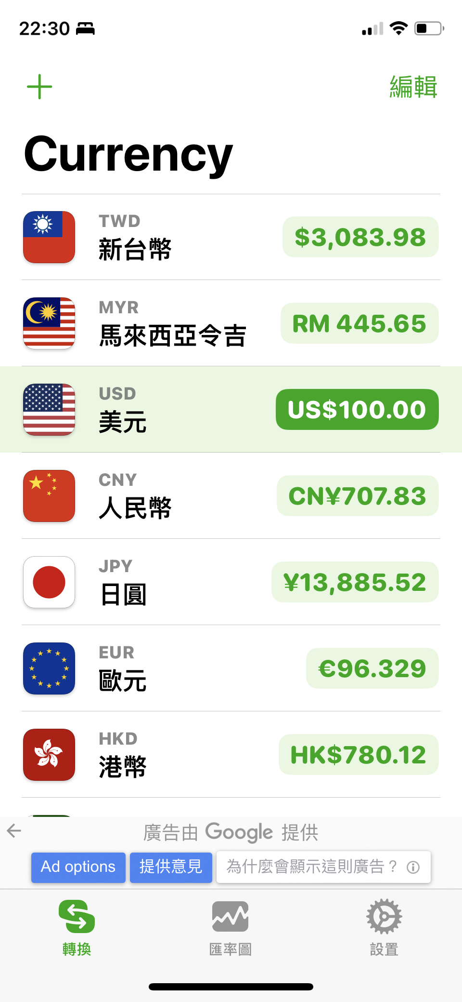
Forex

Slide 5
The Functions of the Foreign Exchange Market ₁
Two Functions
  Enables conversion of the currency of one country into the currency of another.
  Provides some insurance against foreign exchange risk—the adverse consequences of unpredictable changes in exchange rates.
Notes:
LO 10-1 Describe the functions of the foreign exchange market.

Slide 6
The Functions of the Foreign Exchange Market ₂
Currency Conversion
  To convert export receipts, income received from foreign investments, or income received from licensing agreements.
  To pay a foreign company for products or services.
  To invest spare cash for short terms in money markets.
  For currency speculation: short-term movement of funds from one currency to another in hopes of profiting from shifts in exchange rates.
    Carry trade borrows one currency where interest rates are low and invests these in another currency where interest rates are high.
Notes:
Each country has a currency in which the prices of goods and services are quoted. In the United States, it is the dollar ($); in Great Britain, the pound (£); in France, Germany, and the other 17 members of the euro zone, it is the euro (€); in Japan, the yen (¥); and so on. In general, within the borders of a particular country, one must use the national currency.
Carry trade, which involves borrowing in one currency where interest rates are low and then using the proceeds to invest in another currency where interest rates are high, has become a more common form of speculation.

Slide 7
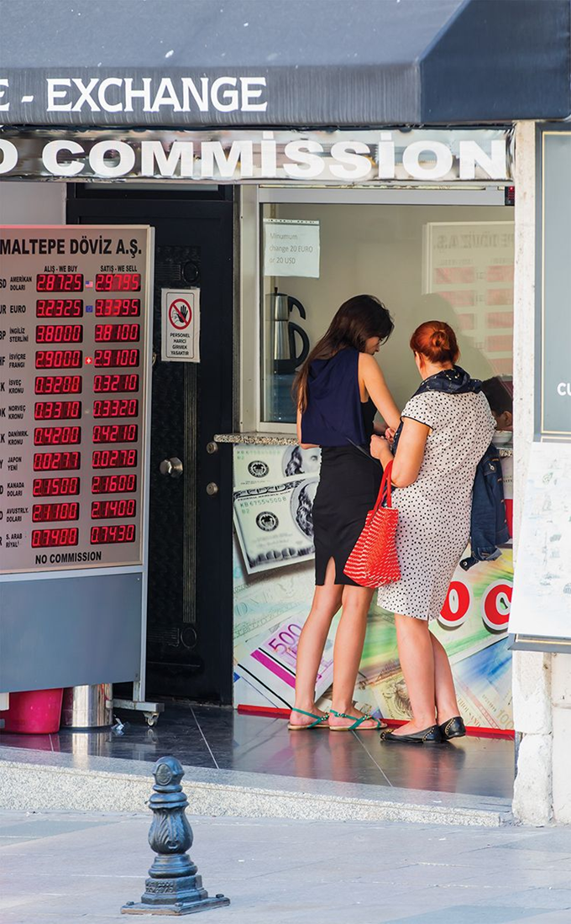
Conversion
Tourists exchanging currency in Istanbul, Turkey.
Muratart/Shutterstock

Slide 8
The Functions of the Foreign Exchange Market ₃
Insuring against Foreign Exchange Risk
The foreign exchange market can provide insurance against foreign exchange risk.
A firm that protects itself against foreign exchange risk is hedging.
The market performs this function using:
  Spot exchange rates.
  Forward exchange rates.
  Currency swaps.
Notes:
LO 10-2 Understand what is meant by spot exchange rates.

Slide 9
Spot Exchange Rates
  Rate at which a foreign exchange dealer converts one currency into another currency on a particular day.
  Determined by the interaction between supply and demand.
  Changes continually.
Notes:
Spot exchange rates are reported on a real-time basis on many financial websites. An exchange rate can be quoted in two ways: as the amount of foreign currency one U.S. dollar will buy or as the value of a dollar for one unit of foreign currency. Thus, on March 6, 2020, at 9:25 a.m., Eastern Standard Time, 1 U.S. dollar bought €0.88, and €1 euro bought US$1.13.

Slide 10
Forward Exchange Rates
遠期外匯
  The exchange rate governing a forward exchange.
  Forward exchange: two parties agree to exchange currency and execute the deal at some specific date in the future.
  Forward exchange rates are typically quoted for 30, 90, or 180 days into the future.
  Can sometimes work against a company.
Notes:
LO 10-3 Recognize the role that forward exchange rates play in insuring against foreign exchange risk.
In sum, when a firm enters into a forward exchange contract, it is taking out insurance against the possibility that future exchange rate movements will make a transaction unprofitable by the time that transaction has been executed. Although many firms routinely enter into forward exchange contracts to hedge their foreign exchange risk, sometimes this can work against the company.

Slide 11
Currency Swaps
  Simultaneous purchase and sale of a given amount of foreign exchange for two different value dates.
  Swaps are used when it is desirable to move out of one currency into another for a limited period without incurring foreign exchange rate risk.
Notes:
According to the most recent data, forward instruments account for almost two-thirds of all foreign exchange transactions, while spot exchanges account for about one-third. However, the vast majority of these forward exchanges are not forward exchanges of the type we have been discussing but rather a more sophisticated instrument known as currency swaps.

Slide 12
The Nature of the Foreign Exchange Market
Foreign Exchange Market
  Global network of banks, brokers, and foreign exchange dealers connected by electronic communications systems.
    The market is always open somewhere in the world.
  If exchange rates quoted in different markets are not the same, there would be opportunity for arbitrage—process of buying a currency low and selling it high.
  Most transactions involve U.S. dollars on one side.
  The U.S. dollar is a vehicle currency.
Notes:
The most important trading centers are London (43 percent of activity); New York (17 percent of activity); and Zurich, Tokyo, Hong Kong, and Singapore (all with around 5 to 6 percent of activity).
Due to its central role in so many foreign exchange deals, the dollar is a vehicle currency. In 2019, 88 percent of all foreign exchange transactions involved dollars on one side of the transaction. After the dollar, the most important vehicle currencies were the euro (32 percent), the Japanese yen (17 percent), and the British pound (13 percent)—reflecting the historical importance of these trading entities in the world economy.

Slide 13
Economic Theories of Exchange Rate Determination ₁
Important Factors Impacting Future Exchange Rate Movements
  A country’s price inflation.
  A country’s interest rate.
  Market psychology.
Notes:
LO 10-4 Understand the different theories explaining how currency exchange rates are determined and their relative merits.
The forces that determine exchange rates are complex, and no theoretical consensus exists, even among academic economists who study the phenomenon every day.

Slide 14
Economic Theories of Exchange Rate Determination ₂
The Law of One Price.
  In competitive markets free of transportation costs and barriers to trade, identical products sold in different countries must sell for the same price when price is in the same currency.
Purchasing Power Parity (PPP).
  Given relatively efficient markets—markets in which few impediments to international trade and investment exist—the price of a “basket of goods” should be roughly equivalent in each country.
  PPP predicts that changes in relative prices result in changes in exchange rates.
  When inflation is relatively high, a currency should depreciate.
Notes:
If the law of one price were true for all goods and services, the purchasing power parity (PPP) exchange rate could be found from any individual set of prices. By comparing the prices of identical products in different currencies, it would be possible to determine the “real,” or PPP, exchange rate that would exist if markets were efficient.
A less extreme version of the PPP theory states that given relatively efficient markets—that is, markets in which few impediments to international trade exist—the price of a “basket of goods” should be roughly equivalent in each country.

Slide 15
Economic Theories of Exchange Rate Determination ₃
Money Supply and Price Inflation.
  If we can predict inflation rates, we can predict how a currency’s value might change.
  Growth of a country’s money supply determines its likely future inflation rate.
  When the growth in the money supply is greater than the growth in output, inflation occurs.
Notes:
If an international business is attempting to predict future movements in the value of a country’s currency on the foreign exchange market, it should examine that country’s policy toward monetary growth. If the government seems committed to controlling the rate of growth in money supply, the country’s future inflation rate may be low (even if the current rate is high) and its currency should not depreciate too much on the foreign exchange market. If the government seems to lack the political will to control the rate of growth in money supply, the future inflation rate may be high, which is likely to cause its currency to depreciate.

Slide 16
Interest Rates and Exchange Rates
Fisher effect:
  a country’s nominal interest rate (i) is the sum of the required real rate of interest (r) and the expected rate of inflation over the period for which the funds are to be lent (I).
    In other words:
    i = r + I
  So, if the real interest rate is the same everywhere, any difference in interest rates between countries reflects differing expectations about inflation rates.
Notes:
Economic theory tells us that interest rates reflect expectations about likely future inflation rates. In countries where inflation is expected to be high, interest rates also will be high, because investors want compensation for the decline in the value of their money. This relationship was first formalized by economist Irvin Fisher and is referred to as the Fisher effect.

Slide 17
Interest Rates and Exchange Rates
International Fisher effect (IFE):
  for any two countries, the spot exchange rate should change in an equal amount but in the opposite direction to the difference in nominal interest rates between the two countries.
    In other words:
  where i$ and i¥ are the respective nominal interest rates in two countries (in this case, the U.S. and Japan), S₁ is the spot exchange rate at the beginning of the period and S₂ is the spot exchange rate at the end of the period.
Notes:
Do interest rate differentials help predict future currency movements? The evidence is mixed; as in the case of PPP theory, in the long run, there seems to be a relationship between interest rate differentials and subsequent changes in spot exchange rates. However, considerable short-run deviations occur. Like PPP, the international Fisher effect is not a good predictor of short-run changes in spot exchange rates.

Slide 18
Investor Psychology and Bandwagon Effects
  Bandwagon effect occurs when expectations on the part of traders turn into self-fulfilling prophecies, and traders join the bandwagon and move exchange rates based on group expectations.
    Government intervention can prevent bandwagon from starting but is not always effective.
  Investor psychology is influenced by political factors and microeconomic events.
Notes:
According to a number of studies, investor psychology and bandwagon effects play an important role in determining short-run exchange rate movements. However, these effects can be hard to predict.

Slide 19
Summary of Exchange Rate Theories
  Relative monetary growth, relative inflation rates, and nominal interest rate differentials are all moderately good predictors of long-run changes in exchange rates.
    These factors are poor predictors of short-run changes.
  So, international businesses should pay attention to countries’ differing monetary growth, inflation, and interest rates.
Notes:
Relative monetary growth, relative inflation rates, and nominal interest rate differentials are all moderately good predictors of long-run changes in exchange rates. They are poor predictors of short-run changes in exchange rates, however, perhaps because of the impact of psychological factors, investor expectations, and bandwagon effects on short-term currency movements. Unfortunately, short-term exchange rate movements are difficult to predict.

Slide 20
Exchange Rate Forecasting
The Efficient Market School
  Efficient market is one in which prices reflect all available information.
  Forward exchange rates are the best predictors of future spot exchange rates.
  Investing in forecasting services is a waste of money.
The Inefficient Market School
  Inefficient market is one in which prices do not reflect all available information.
  Forward exchange rates are not the best predictors of future spot exchange rates.
  Companies should invest in forecasting services.
Notes:
LO 10-5 Identify the merits of different approaches toward exchange rate forecasting.
It may be worthwhile for international businesses to invest in forecasting services (as many do). The belief is that professional exchange rate forecasts might provide better predictions of future spot rates than forward exchange rates do. However, the track record of professional forecasting services is not that good.

Slide 21
Approaches to Forex Forecasting
Fundamental analysis.
  Draws upon economic factors like interest rates, monetary policy, inflation rates, or balance of payments information to predict exchange rates.
Technical analysis.
  Uses price and volume data to determine past trends that are expected to continue.
  Many economists are skeptical of technical analysis.
Notes:
Fundamental analysis draws on economic theory to construct sophisticated econometric models for predicting exchange rate movements. The variables contained in these models typically include those we have discussed, such as relative money supply growth rates, inflation rates, and interest rates. In addition, they may include variables related to balance-of-payments positions.
Technical analysis is based on the premise that there are analyzable market trends and waves and that previous trends and waves can be used to predict future trends and waves. Since there is no theoretical rationale for this assumption of predictability, many economists compare technical analysis to fortune-telling. Despite this skepticism, technical analysis has gained favor in recent years.

Slide 22
Currency Convertibility
Freely convertible
  both residents and nonresidents can purchase unlimited amounts of foreign currency with the domestic currency.
Externally convertible
  only nonresidents can convert their holdings of domestic currency into a foreign currency.
Nonconvertible
  both residents and nonresidents are prohibited from converting their holdings of domestic currency into a foreign currency.
Notes:
Due to government restrictions, a significant number of currencies are not freely convertible into other currencies.

Slide 23
Currency Convertibility ₂
Governments limit convertibility to preserve foreign exchange reserves and prevent capital flight
  when residents and nonresidents rush to convert their holdings of domestic currency into a foreign currency.
In nonconvertible currency, firms may turn to countertrade—barter-like agreements by which goods and services can be traded for other goods and services—to facilitate international trade.
Notes:
How important is countertrade? Twenty years ago, a large number of nonconvertible currencies existed in the world, and countertrade was quite significant. However, in recent years, many governments have made their currencies freely convertible, and the percentage of world trade that involves countertrade is probably significantly below 5 percent.

