Slide 1
Global Supply Chain
_{(Ch. 15)}
11
  CYCU
  Prof. CK Farn
mailto: ckfarn@gmail.com
http://www.mgt.ncu.edu.tw/~ckfarn/cycu
  2024.12

Slide 2
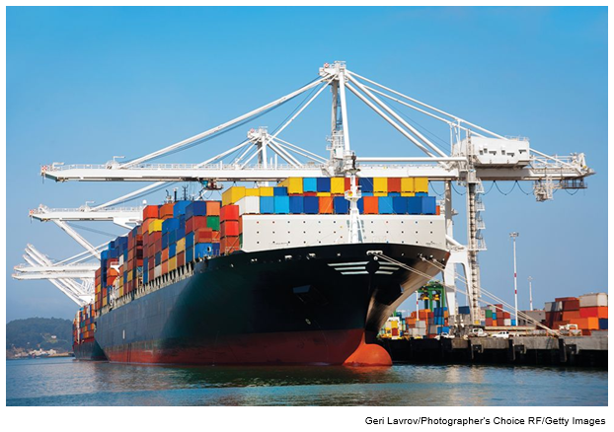
Global Supply Chain
Container ships docked at port.

Slide 3
Introduction
Interrelated Issues in Global Economy
  Where to locate production activities.
  What the long-term strategic role of foreign production sites should be.
  Whether to own or outsource foreign production activities.
  How to manage a globally dispersed supply chain and what the role of Internet-based information technology should be in the management of global logistics.
  Whether to manage global logistics or outsource.
Notes:
Given recent events, some redundancy is usually the best approach in both global production and supply chain management practices, and such redundancy often demands that a company spreads its production and supply chains across countries.
One important aspect of how successful companies run their global supply chains is that they constantly think about the total costs of their chains. A total cost focus of a global supply chain ensures that the goal is not necessarily to strive for the lowest cost possible at each stage of the supply chain (each node in the chain), but to instead strive for the lowest total cost to the customer—and, by extension, the greatest value—at the end of the product supply chain. This means that all aspects of cost—including integration and coordination of companies in the supply chain—have been incorporated in addition to the cost of raw material, component parts, and assembly worldwide.

Slide 4
Strategy, Production, and Supply Chain Management ₁
Value Creation Activities
  Production: activities involved in creating a product or service.
  Supply chain management: the procurement and physical transmission of material through the supply chain, from suppliers to customers.
    Purchasing.
    Logistics.
Notes:
LO 15-1 Explain why global production and supply chain management decisions are of central importance to many global companies.
This chapter focuses on two of these value creation activities—production and supply chain management—and attempts to clarify how they might be performed internationally to (1) lower the costs of value creation and (2) add value by better serving customer needs.
Purchasing: worldwide buying of raw material, component parts, and products used in manufacturing the product or service.
Logistics: plans, implements, and controls the effective flows and inventory of raw material, component parts, and products used in manufacturing.

Slide 5
Strategy, Production, and Supply Chain Management ₂
Strategic Objectives of the Production and Logistics Function
  To lower costs.
  To increase product quality by eliminating defective products from the upstream and downstream supply chain and manufacturing process.
    Quality refers to reliability.
Notes:
The upstream supply chain includes all of the organizations (e.g., suppliers) and resources that are involved in the portion of the supply chain from raw materials to the production facility (this is sometimes also called the inbound supply chain). The downstream supply chain includes all of the organizations (e.g., wholesaler, retailer) that are involved in the portion of the supply chain from the production facility to the end-customer (this is also sometimes called the outbound supply chain).

Slide 6
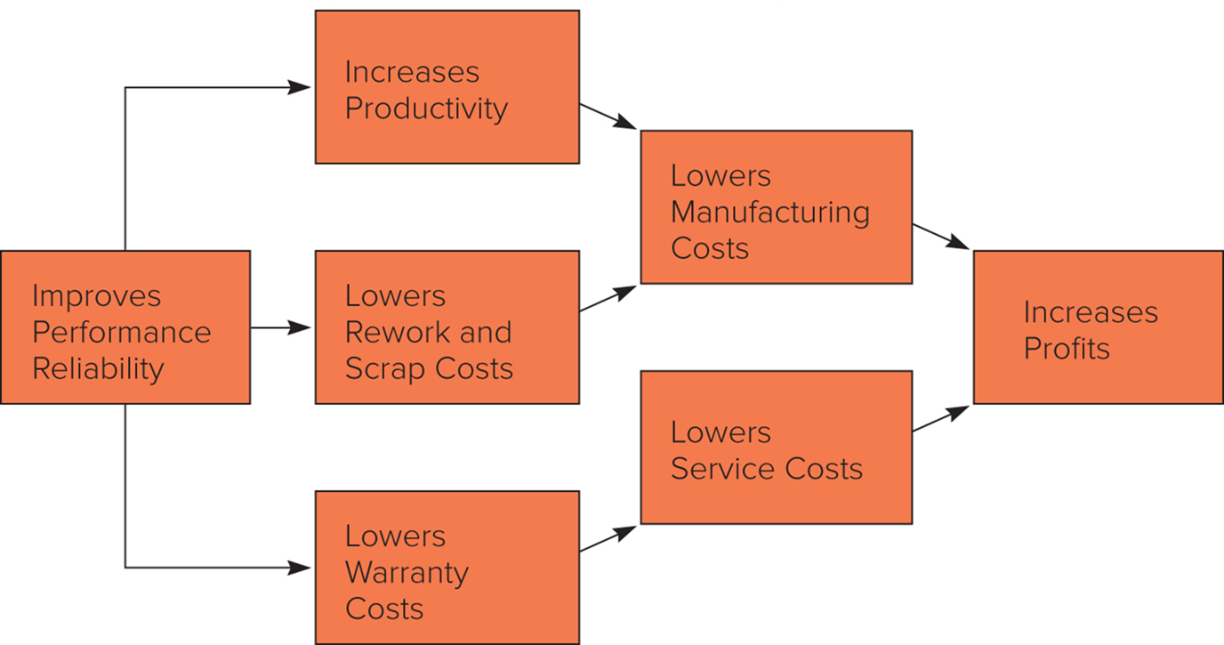
Figure 15.1 The Relationship Between Quality and Costs
Notes:
As illustrated in Figure 15.1, the firm that improves its quality control will also reduce its costs of value creation. Improved quality control reduces costs by:
Increasing productivity because time is not wasted producing poor-quality products that cannot be sold, leading to a direct reduction in unit costs.
Lowering rework and scrap costs associated with defective products.
Reducing the warranty costs and time associated with fixing defective products.

Slide 7
Strategy, Production, and Supply Chain Management ₃
Quality Improvement
  Total quality management (TQM) is a management philosophy with a central focus on the need to improve the quality of a company’s products and services.
  Six Sigma aims to reduce defects, boost productivity, eliminate waste, and cut costs throughout a company.
    Direct descendant of total quality management (TQM).
    At six sigmas, a production process would be 99.99966 percent accurate.
  Some countries have also promoted specific quality guidelines, like the E U’s I S O 9000.
Notes:
The TQM philosophy was developed by a number of American consultants such as W. Edwards Deming, Joseph Juran, and A. V. Feigenbaum. Deming identified a number of steps that should be part of any TQM program. He argued that management should embrace the philosophy that mistakes, defects, and poor-quality materials are not acceptable and should be eliminated.
The European Union requires that the quality of a firm’s manufacturing processes and products be certified under a quality standard known as ISO 9000 before the firm is allowed access to the EU marketplace.

Slide 8
Strategy, Production, and Supply Chain Management ₄
Two Other Objectives for International Companies
  Production and logistics functions must accommodate demands for local responsiveness.
  Production and supply chain management must respond quickly to shifts in customer demand.
Notes:
Demands for local responsiveness create pressures to decentralize production activities to the major national or regional markets in which the firm does business or to implement flexible manufacturing processes that enable the firm to customize the product coming out of a factory according to the market in which it is to be sold.

Slide 9
Where to Produce 1
Country Factors
  Location economies.
  Location externalities.
    Presence of global concentrations of activities.
Issues to consider
  Formal and informal trade barriers.
  Transportation costs.
  Regulations affecting FDI.
  Expected future movements in exchange rates.
Notes:
LO 15-2 Explain how country differences, production technology, and production factors all affect the choice of where to locate production activities.
Although relative factor costs may make a country look attractive as a location for performing a manufacturing activity, regulations prohibiting foreign direct investment may eliminate this option. Similarly, consideration of factor costs might suggest that a firm should source production of a certain component from a particular country, but trade barriers could make this uneconomical.

Slide 10
Where to Produce ₂
Technological Factors
  Fixed Costs.
    If costs are very high, a firm might serve the world market from a single location or from very few locations.
    If costs are very low, a firm might serve the world market from several locations at once.
  Minimum Efficient Scale.
    The level of output at which most plant-level scale economies are exhausted.
    The larger the minimum efficient scale, the more likely centralized production makes sense.
Notes:
The type of technology used in manufacturing can affect location decisions.
As in the case of low fixed costs, the advantages of a low minimum efficient scale include allowing the firm to accommodate demands for local responsiveness or to hedge against currency risk by manufacturing the same product in several locations.

Slide 11
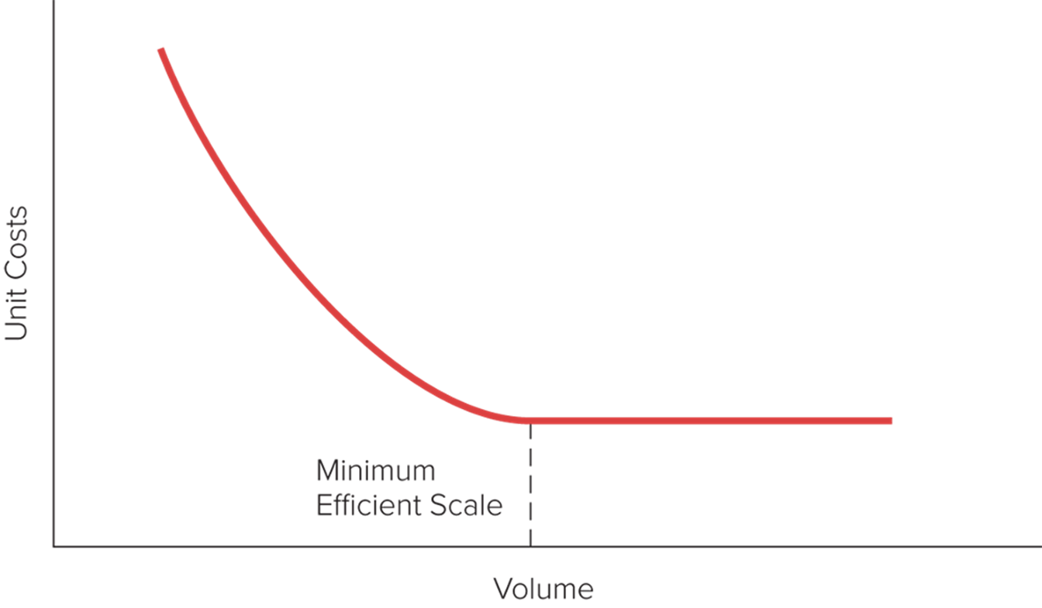
Figure 15.2 Typical Unit Cost Curve
Notes:
The level of output at which most plant-level scale economies are exhausted is referred to as the minimum efficient scale of output. This is the scale of output a plant must operate to realize all major plant-level scale economies (see Figure 15.2).

Slide 12
Where to Produce ₃
Production Factors
  Product Features.
    Value-to-weight ratio.
    Universal needs.
  Locating Production Facilities.
    Centralized location.
      Fixed costs are substantial.
      Minimum efficient scale is high.
      Flexible manufacturing technologies are available.
    Decentralizing close to major markets.
      Fixed costs and the minimum efficient scale of production are low.
      Appropriate flexible manufacturing technologies are not available.
Notes:
LO 15-3 Recognize how the role of foreign subsidiaries in production can be enhanced over time as they accumulate knowledge.
If the value-to-weight ratio is high, produce the product in a single location and export it.
If the value-to-weight ratio is low, manufacture the product in multiple locations across the world.
Universal needs are needs that are the same all over the world. If the product serves universal needs, the need for local responsiveness is reduced and concentrating production in an optimal location becomes attractive.

Slide 13
Table 15.1 Location Strategy and Production 1
Country Factors | Concentrated Production Favored | Decentralized Production Favored
Differences in political economy | Substantial | Few
Differences in culture | Substantial | Few
Differences in factor costs | Substantial | Few
Trade barriers | Few | Substantial
Location externalities | Important in industry | Not important in industry
Exchange rates | Stable | Volatile
Notes:
The appropriate strategic choice for locating production facilities is determined by the various country-specific, technological, and product factors that are summarized in Table 15.1.

Slide 14
Table 15.1 Location Strategy and Production 2
Technological Factors
Fixed costs | High | Low
Minimum efficient scale | High | Low
Flexible manufacturing technology | Available | Not available
Product Factors
Value-to-weight ratio | High | Low
Serves universal needs | Yes | No

Slide 15
Where to Produce ₄
The Hidden Costs of Foreign Locations
  High employee turnover.
  Shoddy workmanship.
  Poor product quality.
  Low productivity.
Notes:
Microsoft, for example, established a major facility in Hyderabad, India. However, the company found that the turnover rate among its Indian employees is higher than in the United States. Demand for software programmers in India is high, and many employees are prone to switch jobs to get better pay. Although Microsoft has tried to limit turnover by offering good benefits and long-term incentive pay, such as stock grants to high performers who stay with the company, many of the Indians who were hired locally apparently place little value on long-term incentives and prefer higher current pay. High employee turnover, of course, has a negative impact on productivity. One Microsoft manager in India noted that 40 percent of his core team had left within the past 12 months, making it very difficult to stay on track with development projects.

Slide 16
Make-or-Buy Decisions
Make-or-Buy Decisions
  Decisions about whether to perform a certain value creation activity in-house or outsource it to another firm.
  Main factors in the decision are cost and production capacity.
  Other factors include:
    Product success.
    Specialized knowledge.
    Strategic fit.
    Cost and production capacity.
    Supplier competencies.
    Inventory planning.
Notes:
LO 15-4 Identify the factors that influence a firm's decision of whether to source supplies from within the company or from foreign suppliers.
Make-or-buy decisions are made at both the strategic and operational levels, with the strategic level being focused on the long term and the operational level being more focused on the short term. The decision of whether to buy or make a product is a much more complex and research-intensive process than the typical global firm may expect.

Slide 17
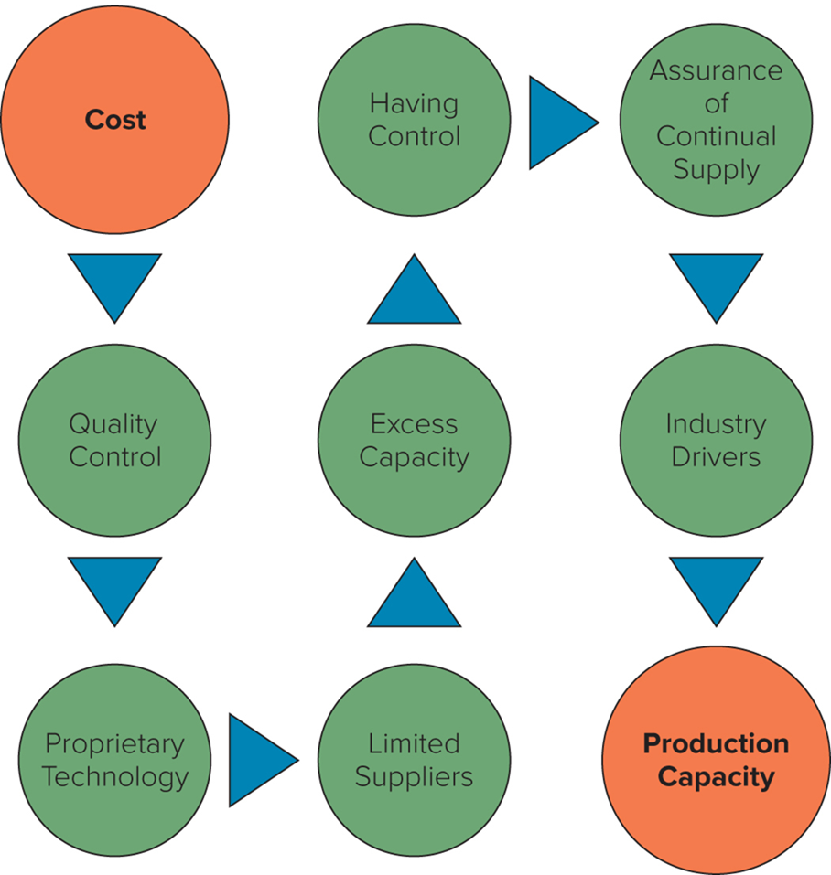
Figure 15.3 Operationally Favoring a Make Decision
Notes:
The elements that favor a make decision—beyond the core elements of cost and production capacity—include quality control, proprietary technology, having control, excess capacity, limited suppliers, assurance of continual supply, and industry drivers. After the cost and production capacity decisions have been explored and made (really, after the cost and production hurdles have been overcome), the next set of decisions follows logically from the path in Figure 15.3.

Slide 18
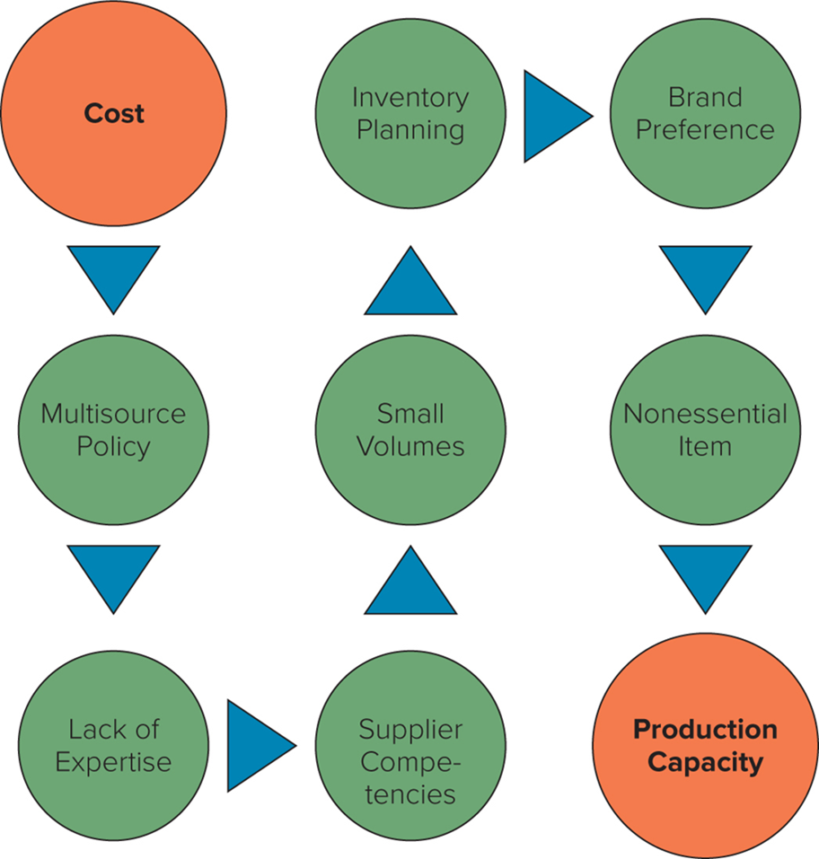
Figure 15.4 Operationally Favoring a Buy Decision
Notes:
As with the make decision, after the cost and production capacity decisions have been considered and made, the next set of decisions for the buy choice follow logically from the path in Figure 15.4.

Slide 19
Global Supply Chain Functions ₁
Global Logistics
  Core activities:
    Global distribution center management.
    Inventory management.
    Packaging and materials handling.
    Transportation.
    Reverse logistics.
Notes:
LO 15-5 Understand the functions of logistics and purchasing (sourcing) within global supply chains.

Slide 20
Global Supply Chain Functions ₂
Global Logistics continued
  Global distribution center.
    A facility that positions and allows customization of products for delivery to worldwide wholesalers, retailers, or directly to consumers anywhere in the world.
    The foundation of a global supply network.
  Global inventory management.
    The decision-making process regarding the raw materials, work-in-process, and finished goods inventory for an MNC.
Notes:
Distribution centers (DCs) are used by manufacturers, importers, exporters, wholesalers, retailers, transportation companies, and customs agencies to store products and provide a location where customization can be facilitated.
Examining the largest 20,910 global companies with headquarters in 105 countries, we find that these companies, on average across all industries, carry 14.41 percent of their total assets in some form of inventory. These companies have 32 percent of their inventory in raw materials, 18 percent of their inventory in work-in-process, and 50 percent of their inventory in finished goods.

Slide 21
Global Supply Chain Functions ₃
Global Logistics continued
  Packaging: three different categories.
    Primary packaging holds the product itself.
    Secondary packaging contains several primary packages.
    Transit packaging is used to transport primary and secondary packages.
  The functions of packaging are to perform, protect, and inform.
Notes:
Perform refers to (1) the ability of the product in the package to handle being transported between nodes in the global supply chain, (2) the ability of the product to be stored for typical lengths of time for a particular product category, and (3) the package providing the convenience expected by both the supply chain partners and the end-customers.
Protect refers to the package’s ability to (1) contain the products properly, (2) preserve the products to maintain their freshness or newness, and (3) provide the necessary security and safety to ensure that the products reach their end destination in their intended shape.
Inform refers to the package’s inclusion of (1) logical and sufficient instructions for the use of the products inside the package, including specific requirements to satisfy local regulations; (2) a statement of a compelling product guarantee; and (3) information about service for the product if and when it is needed.

Slide 22
Global Supply Chain Functions ₄
Global Logistics continued
  Transportation.
    Movement of raw material, component parts, and finished goods throughout the global supply chain.
    Largest percentage of any logistics budget.
    Ocean is the least expensive and air is the most expensive.
  Reverse logistics.
    Process of moving inventory from point of consumption to point of origin for the purpose of recapturing value or proper disposal.
    Ultimate goal is to optimize the after-market activity or make it more efficient.
Notes:
Transportation rates are heavily influenced by economies of scale, so larger shipments are typically relatively less expensive than smaller shipments. The characteristics of the shipment lso influence transportation rates through such factors as product density, value, perishability, the potential for damage, and other such factors. Finally, oil prices have a major impact on transportation rates because anywhere from 10 to 40 percent of most carrier costs, depending on the mode, are related to fuel.

Slide 23
Global Supply Chain Functions ₅
Global Purchasing
  Five strategic levels:
    Level I: domestic purchasing activities only.
    Level I I: international purchasing only as needed.
    Level I I I: international purchasing as part of firm’s overall supply chain management strategy.
    Level I V: global purchasing activities that are integrated across the firm’s locations worldwide.
    Level V: global purchasing activities that are integrated across worldwide locations and functional groups.
Notes:
Beyond the domestic, international, and global purchasing strategies in levels I through V, purchasing includes a number of basic choices that companies make in deciding how to engage with markets. The starting point is a choice of internal purchasing versus external purchasing—in other words, “how to purchase.” The next decision, in both internal and external purchasing, is to figure out “where to purchase” (domestically or globally). This takes us ultimately to the “types of purchasing” (where and how) and the four choices for purchasing strategy: domestic internal purchasing, global internal purchasing, domestic external purchasing, and global external purchasing.

Slide 24
Table 15.2 Outsourcing Terms and Options
Outsourcing | A multinational corporation buys products or services from one of its suppliers that produces them somewhere else, whether domestically or globally.
Insourcing | A multinational corporation decides to stop outsourcing products or services and instead starts to produce them internally; insourcing is the opposite of outsourcing.
Offshoring | A multinational corporation buys products or services from one of its suppliers that produces them somewhere globally (outside the MNCs home country).
Offshore outsourcing | A multinational corporation buys products or services from one of its suppliers in a country other than the one in which the product is manufactured or the service is developed.
Nearshoring | A multinational corporation transfers business or information technology processes to suppliers in a nearby country, often one that shares a border with the firm’s own country.
Co-sourcing | A multinational corporation uses both its own employees from inside the firm and an external supplier to perform certain tasks, often in concert with each other. This applies to all four forms of purchasing strategy.
Notes:
Table 15.2 outlines the outsourcing-related terms and options that companies have, especially the following terms that are often confusing to understand, develop strategy around, and implement: outsourcing, insourcing, offshoring, offshore outsourcing, nearshoring, and co-sourcing.

Slide 25
Managing a Global Supply Chain ₁
Efficient Supply Chain Management
  Can have a substantial impact on a firm’s profitability.
  Four important areas:
    Just-in-time inventory.
    Information technology.
    Coordination.
    Interorganizational relationships.
Notes:
LO 15-6 Describe what is required to efficiently manage a global supply chain.
For the typical manufacturing enterprise, material costs account for between 50 and 70 percent of revenues, depending on the industry. Even a small reduction in these costs can have a substantial impact on profitability.

Slide 26
Managing a Global Supply Chain ₂
Role of Just-in-Time (JIT) Inventory
  Economizes on inventory holding costs by having materials arrive at a manufacturing plant just in time to enter the production process, and not before.
    Can result in major cost savings from reduced warehousing and inventory holding costs.
    Can help firms spot defective parts, take them out of the manufacturing process, and boost product quality.
  But leaves firms without a buffer stock of inventory, which makes it difficult to respond quickly to problems.
Notes:
To reduce the risks associated with depending on one supplier for an important input, some firms source these inputs from several suppliers located in different countries. While this may not help in the case of an event with global ramifications—such as September 11, 2001, in the United States, or the 2020 COVID19 pandemic—it does help manage country-specific supply disruptions, which are more common. Strategically, all global companies need to build in some degree of redundancy in supply chains by having multiple options for suppliers.

Slide 27
Managing a Global Supply Chain ₃
Role of Information Technology
  Information systems allow firms to optimize production scheduling.
  Electronic Data Interchange (EDI).
  Less expensive systems now exist, making it easier for companies of all sizes to access.
  Blockchain technology is an additional layer in the system.
Notes:
Electronic data interchange (EDI) refers to the electronic interchange of data between two or more companies.
Enterprise resource planning (ERP) is a wide-ranging business planning and control system that includes supply chain-related subsystems (e.g., materials requirements planning, or MRP).
Collaborative planning, forecasting, and replenishment (CPFR) was developed to fill the inter-organizational connections that ERP cannot fill. Vendor management of inventory (VMI) allows for a holistic overview of the supply chain with a single point of control for all inventory management.
A warehouse management system (WMS) often operates in concert with ERP systems; for example, an ERP system defines material requirements, and these are transmitted to a distribution center for a WMS.
Blockchain technology makes it possible for ecosystems of supply chain partners (or any business partners) to share and agree upon key pieces of information. Blockchain technology refers to a distributed electronic ledger that has the capacity to record a variety of transaction types, such as those that occur within a supply chain.

Slide 28
Managing a Global Supply Chain ₄
Coordination in Global Supply Chains
  Global supply chain coordination: the shared decision-making opportunities and operational collaboration of key global supply chain activities.
    A more integrated, coherent, efficient, and effective supply chain.
  Operational objectives:
    Responsiveness.
    Variance reduction.
    Inventory reduction.
    Shipment consolidation.
    Quality.
    Life-cycle support.
Notes:
Responsiveness refers to a global firm’s ability to satisfy customers’ requirements across global supply chain functions in a timely manner.
Variance reduction refers to integrating a control system across global supply chain functions to eliminate global supply chain disruptions.
Inventory reduction refers to integrating an inventory system, controlling asset commitment, and turning velocity across global supply chain functions.
Shipment consolidation refers to using various programs to combine small shipments and provide timely, consolidated movement. This includes multiunit coordination across global supply chain functions.
Quality refers to integrating a system so that it achieves zero defects throughout global supply chains.
Life-cycle support refers to integrating the activities of reverse logistics, recycling, after-market service, product recall, and product disposal across global supply chain functions.

Slide 29
Managing a Global Supply Chain ₅
Interorganizational Relationships
  Trust and commitment between interacting organizations are important to an efficient and effective global supply chain.
Notes:
Interorganizational relationships have been studied and talked about in various contexts for decades. The two keys are trust and commitment. If we always had 100 percent trust in relationships and 100 percent commitment to them, most global supply chains would ultimately be efficient and effective.

Slide 30
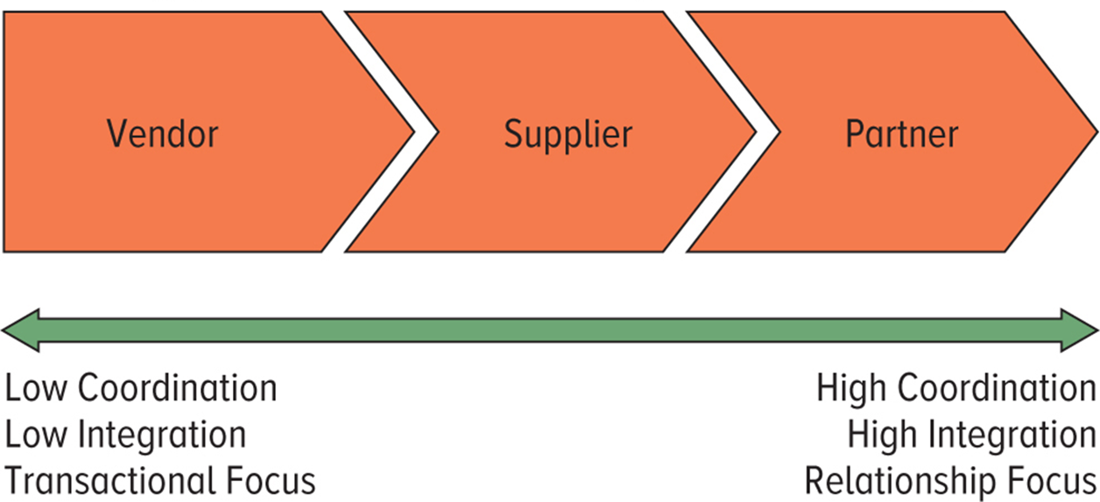
Figure 15.5 Upstream/Inbound Relationships
Notes:
For the upstream/inbound portion of the global supply chain, the three logical scenarios of interacting organizations are labeled as vendors, suppliers, and partners. Each scenario is based on the degree of coordination, integration, and transactional versus relationship emphasis that the firm should adopt in partnering with other entities in the global supply chain.

Slide 31
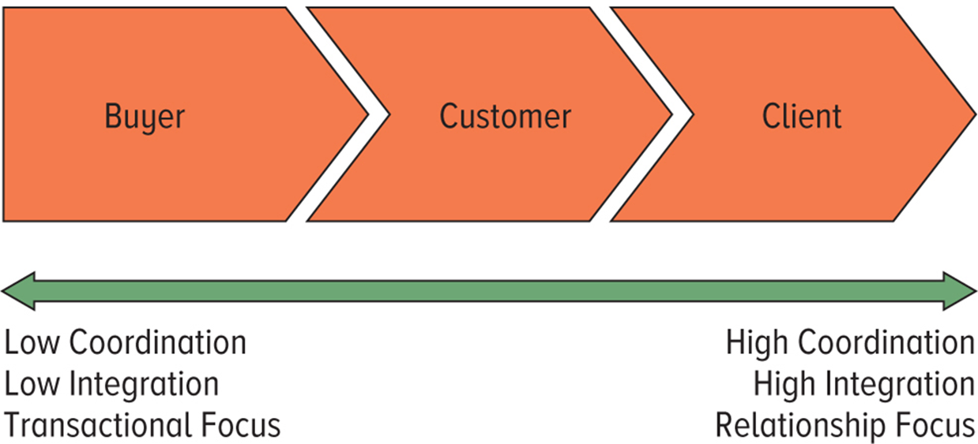
Figure 15.6 Downstream/Outbound Relationships
Notes:
For the downstream/outbound portion of the global supply chain, the three logical scenarios of interacting organizations are labeled as buyers, customers, and clients. As with the upstream/inbound examples, each downstream/outbound scenario is based on the degree of coordination, integration, and transactional versus relationship focus that the firm should adopt in partnering with other entities in the global supply chain.

Slide 32
Impact of the Macro Environment
Stresses on Global Supply Chain
  Rising tariff barriers.
  Trade war between U.S. and China.
  Britain’s exit from the European Union.
  America’s retreat from proposed regional trade agreements (Trans-Pacific Partnership).
  Emergence of virus responsible for COVID-19 disease.
  Recent turmoil has increased attractiveness of a real hedging strategy.
    Other changes also impact supply chain decisions.
    Managers must continually scan global environment.
Notes:
The turmoil of the last few years has highlighted how difficult it can be to predict the future and has increased the attractiveness of a real hedging strategy where a company decides to produce and/or source products from several different nations, as opposed to a single nation, even though at any given point in time, one nation may seem to be significantly more attractive than the others.
Redundancy in supply chains can have a strategic value that goes beyond apparent cost advantages at any one point in time, allowing an enterprise to create a hedge against future changes in the attractiveness of different nations. Thus, while a few years ago it might have seemed somewhat inefficient to simultaneously source from India, Brazil, and Poland, in addition to China, today such a strategy might seem prescient.

