Slide 1
Global Marketing
_{(Ch. 16)}
12
  CYCU
  Prof. CK Farn
mailto: ckfarn@gmail.com
http://www.mgt.ncu.edu.tw/~ckfarn/cycu
  2024.12

Slide 2

Opening Case
Share a Coke
  Coca-Cola is one of the most recognizable brands in the world.
    Sold in over 200 countries worldwide.
    Brand emphasis—selling “happiness” in a bottle.
  “Share a Coke” campaign developed in Australia to increase sales to millennials.
    Campaign hugely successful, increased demand.
Chayut Orapinpatipat/Shutterstock
Localized “Share a Coke” ads reach over 80 countries in 7 years.
Notes:
Coca-Cola is one of the most recognizable brands in the world. Coca-Cola is the iconic American drink that has become a global staple. The company sells its flagship brand in more than 200 countries worldwide across six operating regions: Asia Pacific, Europe, Africa, Middle East, Latin America, and North America. A significant part of Coca-Cola’s success has always been its emphasis on brand over product. Coke doesn’t sell a drink in a bottle, it sells “happiness” in a bottle. Coke sells consumers the experience and lifestyle associated with its brand.
The great strength of the “Share a Coke” campaign? It gave consumers the opportunity to express themselves through a bottle of Coke, and to share that experience with someone else.
Sources: “How a Groundbreaking Campaign Got Its Start Down Under,” The Coca-Cola Company, September 24, 2014; Daniel Codella, “The Winning Coca-Cola Formula for a Successful Campaign,” Business 2 Community, May 7, 2019; Nathalie Tadena, “Coke’s Personalized Marketing Campaign Gains Online Buzz,” The Wall Street Journal, July 15, 2014.

Slide 3
Introduction ₁
Global Marketing, Business Analytics, and R&D
  Can reduce costs of value creation and add value by better serving customer needs in the global marketplace.
    Includes distribution strategy.
  Mass production of a standardized product can generate unit cost reductions, but ignoring country differences in consumer tastes can lead to failure.
Notes:
A global marketing strategy that views the world’s consumers as similar in their tastes and preferences is consistent with the mass production of a standardized output. By mass-producing a standardized output—whether it be soap, semiconductor chips, Coca-Cola, or high-end apparel—the firm can realize substantial unit cost reductions from experience curve effects and other economies of scale. At the same time, ignoring country differences in consumer tastes and preferences can lead to failure.

Slide 4
Introduction ₂
Marketing Function
  Identifies gaps in the market so firm can develop new products to fill those gaps.
  Marketing mix: the choices the firm offers to its targeted market.
    Product attributes.
    Distribution strategy (place).
    Communication strategy (promotion).
    Pricing strategy.
Notes:
The best way to think about the marketing mix is that it represents the tactical activities and behaviors that are implemented by a global company based on its international marketing strategy to offer the best possible “mix” of product, distribution, communication, and price to a specific target market in a country or region.

Slide 5
Globalization of Markets and Brands
Globalization of World Markets
  Theodore Levitt: world markets are becoming increasingly similar, making it unnecessary to localize the marketing mix.
  May be true for bulk industrial products, but not necessarily for consumer products.
    Consumers may prefer local options if they exist.
  Trade barriers and differences in product and technical standards also limit the ability of firms to sell a standardized product to a global market.
Notes:
Levitt’s remarks have become a lightening rod in the debate about globalization. However, many academics feel that Levitt overstates his case. Although he may have a point when it comes to many basic industrial products, such as steel, bulk chemicals, and semiconductors, globalization in the sense used by Levitt seems to be the exception rather than the rule in many consumer goods markets and industrial markets.
While we clearly see more homogenization and standardization of needs and wants among younger people, typically 40 years and younger, there are still wide gaps in tastes among older people. What will be interesting to find out is if this increased homogenization among younger people will remain when they become older.

Slide 6
Market Segmentation
Identifying distinct groups of consumers whose needs, wants, and purchasing behavior differs from others in important ways.
  Geography.
  Demography.
  Sociocultural factors.
  Psychological factors.
Notes:
Because different segments exhibit different needs, wants, and patterns of purchasing behavior, firms often adjust their marketing mix from segment to segment. Thus, the precise design of a product, the pricing strategy, the distribution channels used, and the choice of communication strategy may all be varied from segment to segment.

Slide 7
Market Segmentation in Foreign Countries
Firms must:
  Adjust their marketing mix from segment to segment.
  Be aware of differences between countries in the structure of market segments.
  Consider intermarket segments that transcend national borders.
    Predicted to become more common.
    Global youth segment suggests there are common values among teens around the world.
Notes:
Strategically, marketing managers have marketing mix options with these two choices. Targeting one country and its multiple potential market segments with multiple marketing mixes allows a company to focus on the cultural characteristics of one country (or the characteristics of a manageable set of countries). Targeting many countries and the intermarket segment that has characteristics that are largely the same across countries allows a company to focus on the cultural characteristics that are universal for certain customers across countries.

Slide 8
Business Analytics ₁
Business Analytics
  Knowledge, skills, and technology that allow for exploration of a company’s international strategies to drive future development and implementation.
    Begins with a dataset.
    Big data stored on large-scale server.
  Three core applications:
    Descriptive analytics.
    Predictive analytics.
    Prescriptive analytics.
Notes:
LO 16-1 Understand the importance of business analytics and international market research.
Descriptive analytics refers to the use of relatively simple statistical techniques to describe what is contained in a dataset.
Predictive analytics can be defined as the use of advanced statistical techniques (and software) to identify and build predictive models that can help to identify trends and relationships not readily observed in descriptive analyses.
Prescriptive analytics can be defined as the use of management science methodologies (i.e., applied mathematical techniques) to guide a company in its endeavors to best use allocable resources.

Slide 9
Business Analytics ₂
International Marketing Research
  International market research: systematic collection, recording, analysis, and interpretation of data.
  All firms want basic data.
    Data on country and potential market segments.
    Data to forecast customer demands within specific area.
    Data to make marketing mix decisions.
Notes:
Compared with market research that is domestic only, international market research involves additional issues such as (1) translation of questionnaires and reports into appropriate foreign languages and (2) accounting for cultural and environmental differences in data collection.
A sample of prominent international market research firms includes Nielsen, Kantar, Ipsos, and the NPD Group.

Slide 10

Figure 16.1
International Market Research Steps
Notes:
Defining the research objectives includes both (1) defining the research problem and (2) setting objectives for the international market research.
Determining the data sources that will address specific research problems and ultimately achieve the objectives is often not an easy task, especially if the international market research spans more than one country market. In market research, we talk about two forms of data that can be used: primary and secondary data.
Assessing the costs and benefits of the research often relates to the cost of collecting primary data that can address the research problem and objectives directly versus using available secondary data. If secondary data are available, such data are typically available as a less costly alternative to collecting primary data.
Collecting the data simply refers to gathering data via primary or secondary methods that address the research problem and objectives that the global company has established.
Analyzing and interpreting the research begins when the data have been collected.
Reporting the research findings is a way to communicate the overall results of the international market research project.

Slide 11
Product Attributes 1
Product Attributes
  Products can be viewed as a bundle of attributes.
  Products sell well when attributes match consumer needs.
  Consumer needs vary from country to country.
    Culture.
    Levels of economic development.
  Ability to sell the same product worldwide is limited.
Notes:
LO 16-2 Explain why it might make sense to vary the attributes of a product from country to country.
A product can be viewed as a bundle of attributes. For example, the attributes that make up a car include power, design, quality, performance, fuel consumption, and comfort; the attributes of a hamburger include taste, texture, and size; a hotel’s attributes include atmosphere, quality, comfort, and service.

Slide 12
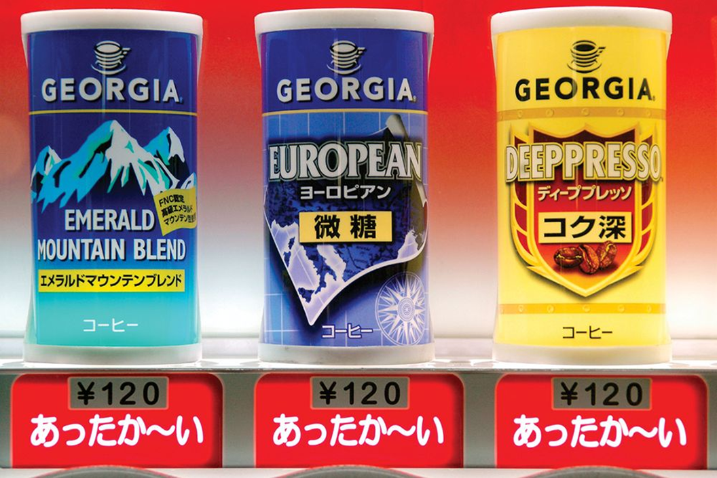
Product Attributes 2
Cultural Differences
  Tradition.
  Social structure.
  Language.
  Religion.
  Education.
Phillip Augustavo/Alamy Stock Photo
Takayama vending machine coffee in Japan.
Notes:
Tradition is particularly important in foodstuffs and beverages.

Slide 13
Product Attributes ₃
Economic Development
  Consumers in highly developed countries tend to demand a lot of extra performance attributes in their products.
  Consumers in less developed nations tend to prefer more basic products.
  Contrary to Levitt’s suggestions, consumers in most developed countries are not willing to sacrifice preferred attributes for lower prices.
Notes:
Consumers in the most advanced countries often shun globally standardized products that have been developed with the lowest common denominator in mind. They are willing to pay more for products that have additional features and attributes customized to their tastes and preferences. For example, demand for top-of-the-line four-wheel-drive sport-utility vehicles—such as Chrysler’s Jeep, Ford’s Explorer, and Toyota’s Land Cruiser—has been largely restricted to the United States.

Slide 14
Product Attributes ₄
Product and Technical Standards
  Regional trade agreements may influence certain regional markets to become more globalized.
  Differing government-mandated standards can force companies to rule out mass production and constrain globalization of markets.
  Differing technical standards limit the globalization of markets.
Notes:
Even with the forces that are creating some convergence of consumer tastes and preferences among advanced, industrialized nations, Levitt’s vision of global markets may still be a long way off.

Slide 15
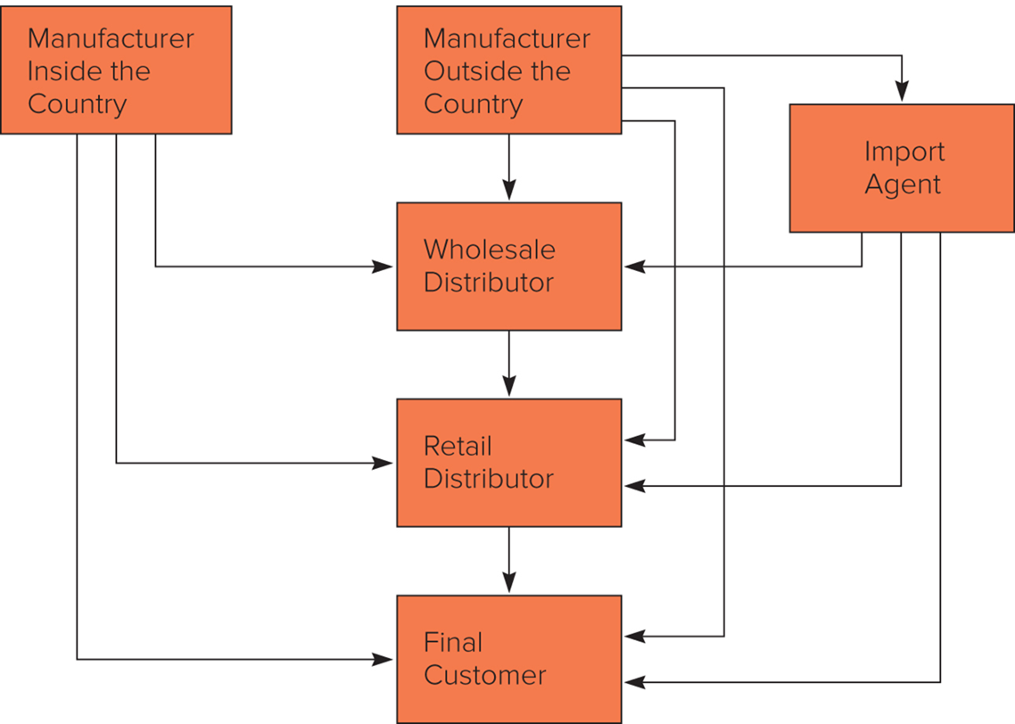
Figure 16.2 A Typical Distribution System
Notes:
Figure 16.2 illustrates a typical distribution system consisting of a channel that includes a wholesale distributor and a retailer.
A firm’s distribution strategy (the means it chooses for delivering the product to the consumer) is a critical element of the marketing mix. If the firm manufacturers its product in the particular country, it can sell directly to the consumer, to the retailer, or to the wholesaler. The same options are available to a firm that manufactures outside the country, or the firm could sell to an import agent.

Slide 16
Distribution Strategy ₁
Differences between Countries
  Retail Concentration.
    In a concentrated system, a few retailers supply most of the market.
    In a fragmented system, there are many retailers, none of which has a major share of the market.
Notes:
LO 16-3 Recognize why and how a firm’s distribution strategy might vary among countries.
There is a tendency for greater retail concentration in developed countries. Three factors that contribute to this are the increases in car ownership, the number of households with refrigerators and freezers, and the number of two-income households.
In contrast, retail systems are very fragmented in many developing countries, which can make for interesting distribution challenges.

Slide 17
Distribution Strategy ₂
Differences between Countries _{continued}
  Channel Length.
    The number of intermediaries between the producer and the consumer.
      When the producer sells directly to the consumer, the channel is very short.
      When the producer sells through an import agent, a wholesaler, and a retailer, a long channel exists.
    Fragmented retail systems tend to have longer channels.
      Example: Japan.
    Entry of large discount superstores is shortening channel length in some countries.
Notes:
When the retail sector is very concentrated, it makes sense for the firm to deal directly with retailers, cutting out wholesalers. A relatively small sales force is required to deal with a concentrated retail sector, and the orders generated from each sales call can be large. Such circumstances tend to prevail in the United States, where large food companies may sell directly to supermarkets rather than going through wholesale distributors.

Slide 18
Distribution Strategy ₃
Differences between Countries continued
  Channel Exclusivity.
    An exclusive distribution channel is one that is difficult for outsiders to access.
    Retailers usually prefer to carry products from established manufacturers.
      Japan's system is an example of a very exclusive system.
Notes:
In Japan, relationships among manufacturers, wholesalers, and retailers often go back decades. Many of these relationships are based on the understanding that distributors will not carry the products of competing firms.

Slide 19
Distribution Strategy ₄
Differences between Countries _{continued}
  Channel Quality.
  The expertise, competencies, and skills of established retailers in a nation and their ability to sell and support the products of international businesses.
  The quality of retailers is good in most developed countries but is variable at best in emerging markets and less developed countries.
  Poor quality channel can impede market entry.
Notes:
When channel quality is poor, an international business may have to devote considerable attention to upgrading the channel, for example, by providing extensive education and support to existing retailers and, in extreme cases, by establishing its own channel.

Slide 20
Distribution Strategy ₅
Choosing a Distribution Strategy
  The choice depends on the relative costs and benefits of each alternative.
  Each intermediary adds its own markup to the products—there is a link between channel length, final selling price, and profit margin.
    If price is important, a shorter channel is better.
    If a retail sector is very fragmented, a long channel is better.
  Consider less traditional alternatives to gain market access.
Notes:
A choice of distribution strategy determines which channel the firm will use to reach potential consumers. The optimal strategy is determined by the relative costs and benefits of each alternative, which vary from country to country, depending on the four factors just discussed.
Firms might want to consider other, less traditional alternatives to gaining market access. For example, frustrated by channel exclusivity in Japan, some foreign manufacturers of consumer goods have attempted to sell directly to Japanese consumers using direct mail and catalogs. If channel quality is poor, a firm should consider what steps it could take to upgrade the quality of the channel, including establishing its own distribution channel.

Slide 21
Communication Strategy ₁
Communication Channels
  Social media.
  Direct selling.
  Sales promotion.
  Forms of advertising.
Notes:
LO 16-4 Identify why and how advertising and promotional strategies might vary among countries.
Prior to social media, firms were able to “signal” what type of product or service they offered in the global marketplace. Today, that messaging is collectively done by customers and the companies.
Consequently, multinational corporations need to have active, interactive social media platforms to go along with the more traditional direct selling, sales promotion, and various forms of advertising that they use.

Slide 22
Communication Strategy ₂
Barriers to International Communication
  Cultural Barriers.
    Can make it difficult to communicate messages across cultures.
    Develop cross-cultural literacy to combat this.
  Source and Country of Origin Effects.
    Source effects: when receiver of message evaluates it based on status or image of sender.
    Country of origin effects: the extent to which the place of manufacturing influences product evaluations.
  Noise Levels.
    Number of other messages competing for potential consumer’s attention.
Notes:
Source effects and country of origin effects are not always negative. French wine, Italian clothes, and German luxury cars benefit from nearly universal positive source effects. In such cases, it may pay a firm to emphasize its foreign origins.

Slide 23
Communication Strategy 3
Push versus Pull Strategies
  Push strategy emphasizes personal selling.
  Pull strategy emphasizes mass media advertising.
  Factors that affect this decision:
    Product type and consumer sophistication.
    Channel length.
    Media availability.
Notes:
Although some firms employ only a pull strategy and others only a push strategy, still other firms combine direct selling with mass advertising to maximize communication effectiveness.

Slide 24
Pricing Strategy 1
Price Discrimination
  Firms can maximize profits through price discrimination.
    Consumers in different countries are charged different prices for the same product or for slightly different variations of the product.
    The firm must be able to keep national markets separate.
    Different price elasticities of demand must exist in different countries.
Notes:
LO 16-5 Explain why and how a firm's pricing strategy might vary among countries.
International pricing strategy is an important component of the overall international marketing mix. Price discrimination involves charging whatever the market will bear; in a competitive market, prices may have to be lower than in a market where the firm has a monopoly.

Slide 25
Pricing Strategy ₂
Price Discrimination continued
  Price elasticity of demand: measures how responsive demand for a product is to changes in price.
    Demand is elastic when a small change in price produces a large change in demand.
    Demand is inelastic when a large change in price produces only a small change in demand.
    Elasticity of demand is determined by income level and competitive conditions.
      Price elasticities tend to be greater in countries with lower income levels and more competitors.
Notes:
In general, the more competitors there are, the greater consumers’ bargaining power will be, and the more likely consumers will be to buy from the firm that charges the lowest price.

Slide 26
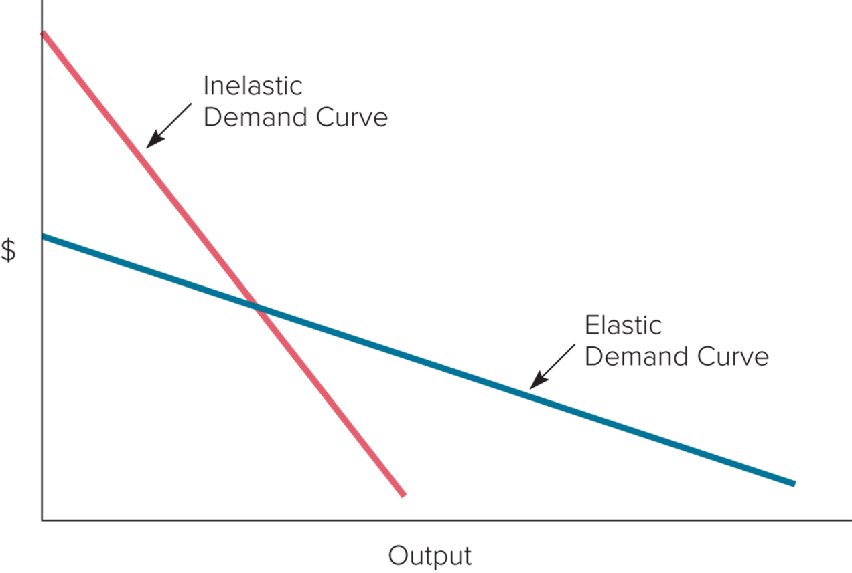
Figure 16.3 Elastic and Inelastic Demand Curves
Notes:
Figure 16.3 illustrates elastic and inelastic demand curves. Generally, a firm can charge a higher price in a country where demand is inelastic.

Slide 27
Pricing Strategy 3
Strategic Pricing
  Predatory Pricing.
    Profit gained in one market is used to support aggressive pricing designed to drive competitors out in another market.
  Multipoint Pricing.
    A firm’s pricing strategy in one market may have an impact on a rival’s pricing strategy in another market.
    Aggressive pricing in one market can prompt a competitive response from a rival in another market.
    Central monitoring of pricing decisions around the world is important.
Notes:
Strategic pricing involves pricing aimed at giving a company a competitive advantage over its rivals.

Slide 28
Configuring the Marketing Mix
The Marketing Mix
  Today, younger customers are more willing to engage in a “global” way.
  Standardization of marketing mix is the norm in some industries.
    McDonald’s might seem standardized worldwide, but its menu varies from country to country.
  Customization versus standardization is not an all-or-nothing issue.
  A truly “globalized” product is generally an illusion.
Notes:
LO 16-6 Understand how to configure the marketing mix globally.
The movie industry and the financial services industry are often thought of as industries in which global standardization of the marketing mix is the norm. A financial services company such as American Express sells the same basic charge card service worldwide, utilizes the same basic fee structure for that product, and adopts the same basic global advertising message (“Don’t leave home without it”). That said, Amex also runs into differences in national regulations, which means that it still has to vary aspects of its communication strategy from country to country.

Slide 29
Product Development and R&D ₁
International Marketing, R&D, and Manufacturing
  Firms need to develop and market new products.
  Technological innovation is important in new product development.
    Technology can make a host of new products available.
    Technology can make established products obsolete overnight.
    Product life cycles are shorter than in the past because technological innovation generates “creative destruction.”
Notes:
LO 16-7 Describe how globalization is affecting product development.
Firms need to invest in R&D and apply the technology to developing products that meet consumer needs and that can be manufactured in a cost-effective way.

Slide 30
Product Development and R&D ₂
The Location of R&D
  New product ideas come from the interactions of scientific research, demand conditions, and competitive conditions.
  New product development is greater when:
    More is spent on basic and applied research and development.
    Demand is strong.
    Consumers are affluent.
    Competition is intense.
  U.S. no longer always considered the lead market.
Notes:
Over the past 25 years, things have been changing quickly. The U.S. monopoly on new product development has weakened considerably. Although U.S. firms are still at the leading edge of many new technologies, Asian and European firms are also strong players. As a result, it is often no longer appropriate to consider the United States as the lead market. Because leading-edge research is now carried out in many locations around the world, the argument for centralizing R&D activity in the United States is not as strong as it was three decades ago.

