Slide 1
Quality Control (Ch.10)
8
CYCU
Prof. CK Farn
mailto: ckfarn@gmail.com
http://www.mgt.ncu.edu.tw/~ckfarn/cycu
2024.11

Slide 2
What Is Quality Control?
A process that evaluates output relative to a standard and takes corrective action when output doesn’t meet standards
If results are acceptable no further action is required
Unacceptable results call for correction action
Inspection alone is not sufficient to achieve a reasonable level of quality
Most organizations rely upon some inspection and a great deal of process control to achieve an acceptable level of quality

Slide 3
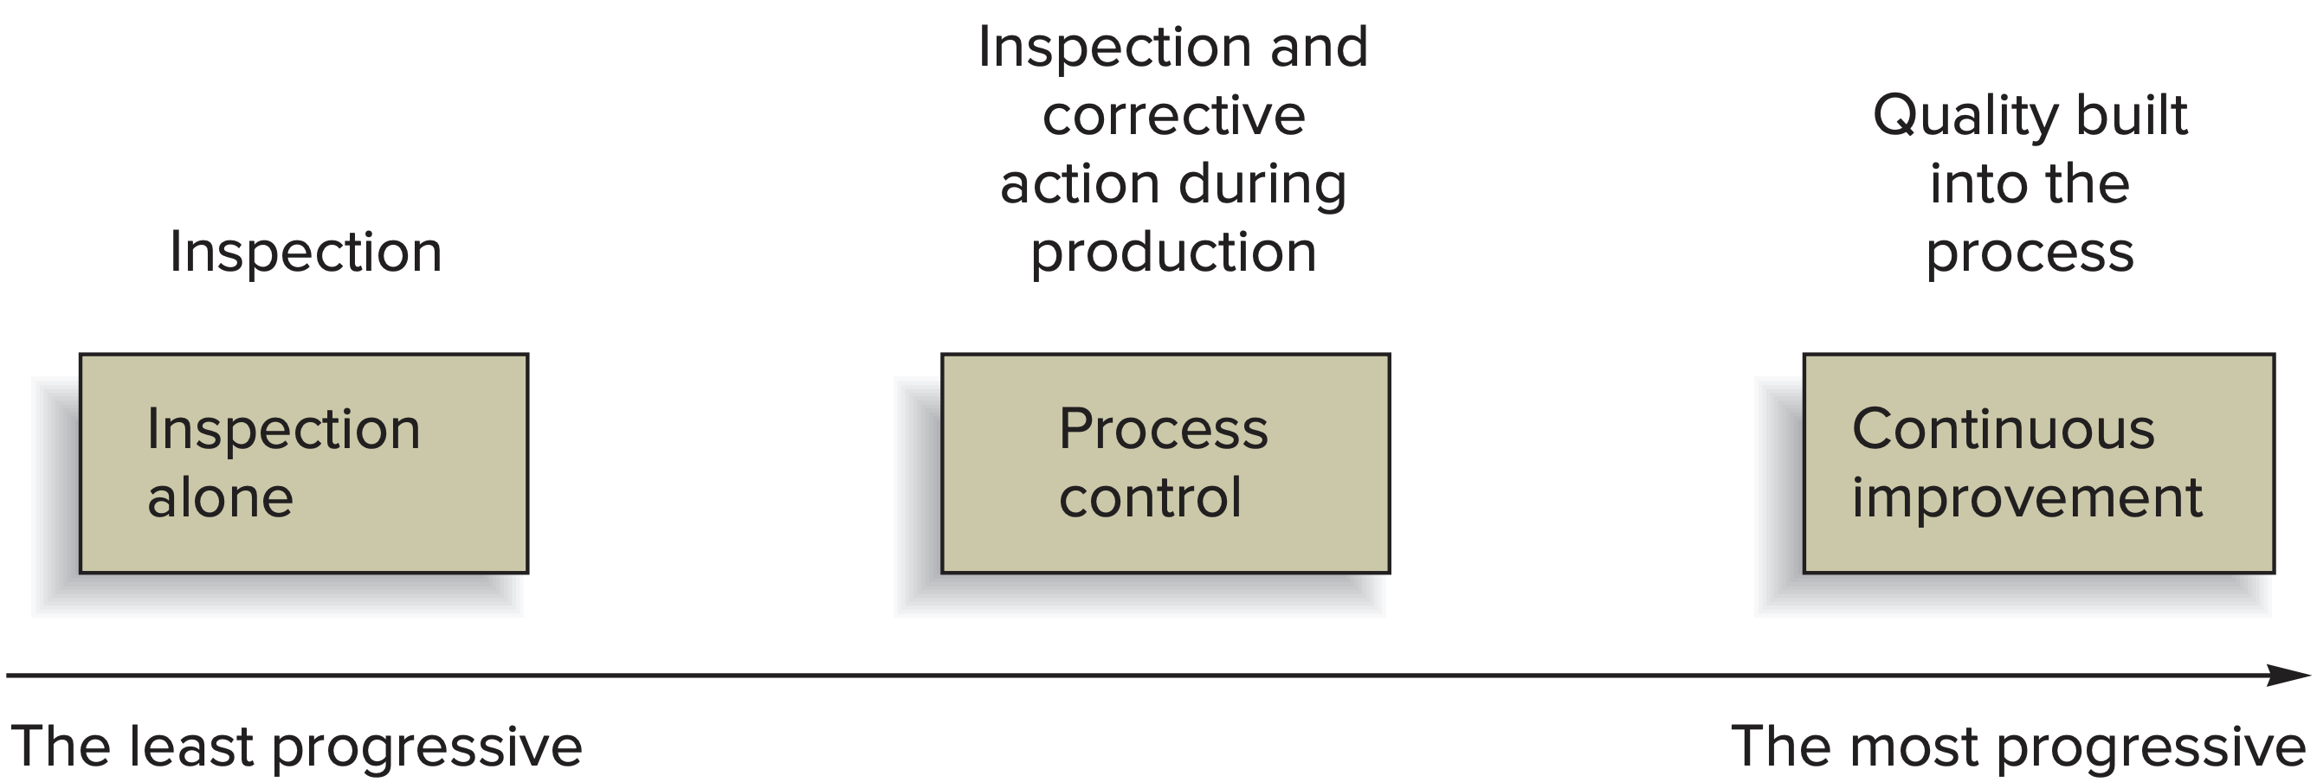
Phases of Quality Assurance

Slide 4
Inspection
An appraisal activity that compares goods or services to a standard
Inspection issues:
How much to inspect and how often
At what points in the process to inspect
Whether to inspect in a centralized or on-site location
Whether to inspect attributes or variables

Slide 5
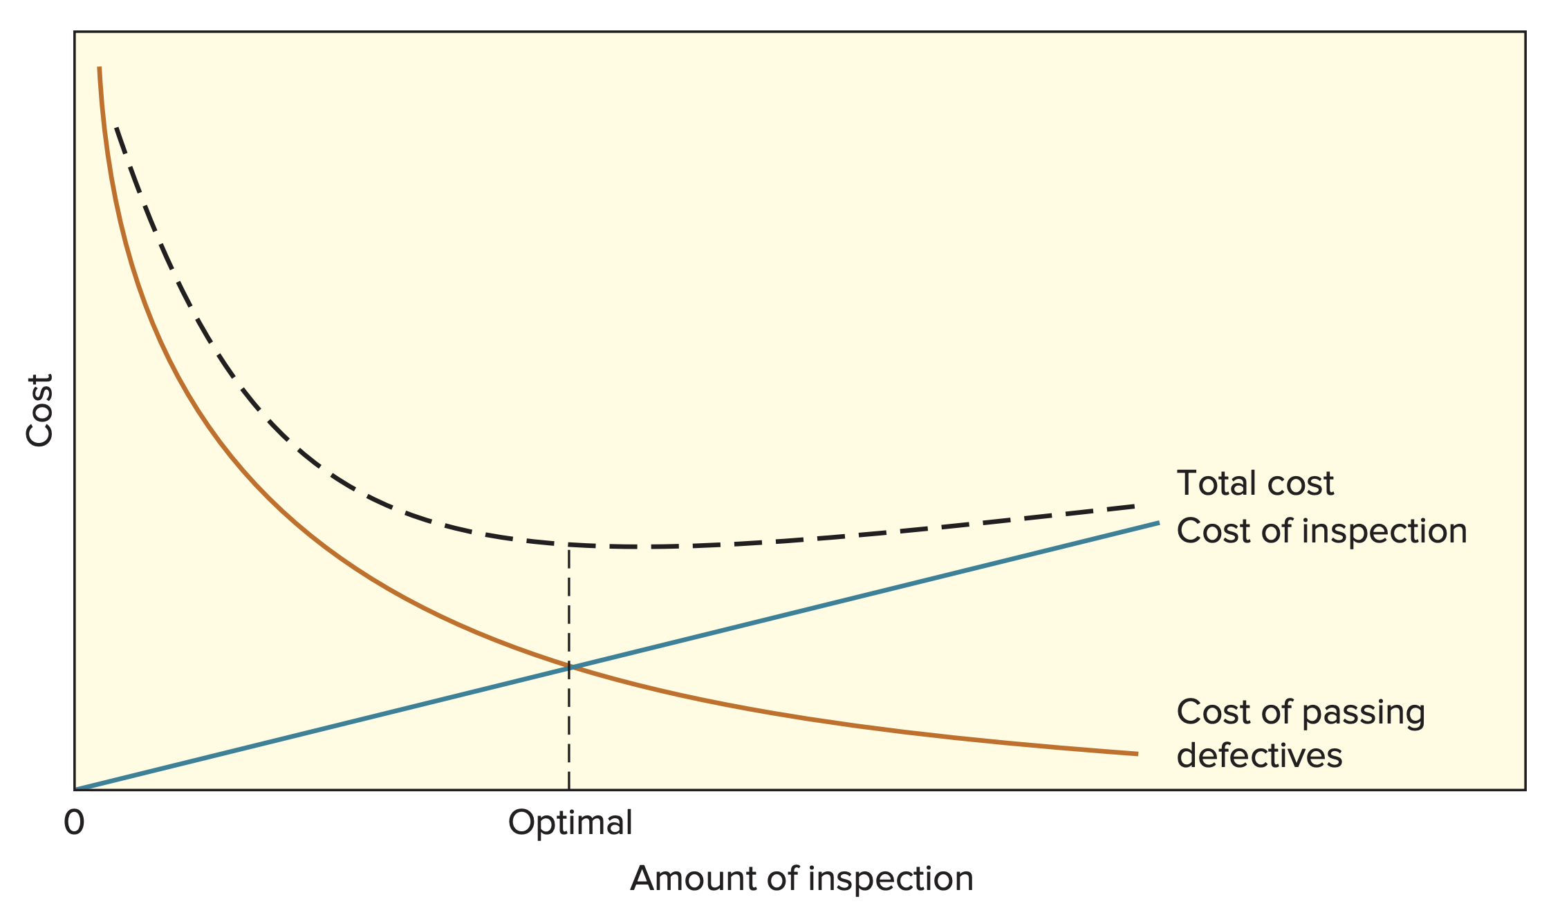
How Much to Inspect

Slide 6
Where to Inspect in the Process
Typical inspection points:
Raw materials and purchased parts
Finished products
Before a costly operation
Before an irreversible process
Before a covering process

Slide 7
Example of inspection at a Hotel/Motel
Inspection Point | Characteristics
Accounting/billing | Accuracy, timeliness
Building and grounds | Appearance and safety
Main desk | Appearance, waiting times, accuracy of bills
Maid service | Completeness, productivity
Personnel | Appearance, manners, productivity
Reservations/occupancy | Over/underbooking, percent occupancy
Restaurants | Kitchen, menus, meals, bills
Room service | Waiting time, quality of food
Supplies | Ordering, receiving, inventories

Slide 8
Off-Site vs. On-Site Inspection
Effects on cost and level of disruption are a major issue in selecting centralized versus on-site inspection
Off-Site
Specialized tests that may best be completed in a lab
More specialized testing equipment
More favorable testing environment
On-Site
Quicker decisions are rendered
Avoid introduction of extraneous factors
Quality at the source

Slide 9
Statistical Process Control (SPC)
Quality control seeks quality of conformance
A product or service conforms to specifications
A tool used to help in this process:
SPC
Statistical evaluation of the output of a process
Helps us to decide if a process is “in control” or if corrective action is needed

Slide 10
Process Variability
Two basic questions concerning variability:
Issue of process control
Are the variations random? If nonrandom variation is present, the process is said to be unstable.
Issue of process capability
Given a stable process, is the inherent variability of the process within a range that conforms to performance criteria?

Slide 11
Variation
Random (common cause) variation:
Natural variation in the output of a process, created by countless minor factors
Assignable (special cause) variation:
A variation whose cause can be identified
A nonrandom variation

Slide 12
Sampling and Sampling Distribution
SPC involves periodically taking samples of process output and computing sample statistics:
Sample means
The number of occurrences of some outcome
Sample statistics are used to judge the randomness of process variation

Slide 13
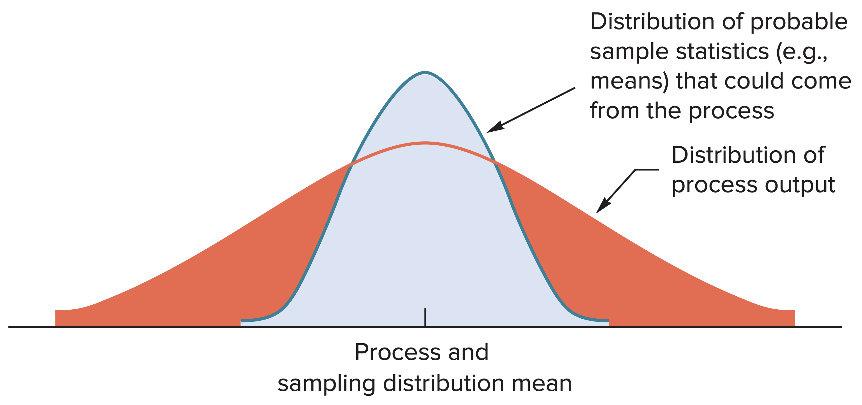
Sampling and Sampling Distribution (cont.)
FIGURE 10.4A The sampling distribution of means is normal, and it has less variability than the process distribution, which might not be normal

Slide 14
Control Process
Sampling and corrective action are only a part of the control process
Steps required for effective control:
Define: What is to be controlled?
Measure: How will measurement be accomplished?
Compare: There must be a standard of comparison
Evaluate: Establish a definition of out of control
Correct: Uncover the cause of nonrandom variability and fix it
Monitor: Verify that the problem has been eliminated

Slide 15
Control Charts: The Voice of the Process
A time-ordered plot of representative sample statistics obtained from an ongoing process (for example, sample means), used to distinguish between random and nonrandom variability
Control limits
The dividing lines between random and nonrandom deviations from the mean of the distribution
Upper and lower control limits define the range of acceptable variation

Slide 16
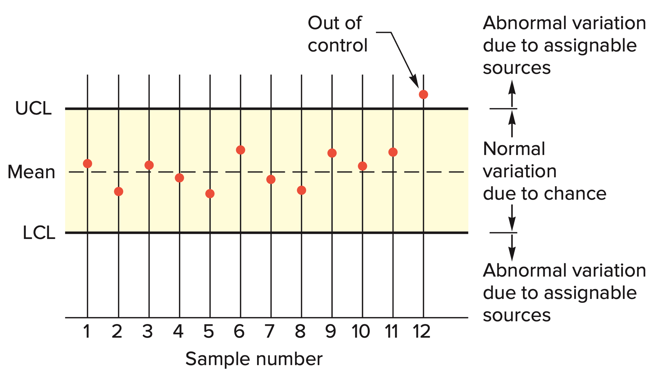
Control Chart
Each point on the control chart represents a sample of n observations

Slide 17
Errors
Type I error
Concluding a process is not in control when it actually is.
The probability of rejecting the null hypothesis when the null hypothesis is true
Manufacturer’s risk
Type II error
Concluding a process is in control when it is not.
The probability of failing to reject the null hypothesis when the null hypothesis is false
Consumer’s risk

Slide 18
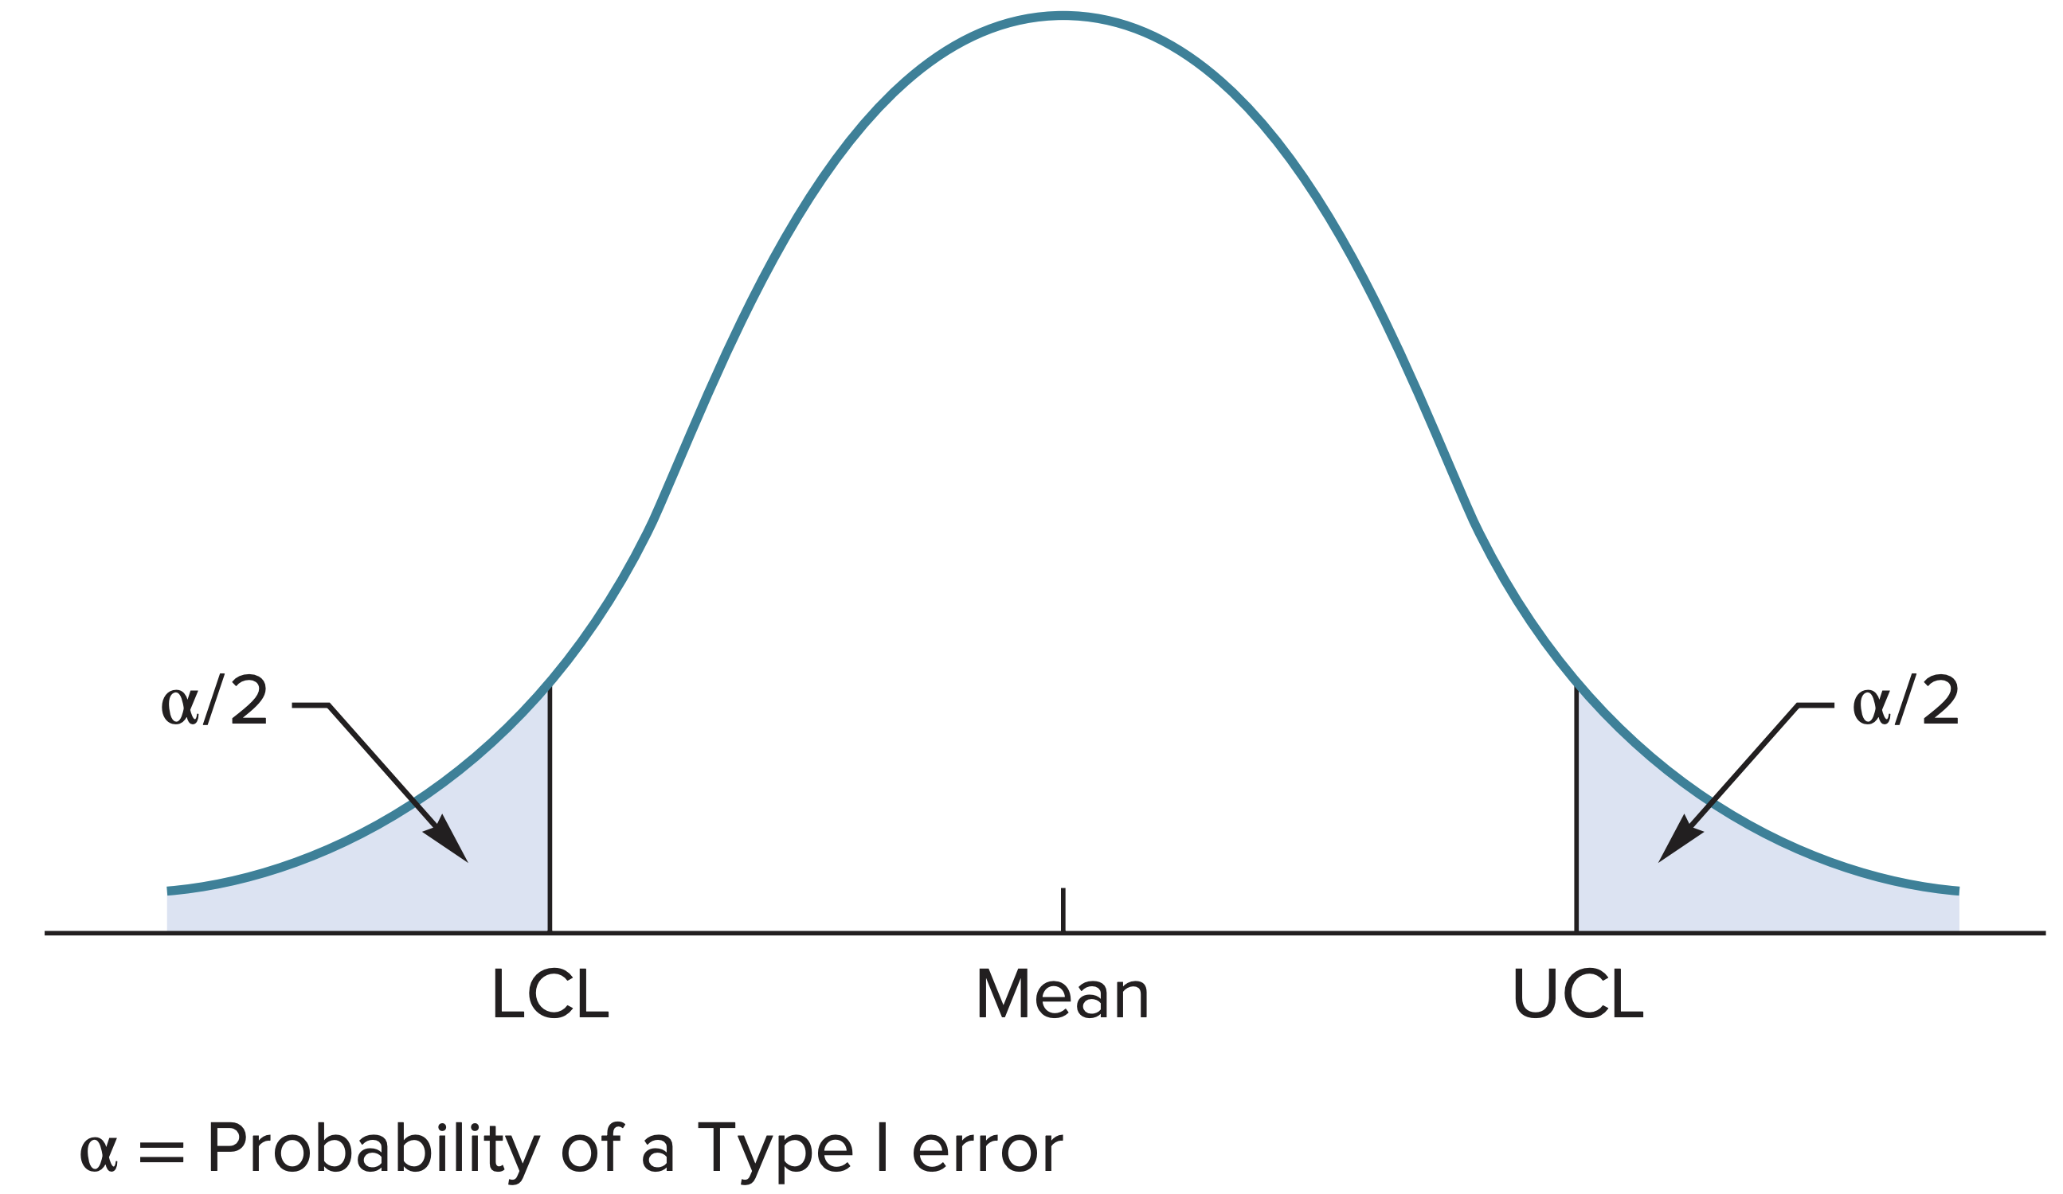
Type I Error

Slide 19
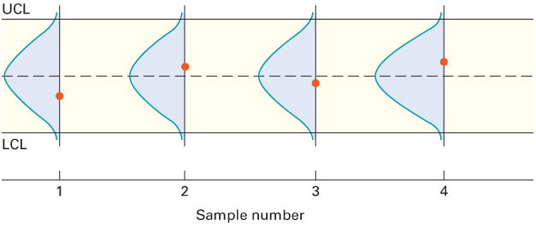
Observations from Sample Distribution

Slide 20
Control Charts for Variables
Variables generate data that are measured
Mean control charts
Used to monitor the central tendency of a process
“x-bar” charts
Range control charts
Used to monitor the process dispersion
R charts

Slide 21
Establishing Control Limits

Slide 22
X-Bar Chart: Control Limits
Used to monitor the central tendency of a process

Slide 23
Range Chart: Control Limits
Used to monitor process dispersion

Slide 24
Factors for Three Sigma Control Charts
 |  |  | FACTORS FOR R CHARTS
Number of Observations in Sample, n | Factor for Chart, A₂ | Lower Control Limit, D₃ | Upper Control Limit, D₄
2 | 1.88 | 0 | 3.27
3 | 1.02 | 0 | 2.57
4 | 0.73 | 0 | 2.28
5 | 0.58 | 0 | 2.11
6 | 0.48 | 0 | 2.00
7 | 0.42 | 0.08 | 1.92
8 | 0.37 | 0.14 | 1.86
9 | 0.34 | 0.18 | 1.82
10 | 0.31 | 0.22 | 1.78
11 | 0.29 | 0.26 | 1.74
12 | 0.27 | 0.28 | 1.72
13 | 0.25 | 0.31 | 1.69
14 | 0.24 | 0.33 | 1.67
15 | 0.22 | 0.35 | 1.65
16 | 0.21 | 0.36 | 1.64
17 | 0.20 | 0.38 | 1.62
18 | 0.19 | 0.39 | 1.61
19 | 0.19 | 0.40 | 1.60
20 | 0.18 | 0.41 | 1.59
TABLE 10.3
Factors for three-sigma control limits for X and R charts
Source: Adapted from Eugene Grant and Richard Leavenworth, Statistical Quality Control, 5th ed. Copyright ©1980 McGraw-Hill Companies, Inc. Used with permission

Slide 25
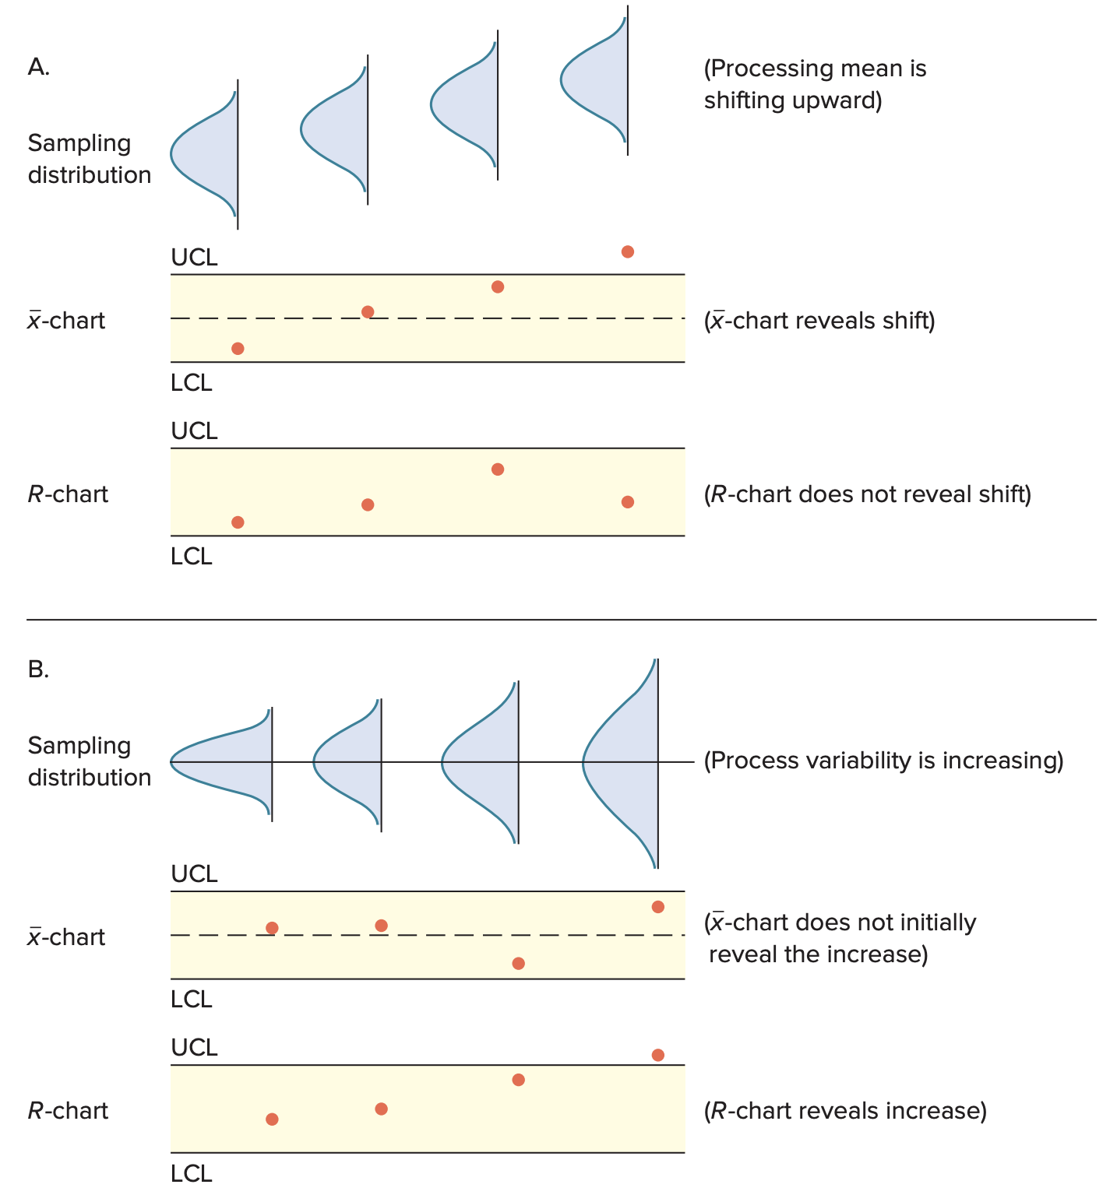
Mean and Range Charts A

Slide 26
Mean and Range Charts B

Slide 27
Using Mean and Range Charts
To determine initial control limits:
Obtain 20 to 25 samples
Compute appropriate sample statistics
Establish preliminary control limits
Determine if any points fall outside of the control limits
If you find no out-of-control signals, assume the process is in control
If you find an out-of-control signal, search for and correct the assignable cause of variation
Resume the process and collect another set of observations on which to base control limits
Plot the data on the control chart and check for out-of-control signals

Slide 28
Control Charts for Attributes
Attributes generate data that are counted.
p-chart
Control chart used to monitor the proportion of defectives in a process
c-chart
Control chart used to monitor the number of defects per unit

Slide 29
Use a p-chart:
When observations can be placed into two categories
Good or bad
Pass or fail
Operate or don’t operate
When the data consists of multiple samples of several observations each

Slide 30
p-chart Control Limits

Slide 31
Use a c-chart:
Use only when the number of occurrences per unit of measure can be counted; non-occurrences cannot be counted.
Scratches, chips, dents, or errors per item
Cracks or faults per unit of distance
Breaks or tears per unit of area
Bacteria or pollutants per unit of volume
Calls, complaints, failures per unit of time

Slide 32
Managerial Considerations
At what points in the process to use control charts
What size samples to take
Sample frequency
What type of control chart to use
Variables
Attributes

Slide 33
Run Tests
Even if a process appears to be in control, the data may still not reflect a random process
Analysts often supplement control charts with a run test
Run test
A test for patterns in a sequence
Run
Sequence of observations with a certain characteristic

Slide 34
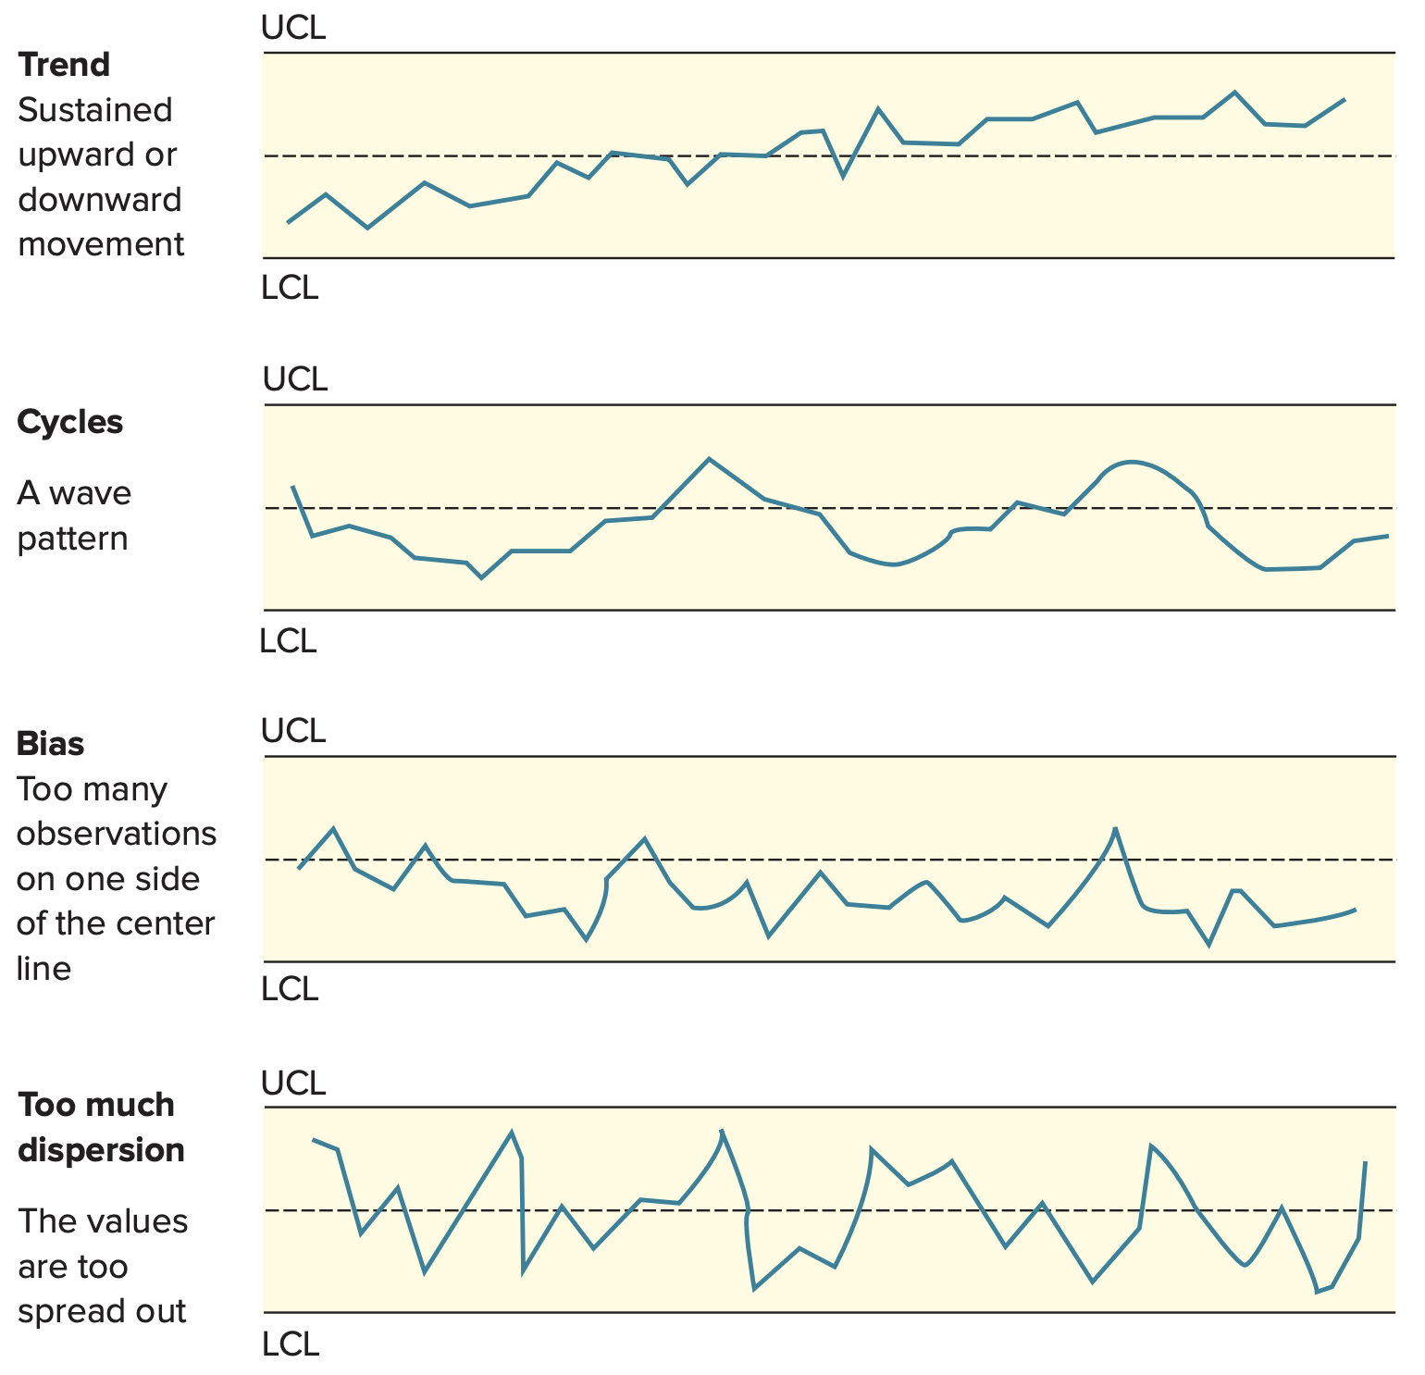
Nonrandom Patterns

Slide 35
Process Capability
Once a process has been determined to be stable, it is necessary to determine if the process is capable of producing output that is within an acceptable range
Tolerances or specifications
Range of acceptable values established by engineering design or customer requirements
Process variability
Natural or inherent variability in a process
Process capability
The inherent variability of process output (process width) relative to the variation allowed by the design specification (specification width)

Slide 36
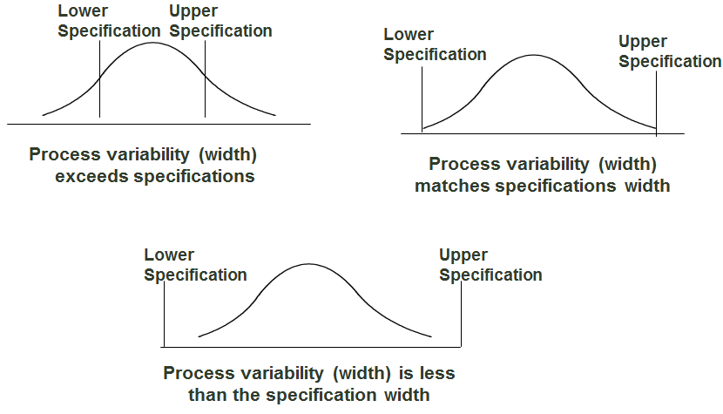
Process Capability (cont.)

Slide 37
Cp

Slide 38
Cpk
Used when a process is not centered at its target, or nominal, value

Slide 39
Improving Process Capability
Simplify
Standardize
Mistake-proof
Upgrade equipment
Automate

Slide 40
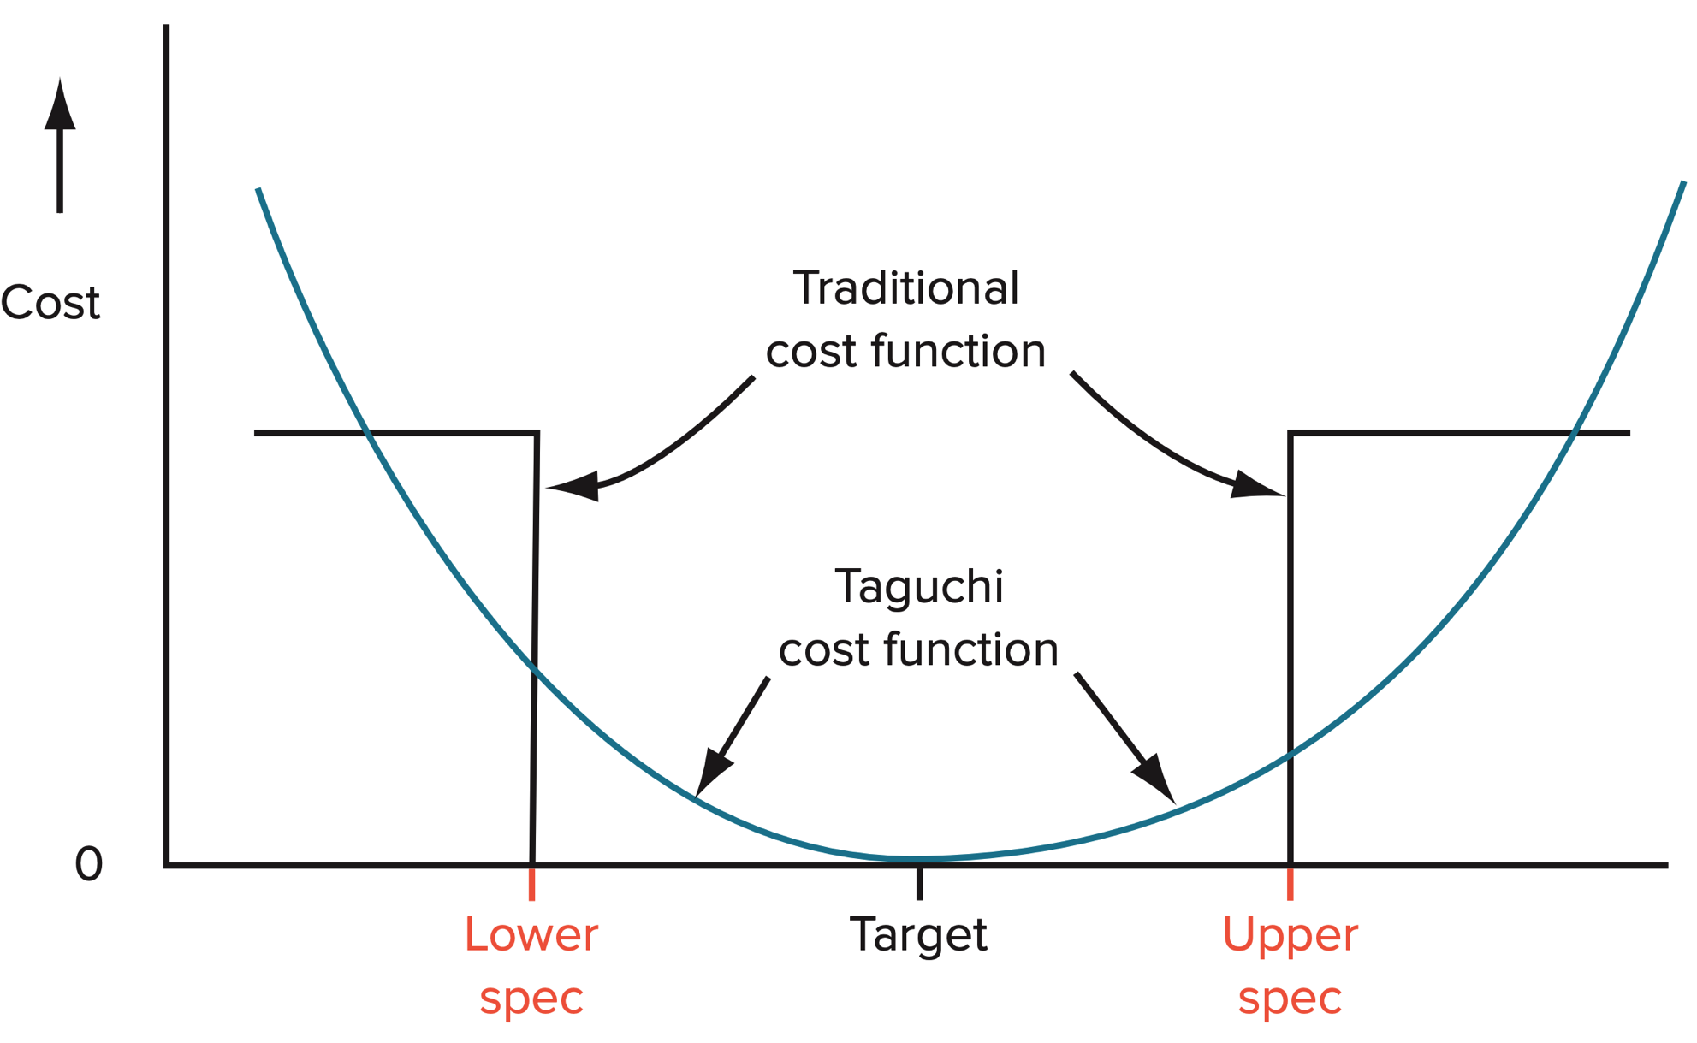
Taguchi Loss Function

Slide 41
Limitations of Capability Measures
There are several risks of using capability measures:
The process may not be stable
The process output may not be normally distributed
The process is not centered but Cp is used

Slide 42
Assignment #4 (Individual)
The Toyota Production System (TPS) has been studied in the POM field since the late 1970s. There are various aspects to TPS. Conduct a study on the application of the TQM concept in Toyota.
Due Dec. 18

