Slide 1
Inventory (Ch.12)
10
  CYCU
  Prof. CK Farn
mailto: ckfarn@gmail.com
http://www.mgt.ncu.edu.tw/~ckfarn/cycu
  2024.12

Slide 2
Inventory
Inventory
  A stock or store of goods
Independent-demand items
  Items that are ready to be sold or used
Inventories are a vital part of business: (1) necessary for operations and (2) contribute to customer satisfaction
  A “typical” firm has roughly 30% of its current assets and as much as 90% of its working capital invested in inventory

Slide 3
Types of Inventory
Raw materials and purchased parts
Work-in-process (WIP)
Finished goods inventories or merchandise
Tools and supplies
Maintenance and repairs (MRO) inventory
Goods-in-transit to warehouses or customers (pipeline inventory)

Slide 4
Inventory Functions
To meet anticipated customer demand
To smooth production requirements
To decouple operations
To protect against stockouts
To take advantage of order cycles
To hedge against price increases
To permit operations
To take advantage of quantity discounts

Slide 5
Objectives of Inventory Control
Level of customer service
  Having the right goods available in the right quantity in the right place at the right time
Costs of ordering and carrying inventories
  The overall objective of inventory management is to achieve satisfactory levels of customer service while keeping inventory costs within reasonable bounds
    Measures of performance
    Customer satisfaction
      Number and quantity of backorders
      Customer complaints
    Inventory turnover

Slide 6
Inventory Turnover Ratio
Ratio of annual cost of goods sold to average inventory investment
  How many times a year the inventory is sold
  Higher the better as it implies more efficient use of the inventory

Slide 7
Effective Inventory Management
Requires:
  A system keep track of inventory
  A reliable forecast of demand
  Knowledge of lead time and lead time variability
  Reasonable estimates of
    Holding costs
    Ordering costs
    Shortage costs
  A classification system for inventory items

Slide 8
Inventory Counting Systems
Periodic system
  Physical count of items in inventory made at periodic intervals
Perpetual inventory system
  System that keeps track of removals from inventory continuously, thus monitoring current levels of each item
    An order is placed when inventory drops to a predetermined minimum level
    Two-bin system
      Two containers of inventory; reorder when the first is empty

Slide 9
Inventory Counting Technologies
Universal product code (UPC)
  Bar code printed on a label that has information about the item to which it is attached
Radio frequency identification (RFID) tags
  A technology that uses radio waves to identify objects, such as goods, in supply chains

Slide 10
Inventory Costs
Purchase cost
  The amount paid to buy the inventory
Holding (carrying) costs
  Cost to carry an item in inventory for a length of time, usually a year
Ordering costs
  Costs of ordering and receiving inventory
Setup costs
  The costs involved in preparing equipment for a job
  Analogous to ordering costs
Shortage costs
  Costs resulting when demand exceeds the supply of inventory; often unrealized profit per unit

Slide 11
ABC Classification System
A-B-C approach
  Classifying inventory according to some measure of importance, and allocating control efforts accordingly
  A items (very important)
    10 to 20 percent of the number of items in inventory and about 60 to 70 percent of the annual dollar value
  B items (moderately important)
  C items (least important)
    50 to 60 percent of the number of items in inventory but only about 10 to 15 percent of the annual dollar value

Slide 12
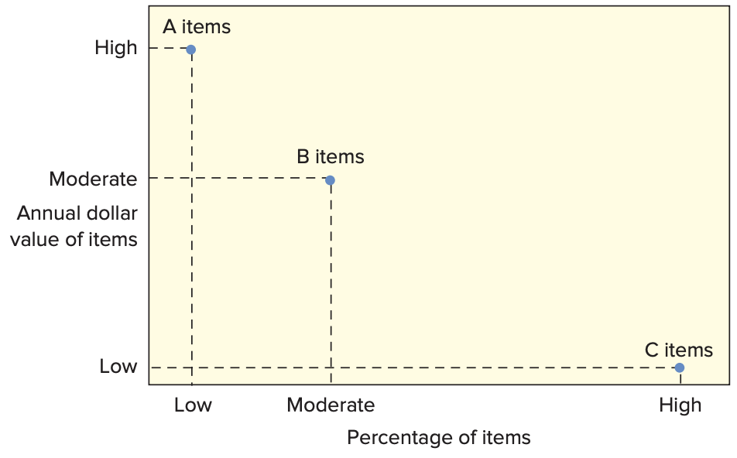
ABC Classification System

Slide 13
Cycle Counting
Cycle counting
  A physical count of items in inventory
Cycle counting management
  How much accuracy is needed?
    A items: ± 0.2 percent
    B items: ± 1 percent
    C items: ± 5 percent
  When should cycle counting be performed?
  Who should do it?

Slide 14
How Much to Order: EOQ Models
Economic order quantity models identify the optimal order quantity by minimizing the sum of annual costs that vary with order size and frequency
  The basic economic order quantity model
  The economic production quantity model
  The quantity discount model

Slide 15
Basic EOQ Model
The basic EOQ model is used to find a fixed order quantity that will minimize total annual inventory costs
Assumptions:
  Only one product is involved
  Annual demand requirements are known
  Demand is even throughout the year
  Lead time does not vary
  Each order is received in a single delivery
  There are no quantity discounts

Slide 16
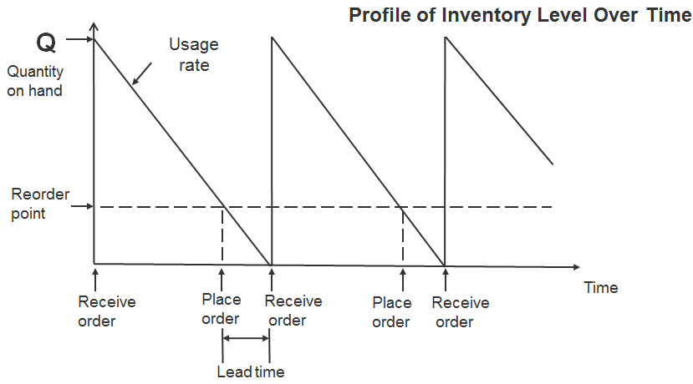
The Inventory Cycle

Slide 17
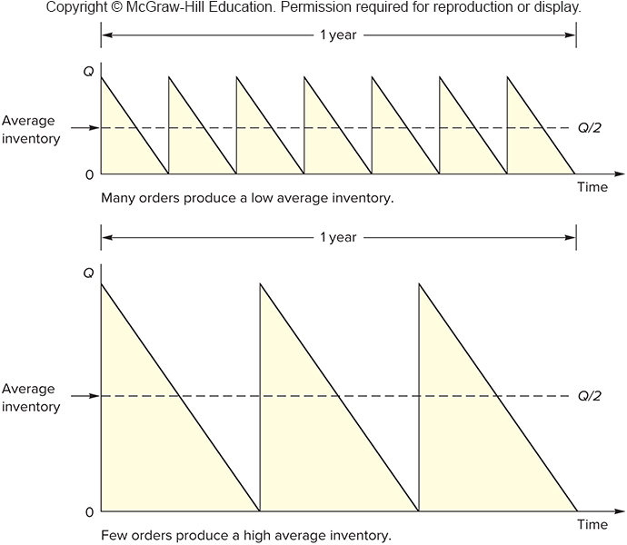
Inventory frequency

Slide 18
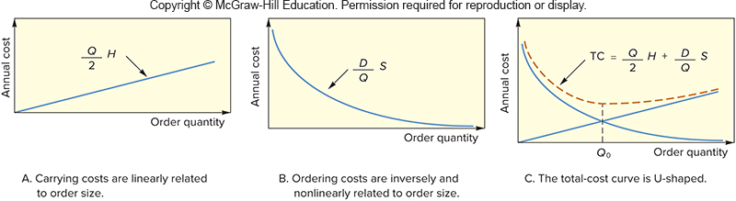
Inventory Cost

Slide 19
Total Annual Cost

Slide 20
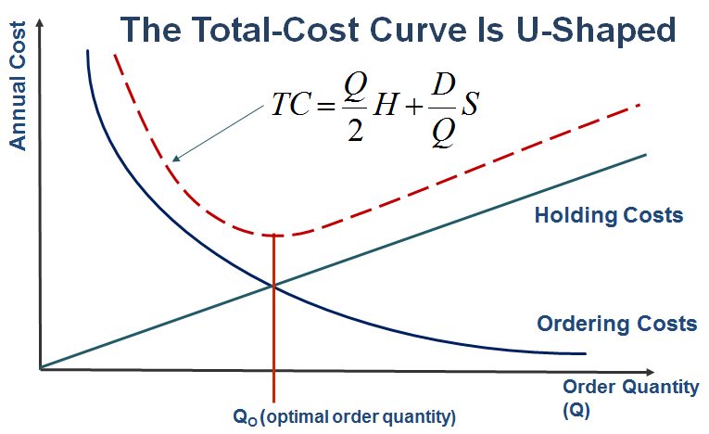
Goal: Total Cost Minimization

Slide 21
Deriving EOQ
Using calculus, we take the derivative of the total cost function and set the derivative (slope) equal to zero and solve for Q.
The total cost curve reaches its minimum where the carrying and ordering costs are equal.
Length of the optimal order cycle = Q₀ / D

Slide 22
Economic Production Quantity (EPQ)
The batch mode is widely used in production. In certain instances, the capacity to produce a part exceeds its usage (demand rate).
Assumptions
  Only one item is involved
  Annual demand requirements are known
  Usage rate is constant
  Usage occurs continually, but production occurs periodically
  The production rate is constant
  Lead time is known and constant
  There are no quantity discounts

Slide 23
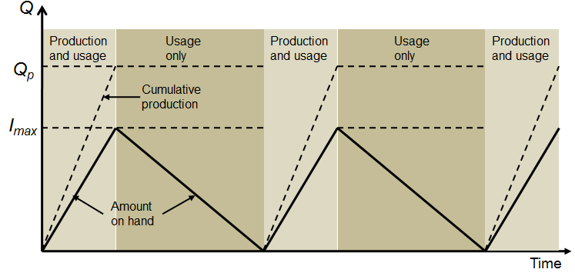
EPQ: Inventory Profile

Slide 24
EPQ – Total Cost

Slide 25
Economic Production Quantity

Slide 26
Economic Production Quantity (cont.)
Other parameters

Slide 27
Quantity Discount Model
Quantity discount
  Price reduction for larger orders offered to customers to induce them to buy in large quantities

Slide 28
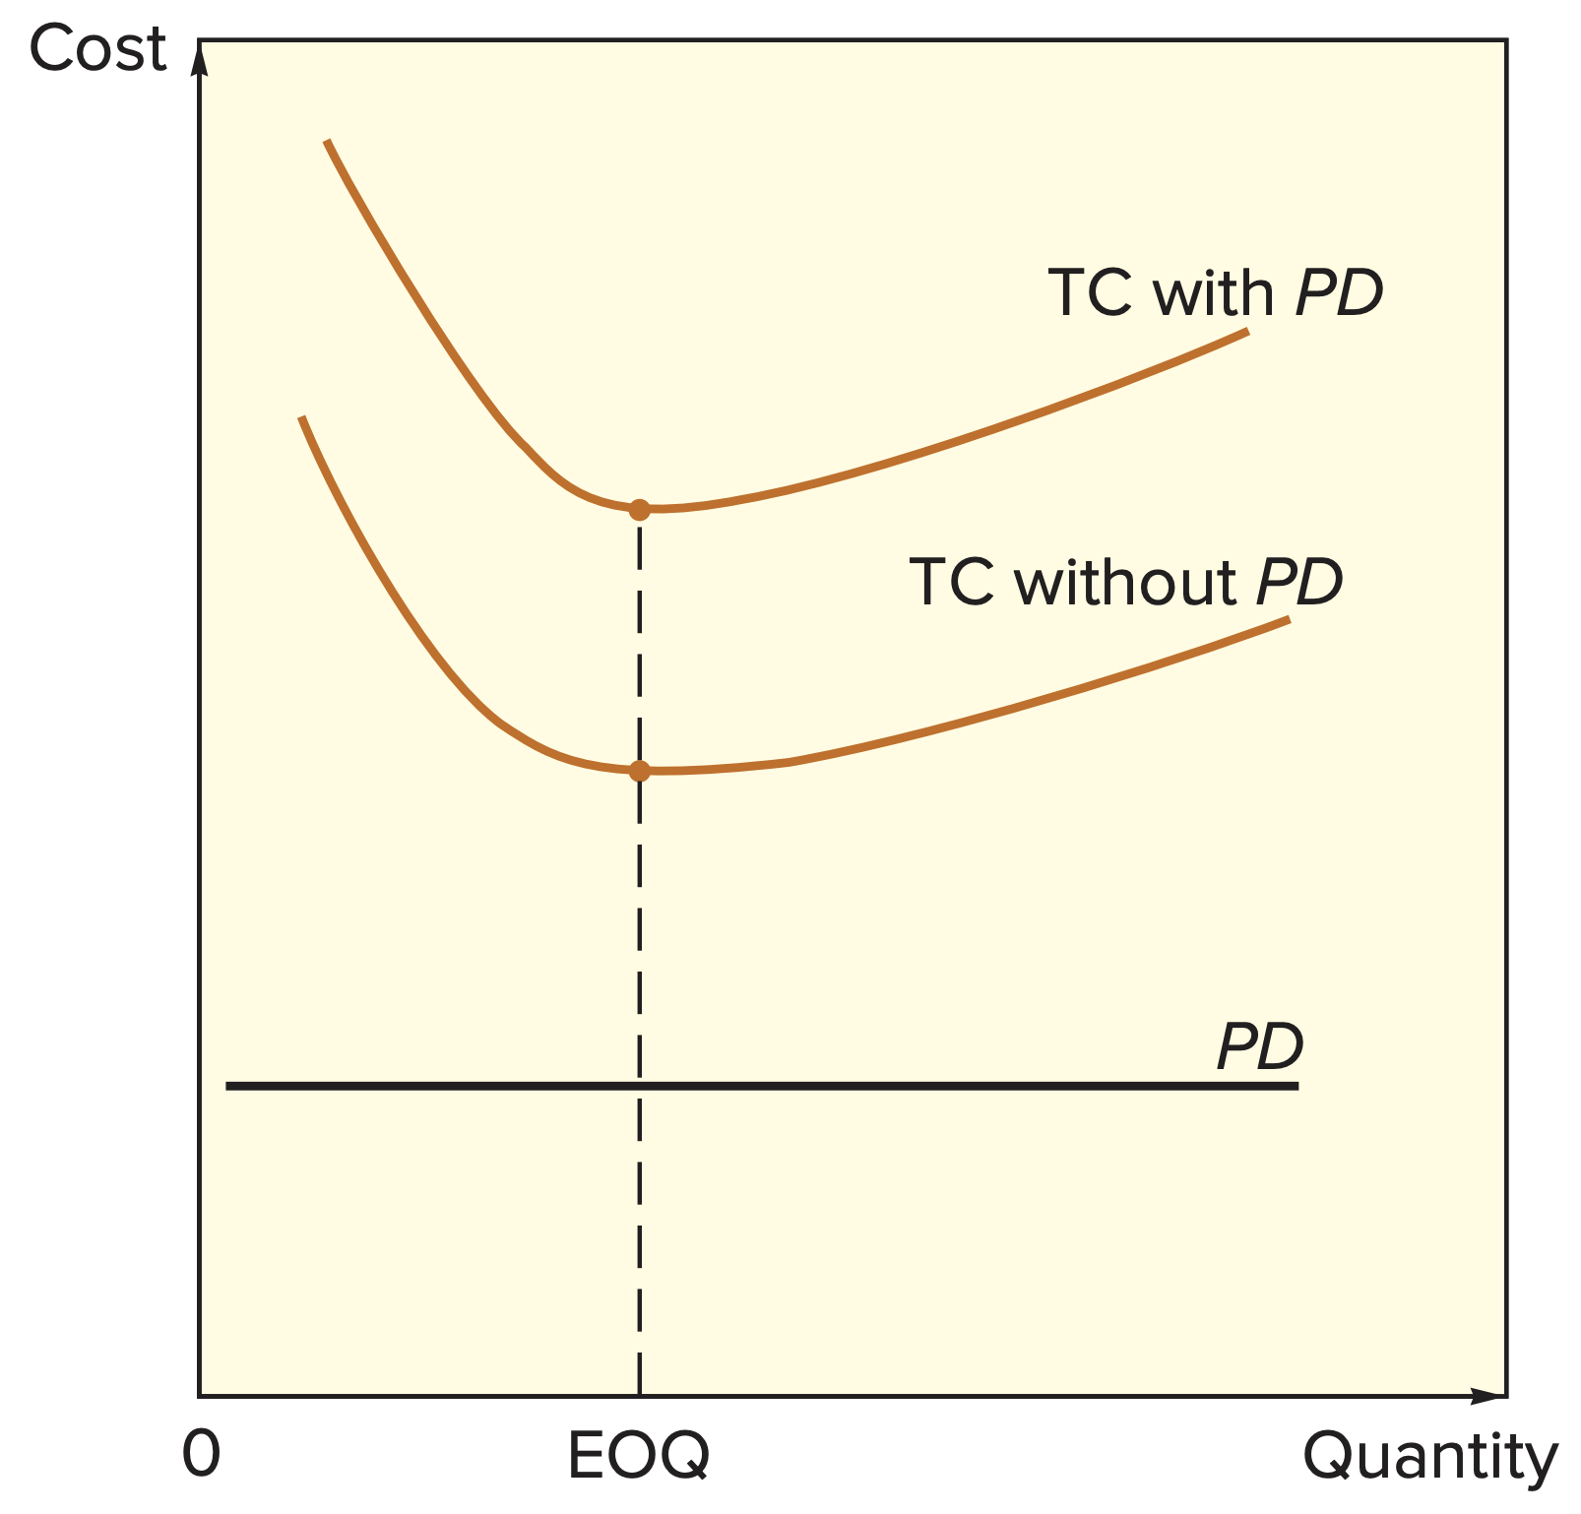
Quantity Discounts

Slide 29
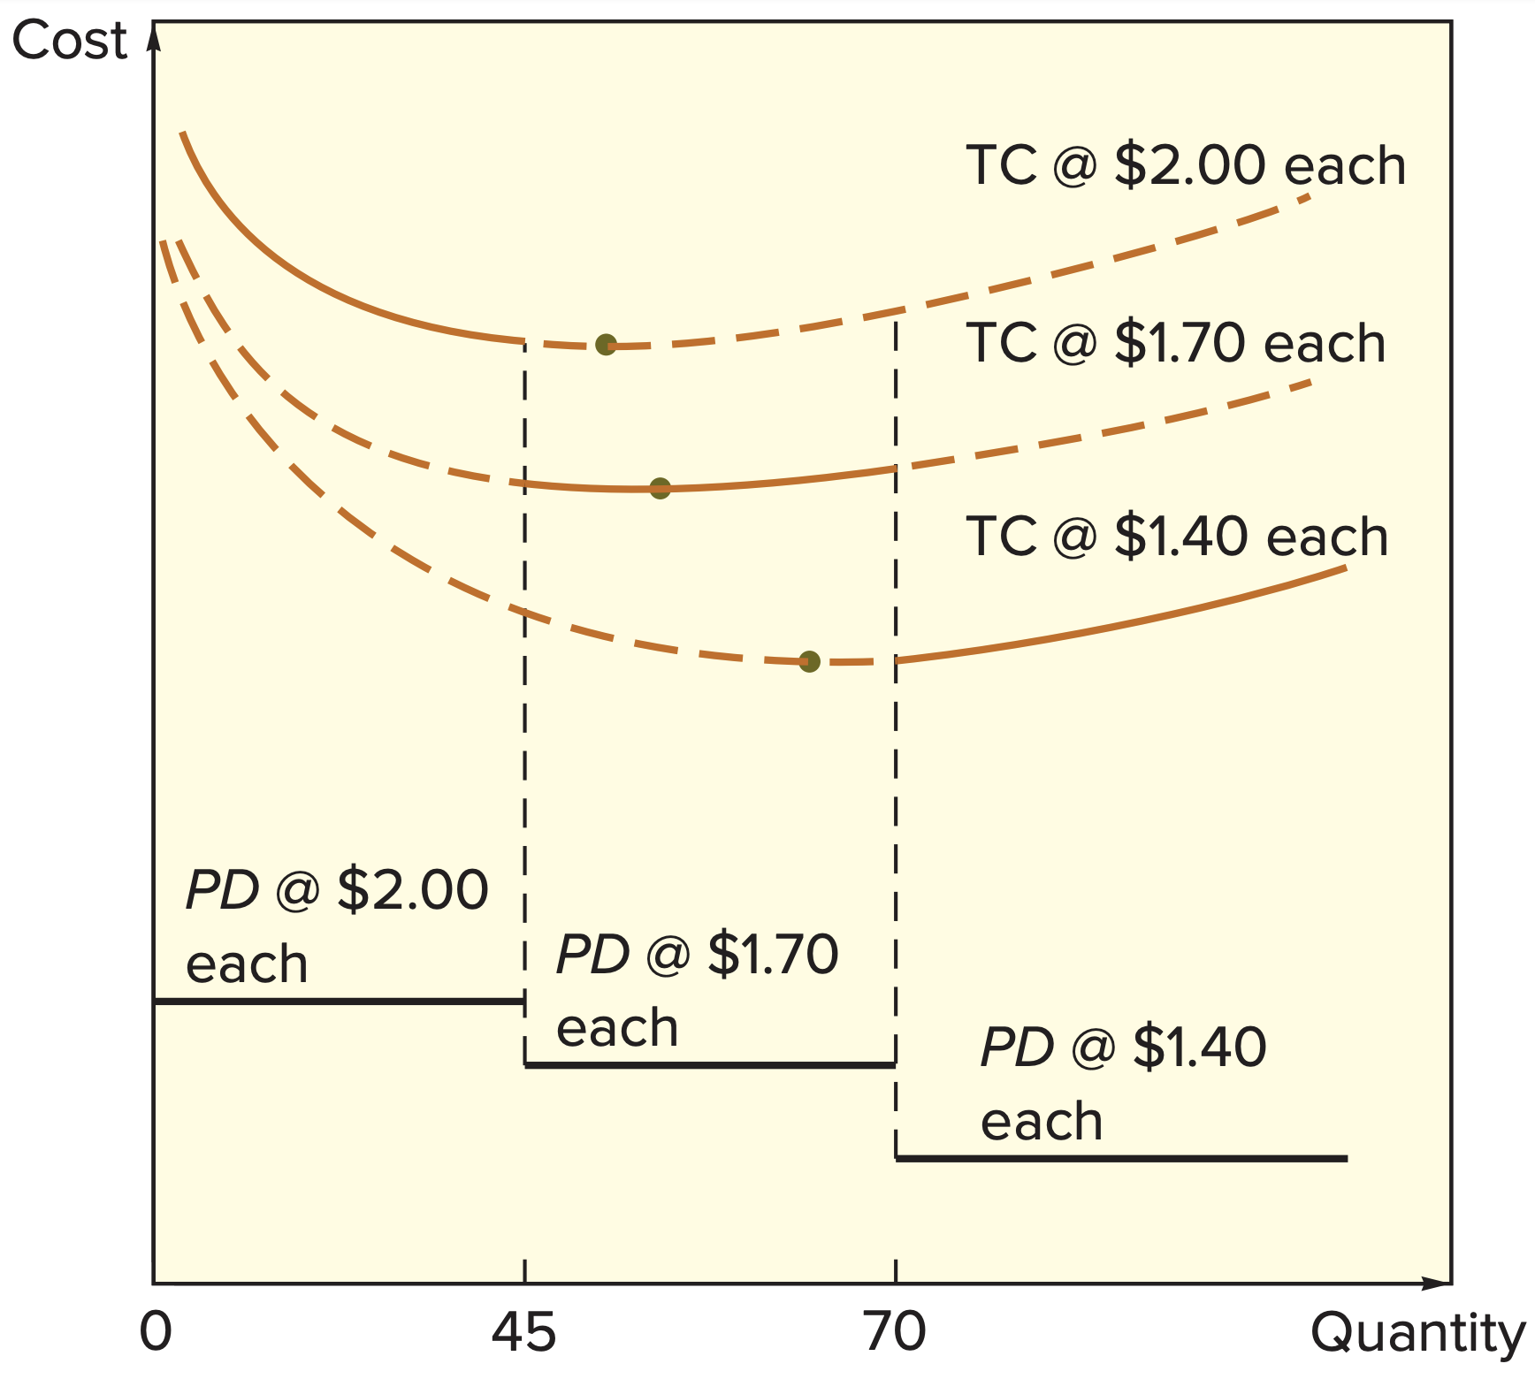
Quantity Discounts (cont.)
The total-cost curve with quantity discounts is composed of a portion of the total-cost curve for each price

Slide 30
When to Reorder
Reorder point
  When the quantity on hand of an item drops to this amount, the item is reordered.
  Determinants of the reorder point
    The rate of demand
    The lead time
    The extent of demand and/or lead time variability
    The degree of stockout risk acceptable to management

Slide 31
Reorder Point: Under Certainty

Slide 32
Reorder Point: Under Uncertainty
Demand or lead time uncertainty creates the possibility that demand will be greater than available supply
To reduce the likelihood of a stockout, it becomes necessary to carry safety stock
  Safety stock
    Stock that is held in excess of expected demand due to variable demand and/or lead time

Slide 33
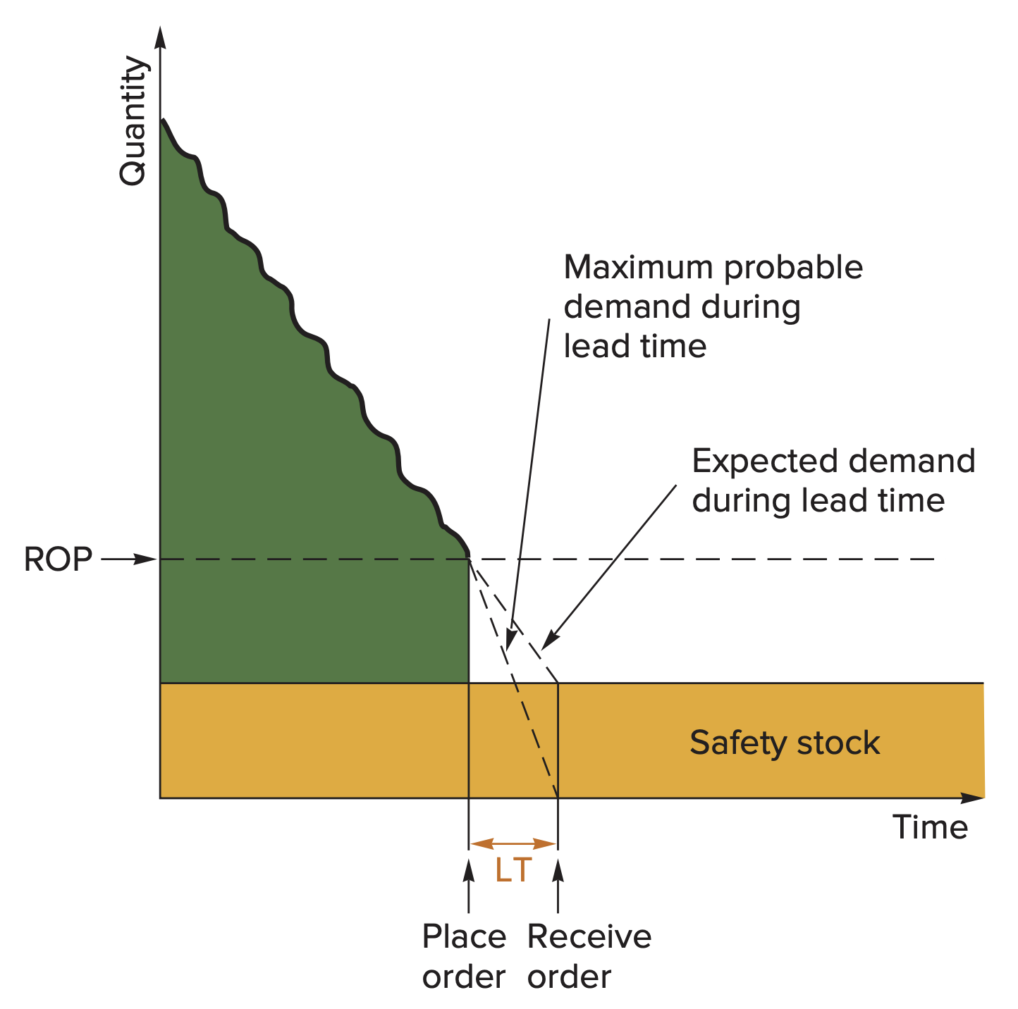
Safety Stock

Slide 34
Safety Stock?
As the amount of safety stock carried increases, the risk of stockout decreases.
  This improves customer service level
Service level
  The probability that demand will not exceed supply during lead time
  Service level = 100% − stockout risk

Slide 35
How Much Safety Stock?
The amount of safety stock that is appropriate for a given situation depends upon:
  The average demand rate and average lead time
  Demand and lead time variability
  The desired service level

Slide 36
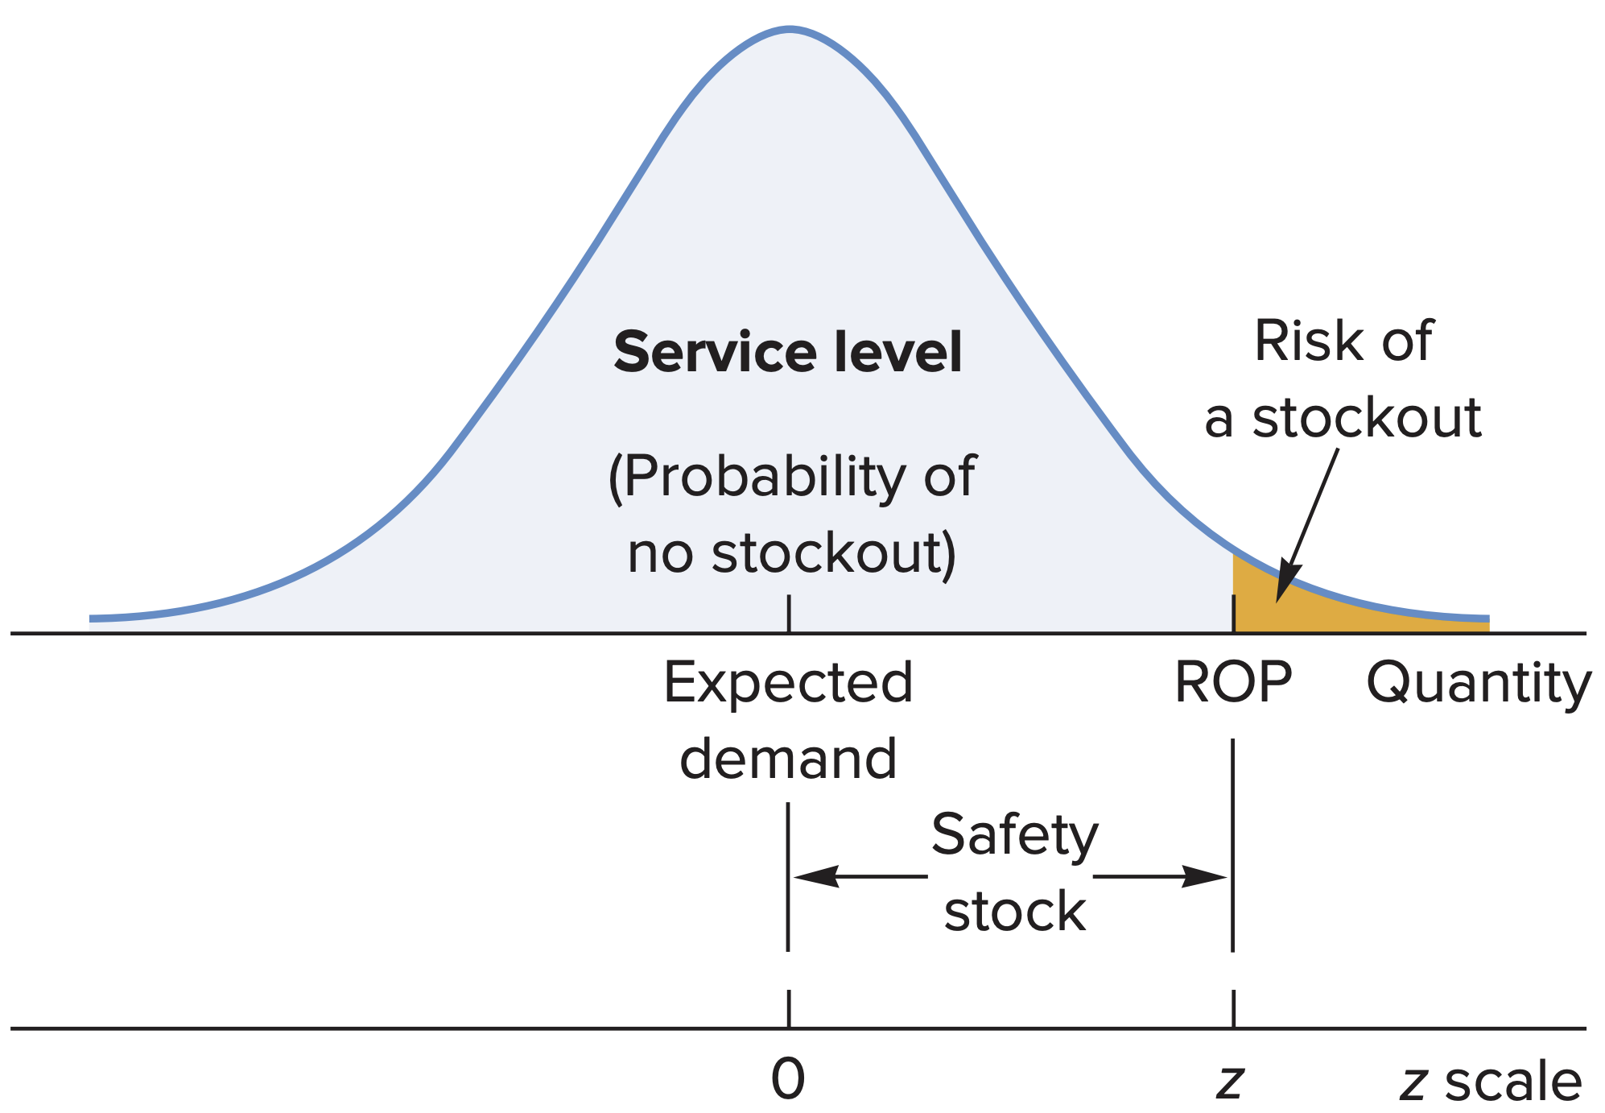
Reorder Point
The ROP based on a normal
distribution of lead time demand

Slide 37
Reorder Point: Demand Uncertainty
Note: If only demand is variable, then

Slide 38
Reorder Point: Lead Time Uncertainty
Note: If only lead time is variable, then

Slide 39
How Much to Order: FOI
Fixed-order-interval (FOI) model
  Orders are placed at fixed time intervals
Reasons for using the FOI model
  Supplier’s policy may encourage its use
  Grouping orders from the same supplier can produce savings in shipping costs
  Some circumstances do not lend themselves to continuously monitoring inventory position

Slide 40
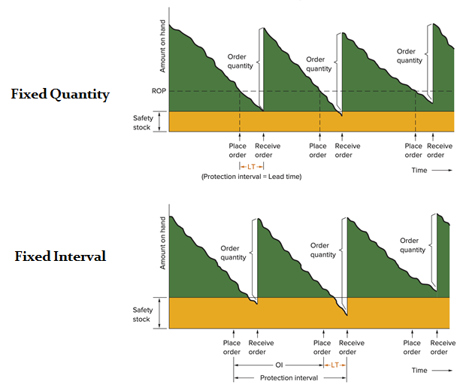
Fixed-Quantity versus Fixed-Interval Ordering

Slide 41
FOI Model

Slide 42
Single-Period Model
Single-period model
  Model for ordering of perishables and other items with limited useful lives
  Shortage cost
    Generally, the unrealized profit per unit
    Cshortage = Cs = Revenue per unit – Cost per unit
  Excess cost
    Different between purchase cost and salvage value of items left over at the end of the period
    Cexcess = Ce = Cost per unit – Salvage value per unit

Slide 43
Single-Period Model (cont.)
The goal of the single-period model is to identify the order quantity that will minimize the long-run excess and shortage costs
Two categories of problem:
  Demand can be characterized by a continuous distribution
  Demand can be characterized by a discrete distribution

Slide 44
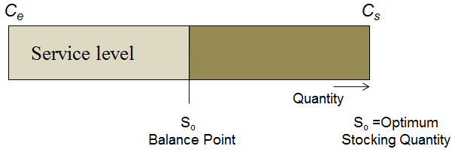
Stocking Levels

