Slide 1
Integrated Business Systems: Introduction to Business and IT
1
CYCU
Prof. CK Farn
mailto: ckfarn@gmail.com
http://www.mgt.ncu.edu.tw/~ckfarn/cycu
2025.02 rev

Slide 2
Instructor
Prof. CK Farn
Retired Distinguished Professor from National Central University
B.S.E., Mech. Engineering, National Taiwan University
M.Sc., Management Sciences, UMIST, Manchester, UK
Ph.D., Management (MIS), UCLA, USA
Email: ckfarn@gmail.com
Google “ckfarn”

Slide 3
Preparations
Web pages
http://www.mgt.ncu.edu.tw/~ckfarn/25S_Integrated_Business.html
Class time
Thu. 09:10-12:00
Break once
Team formation
Teams of 5 to 6, mixed gender
Two teams

Slide 4
Teaching/Learning process
Lectures
Simulation Games
Beer Game
Business Simulation Game
Students are expected to bring in notebook or tablet during the games
Presentations
Class discussions

Slide 5
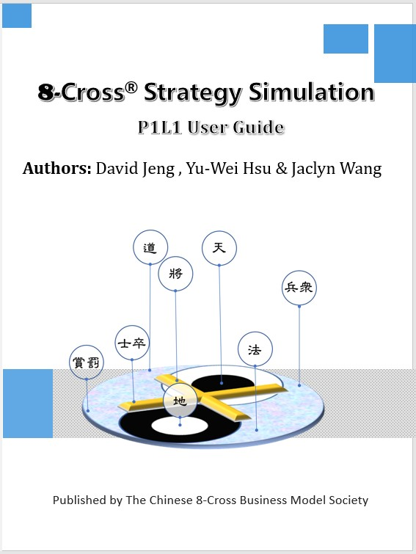
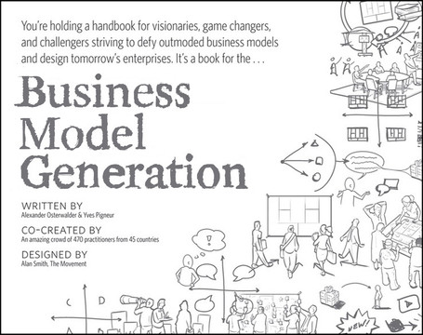
Teaching materials
Reference book
Business Model Canvas
8-Cross Business Simulation
Powerpoint slides
Including Beer Game
On my web page, feel free to download

Slide 6
Objective of this class
Merging into the US program
English reading, writing, listening and speaking
Discussions and asking questions
Presentations, including Q&A
Learn how to learn: information collection and report formulation
Teamwork
Team assignments
Subject matter
Business models, integrated business systems
English
Chinese
Business
Systems
Non
Bus. Sys.

Slide 7
Assessments
Assignments: 30%
Participation: 20%
Mid-term quiz: 20%
Final exam: 30%

Slide 8
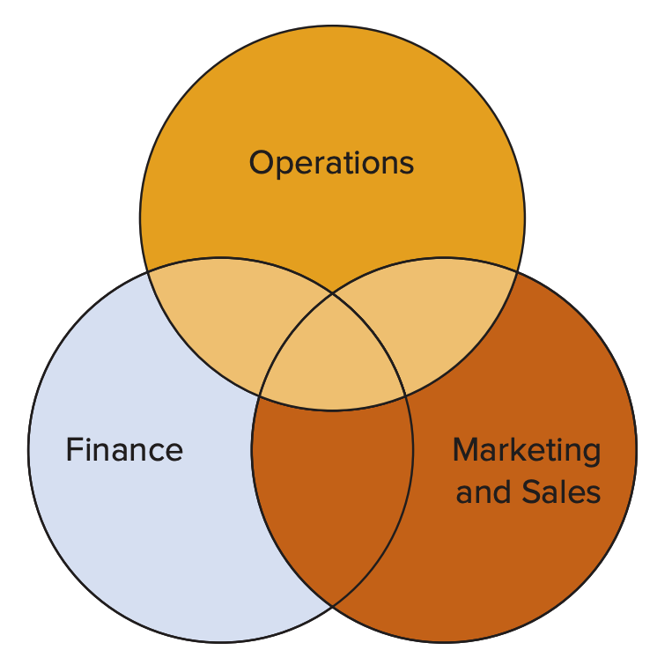
Function Overlap
Finance & operations
Budgeting
Economic analysis of investment proposals
Provision of funds
Marketing & operations
Demand data
Product and service design
Competitor analysis
Lead time data
Integration

Slide 9
Meaning of Integration: IT
Information Technology, or Information Systems are integral part of business operations today
What are examples of IT applications that you can observe in your daily life?
AI? Even in governments!
https://youtu.be/Qc3acONHAMI?si=UEww4A_FOMaa3Bnv

Slide 10
IT impacts on Business Operations
The way businesses conduct their operations
IT “enabled” business change!
Digital transformations
Beyond simple automation
of current operations

Slide 11
Confusions of related terms
Data processing (DP, ADP, EDP)
Management information systems (MIS)
Computerization
Electronization, e-Services
Digitization
Intelligentization
….

Slide 12
Driving Forces for Progress in Modern Economy
Technological Innovations
Pervasive usage of technologies
Extensive range in activities and communications
Unprecedented fast response times
Globalization
Larger economy of scale and economy of scope
Proliferation and fusion in culture

Slide 13
Development of Human Civilization
Can you recall the things in our life that were invented for over 150 years?
Innovation
ICT
Transportation
Power
Printing
Stone
tools
Bronze
Paper
Pottery
Iron
Pre-historical
2K BC
0 AD
2K AD

Slide 14
Business Operations transformed with the Advent of Technologies
Competing forces
Changes rapidly

Slide 15
Technological Innovations
Transportation, logistics and conveyance
Fast moving of materials
Lower production costs
ICT: Information and communications tech.
Revolution in information processing and interactions
The effects of distance and time diminished

Slide 16
Technological Innovations
──so what?
The ways things are done were designed to fit the environmental factors
Many were paper-based
Traditional constraints has been eliminated
Opportunities: Do the unthinkable
Business transformation
Assets becomes liabilities
Look at Kodak, Nokia….
Restructuring in each and every economic sector

Slide 17
What are the changes around you?
International Brands
7-11
Sogo
Costco
International Channels
Sony
B&Q
Apple

Slide 18
Advances in application of IT
Automation of repetitive tasks
e.g. payroll, calculation of interests
Accomplishment of tasks within organization
e.g. production planning, MRP
Accomplishment of tasks among organization
B2C e-Commerce, Customer relationship
B2B e-Commerce, supply chains

Slide 19
The Business World have changed! enabled by modern networking technologies
During the 1960s, the advanced defence research triggered the ARPA-Net
Commercialization of the Internet in 1995/4
20 to 25 later, the business world order have changed!
Revolutions are triggered by the IT!
When will be the next revolution? After Internet?

Slide 20
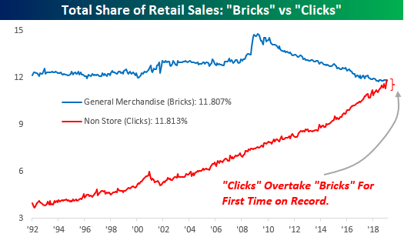
The Business World have changed! The scale of retail sales in the US
The share of general merchandise sales (excluding automobile and travel)
Source: 鉅亨網 (2019) https://news.cnyes.com/news/id/4297671

Slide 21
Closure of physical Stores in 2016/7
5,300 closures during the first half of 2017 (UDN 2017/6/24)
WalMart (2017: #1) is closing 269 stores, 154 in the U.S. (CNBC 2016/1/15) ; closing 63 Sam‘s Club stores (Business Insider 2018/1/12)
Macy’s (2017: #35) is closing 68 stores, cutting 10,000 jobs (AOL Finance 2017/1/4); closing 34 additional locations (AOL Finance 2017/2/22)
Sears (2017: #39) is closing 72 stores on top of 180 closure announced this year (Business Insider 2017/6/6)
JCPenney (2017: #74) is closing 138 stores (Business Insider 2017/3/17)

Slide 22
Surge of the virtual stores
Walmart buys Jet.com for $3B in cash to fight Amazon (techcrunch.com 2016/8/8)
Walmart to Buy Bonobos, Men’s Wear Company, for $310 Million (New York Times 2017/6/16)
The clothing will be sold exclusively on Jet.com.
Amazon to Buy Whole Foods for $13.4 Billion (New York Times 2017/6/16)
Costco Stock Suffers Massive Slide after Amazon-Whole Foods Deal (Fortune.com 2017/6/24)

Slide 23
5G: Next wave of business revolution ₁
The last revolution was triggered by the Internet and smart phones. What is next?
What are the contributions of 5G?
Faster speed? Not fast enough?
Major issue: decentralization
Device to device communications
D2D, V2V
Small Cell
Center
D
D
。。
D
Center
D
D
。。
D

Slide 24
AI: The Next Revolution ₂
Past Artificial Intelligence applications
NLP: Natural Language Processing
Robotics (vision, sensing, actions….)
Expert Systems
What have AI been contributing lately?
Reinforced learning; deep learning…
OpenAI break through
Generative AI (AI learning, making sense)
ChatGPT (announced 2022/11)
DALL-E (images)
Explosions of the AI battle field: Bard/Gemini (Google), Ernie (Baidu) …
DeepSeek? Gork 3 (xAI)? ….

Slide 25
About ChatGPT
New Startup: OpenAI
2015 started up in San Francisco, as a non-profit organization
Established a “for profit” entity in 2019, OpenAI LP , received $1 billion USD investment by Microsoft (additional 10 billion in 2023)
Announced GPT-3 in June 2020
Announced ChatGPT on 30th Nov. 2022 (100 Mil. DAU by Feb. 2023) DAU: Daily Active User
ChatGPT 4, 4o, o1…
Other OpenAI projects
OpenAI Gym
Dall-E

Slide 26
Background on deep learning and GPT
Machine learning and Neural Networks
https://case.ntu.edu.tw/blog/?p=26248
https://case.ntu.edu.tw/blog/?p=26340
GPT: Generative Pre-trained Transformer
GPT-3 175 Billion parameters https://en.wikipedia.org/wiki/GPT-3
GPT-4 100 Trillion parameters https://en.wikipedia.org/wiki/GPT-4

Slide 27
Using ChatGPT
Go to https://chat.openai.com/chat and register as a member
https://youtu.be/WizoCwjEKsg
Support multiple languages
Input the “prompt” for a dialog
One can keep asking in depth questions…

Slide 28
Homework 1
If you do not already have a ChatGPT account (or other tools like Perplexity, Gemini, DeepSeek, etc.), register as a member
Try to chat with an AI tools, providing a series of prompts
Pick the topic “Classroom use of Simulation games,” and try out at least two AI tools, asking relevant questions. Keep prompting follow up questions (at least 8).
Arrive at an essay of between 800-1000 words.

Slide 29
Submit your homework
Prepare a pdf document, with three parts. Document name: 2025S_Temple_HW1_Name.pdf
Name tools you used, and for each tool, a list of prompts that you asked.
The 800-1000 words essay by AI tools.
Analyze the challenges that you may face in the future, with colleagues well versed in these tools as your competitor.
Upload it to the URL announced on the course webpage
You are prohibited from using the AI tools to produce your answer for items 1.c above.

