Slide 1
Supply Chain Procurement, Inventory and Logistics
3
CYCU
Prof. CK Farn
mailto: ckfarn@gmail.com
http://www.mgt.ncu.edu.tw/~ckfarn/cycu
2025.02 Rev

Slide 2
Supply chain
Evolution
https://www.youtube.com/watch?v=uDrQv8Z7owU
https://www.youtube.com/watch?v=B9OSy-JM8mQ
Value Chain
https://www.youtube.com/watch?v=MC_hByD8nBY
Logistics
https://www.youtube.com/watch?v=YugqpSfG87Y

Slide 3
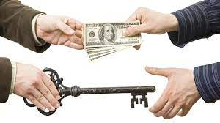
Business transactions
Buy and Sell
A simple business transaction is buying and selling of goods between two parties: buyer and seller
Transactions can be between business entities (B2B), between a business and a consumer (B2C), or between consumers (C2C)
Transactions can be linked together to form a “chain” or a “web”

Slide 4
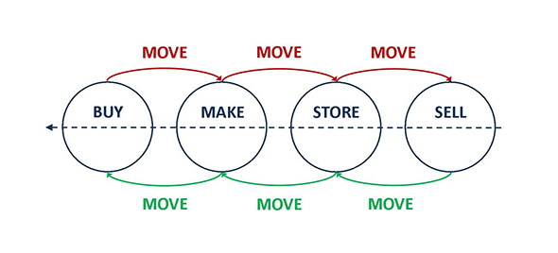
Within a company
Buy in, and sell out directly
Without any transformation of the product
Most of the time, there are transformation involved
Unpacking into smaller packets
Packaging
Assembly
Fabrication
Moving

Slide 5
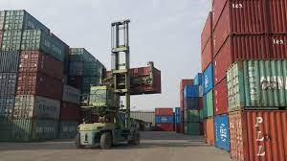
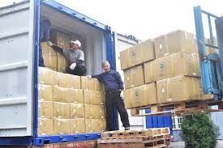
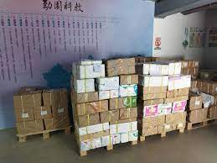
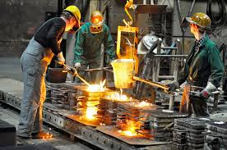
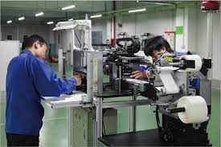
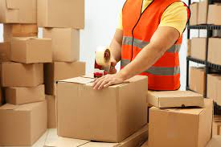
Processing and transformation
container
pallet
Carton and boxes on pallet
assemble
packaging
casting (fabrication)

Slide 6
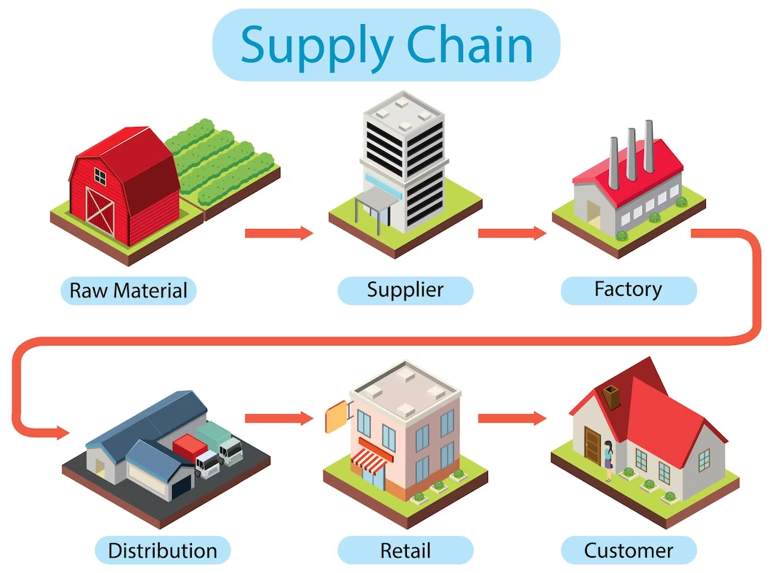
Supply Chain (value chain)

Slide 7
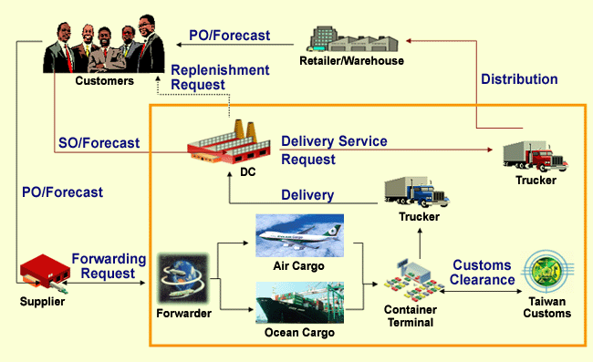
Supply Chain (Logistics)

Slide 8
Inventory
Inventory
A stock or store of goods
Independent-demand items
Items that are ready to be sold or used
Inventories are a vital part of business: (1) necessary for operations and (2) contribute to customer satisfaction
A “typical” firm has roughly 30% of its current assets and as much as 90% of its working capital invested in inventory

Slide 9
Warehouse, inventory, stock
Inventory
goods and materials owned by a company at a particular time, including parts, products being made, and finished products
Stock of goods
the inventory of a business held for sale to customers in the ordinary course of business
Warehouse
a facilities to store their products, such as raw materials, packing materials, components, or unfinished goods until they are ready to be shipped to the distributor or manufacturer where it turns into finished goods

Slide 10
Types of Inventory
Raw materials and purchased parts
Work-in-process (WIP)
Finished goods inventories or merchandise
Tools and supplies
Maintenance and repairs (MRO) inventory
Goods-in-transit to warehouses or customers (pipeline inventory)

Slide 11
Inventory Functions
To meet anticipated customer demand
To smooth production requirements
To decouple operations
To protect against stockouts
To take advantage of order cycles
To hedge against price increases
To permit operations
To take advantage of quantity discounts

Slide 12
Inventory Costs
Purchase cost
The amount paid to buy the inventory
Holding (carrying) costs
Cost to carry an item in inventory for a length of time, usually a year
Ordering costs
Costs of ordering and receiving inventory
Setup costs
The costs involved in preparing equipment for a job
Analogous to ordering costs
Shortage costs
Costs resulting when demand exceeds the supply of inventory; often unrealized profit per unit

Slide 13
Lead time
PO: purchase order
SO: sales order
LT: Leadtime
Make to stock model
Buy
Sell
Seller
PO
Receive
Make
Store
SO
Delivery
Buy
Sell
Buyer
PO
Receive
Leadtime
Make to order model
Sell
Buy
Sell
Seller
SO
PO
Receive
Make
Store
Delivery
Buy
Sell
Buyer
PO
Receive
Leadtime

Slide 14
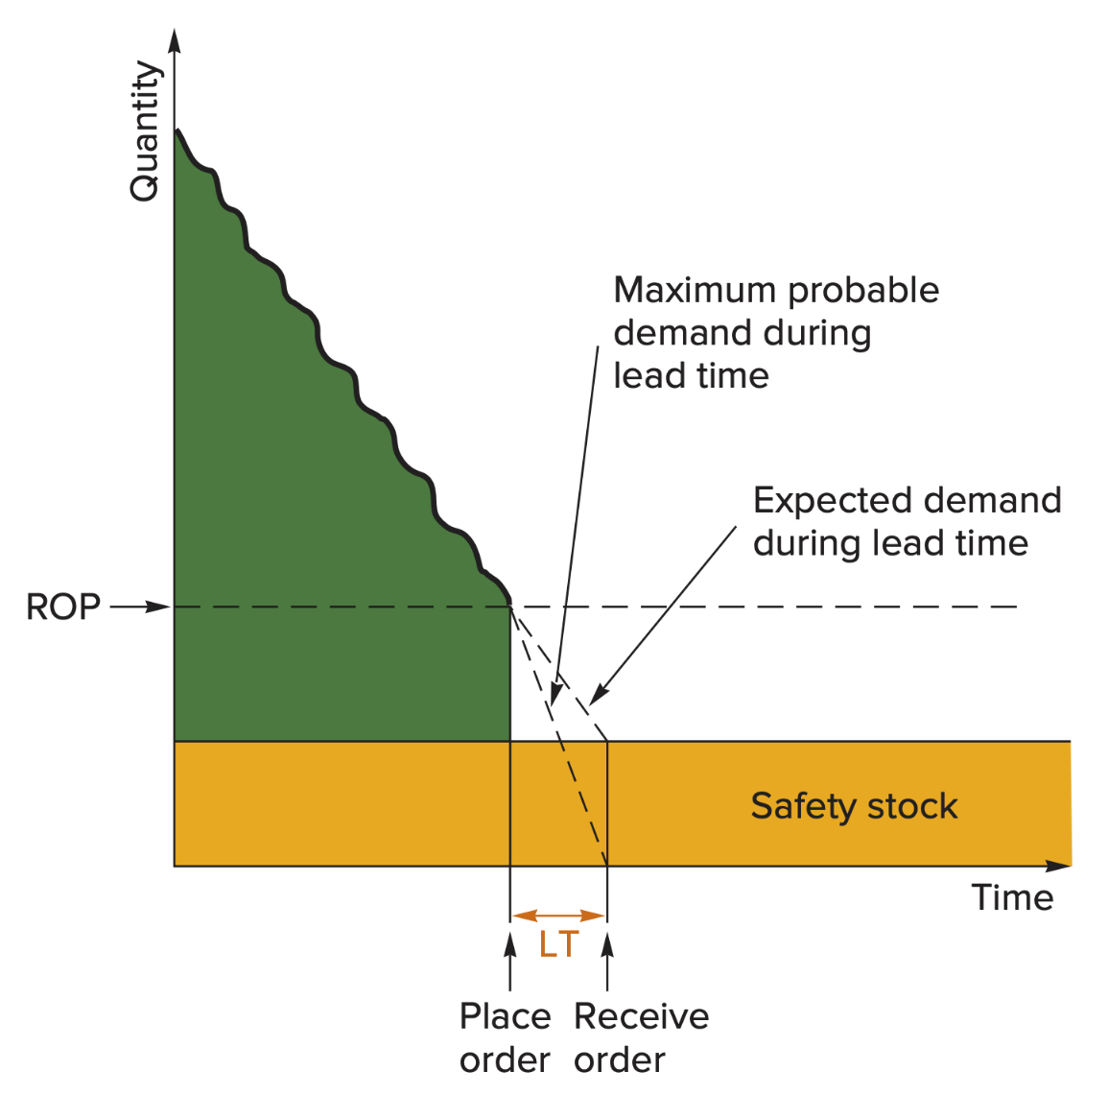
Safety Stock

