Slide 1
Business Data Analytics and Data Driven Operations
9
  CYCU
  Prof. CK Farn
mailto: ckfarn@gmail.com
http://www.mgt.ncu.edu.tw/~ckfarn/cycu
  2025.05 Rev

Slide 2
Data analytics
The process of collecting, cleaning, and analyzing data to extract meaningful insights
A powerful tool that can be used to improve business performance in a number of ways
In today's data-driven world, data analytics is an essential tool for businesses of all sizes
By using data analytics, businesses can improve their performance, increase their profits, and gain a competitive edge
Decision making based on data analysis

Slide 3
Importance of Data Analytics ₁
Improved decision-making
  providing insights into customers, operations, and markets
  identifying opportunities, solve problems, and improve efficiency
Increased customer satisfaction
  understanding customer behavior and preferences
  delivering more personalized and relevant products and services
  leading to increased customer satisfaction and loyalty
Reduced costs
  helping businesses identify areas where they can save money by reducing waste, improving efficiency, and optimizing processes

Slide 4
Importance of Data Analytics ₂
Increased revenue
  identifying new opportunities and improving customer satisfaction, data analytics can help businesses increase revenue
Enhanced competitive advantage
  using data analytics to gain insights that their competitors do not have, businesses can gain a competitive advantage

Slide 5
How DA can be used in business
Marketing
  track customer behavior, identify target audiences, and measure the effectiveness of marketing campaigns
Sales
  identify potential customers, track sales leads, and close deals
Customer service
  track customer satisfaction, identify problems, and resolve issues
Operations
  improve efficiency, identify areas for improvement, and reduce costs.
Finance
  track financial performance, identify risks, and make better investment decisions
etc.

Slide 6
Decision types
Certainty
  We have enough facts and evidence to know the possible results of a decision
Risk
  We know all possible outcomes, and respective probabilities
Uncertainty
  We do not know the possible outcomes, and cannot assess the probabilities

Slide 7
Shifts in decision types
When more data are available, decision types may change
When we know more, uncertainty may become risk, and risk may become certainty
Then, how can we have more data?

Slide 8
Data collection
Data collection is not free
Much of the data can be collected within a business process
  POS check-out
  Taking a public transportation with Easy-Card
Do you have enough data
  Do you want to collect more

Slide 9
IT as an enabling technology
Data collection through sensors and devices
  Bar code, RFID (Radio frequency Identification), NFC (Near Field Communications)
  Tracking movements of mouse and touch screens
Big data storage
Analysis if data that was impossible a decade ago
Make relevant decisions
  Data driven decisions
Process changes

Slide 10
Roles of IT in business data analytics
Data collection and sharing
  collect data from a variety of sources, including internal systems, external databases, and social media
Data storage
  store data in a secure and efficient manner
Data management
  manage the data lifecycle, from collection to deletion
Data analysis (in conjunction with statistics)
  use a variety of tools and techniques to analyze data.
Data visualization
  create visualizations of data to make it easier to understand.
Data reporting
  generate reports that summarize the findings of data analysis.

Slide 11
Visualization
The process of representing data in a visual format
  use of charts, graphs, maps, and other visual representations
Makes data easier to understand
Identifies trends
Compares values
Identifies outliers

Slide 12
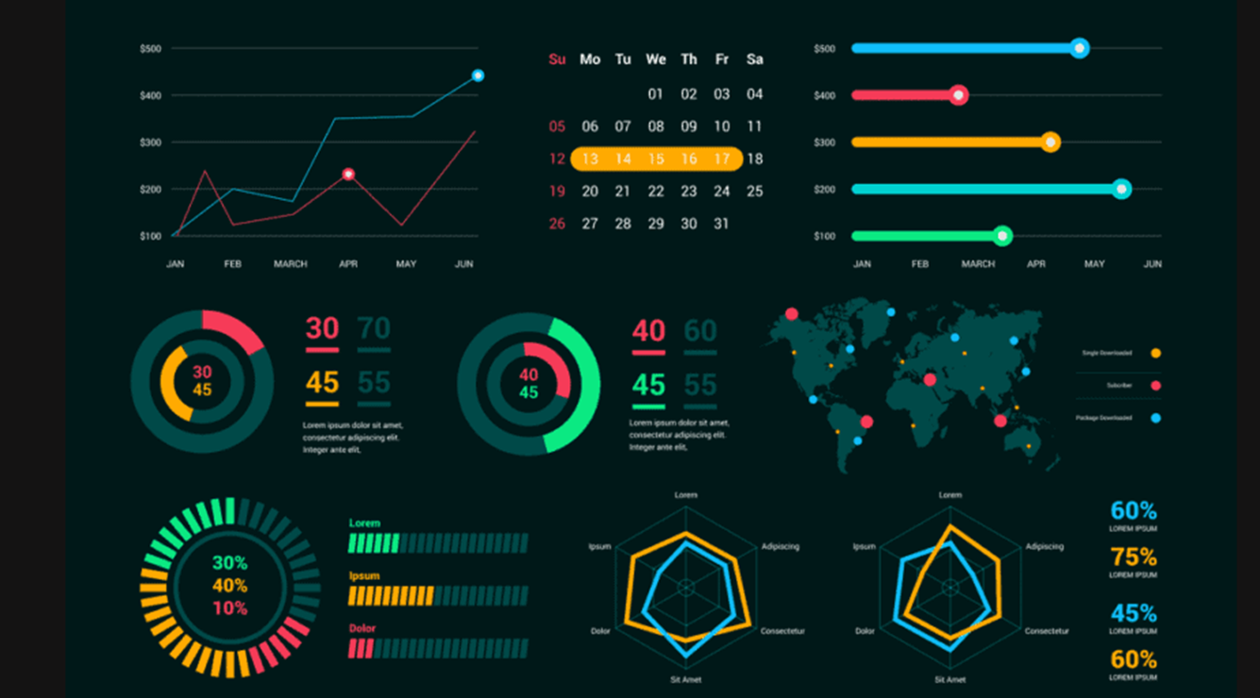
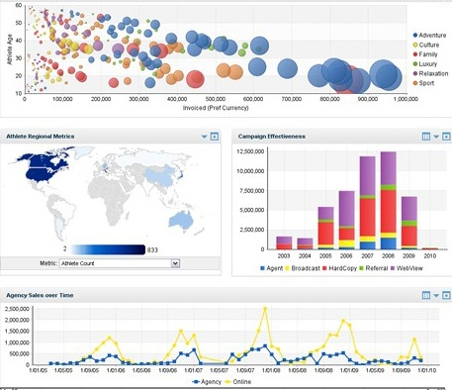
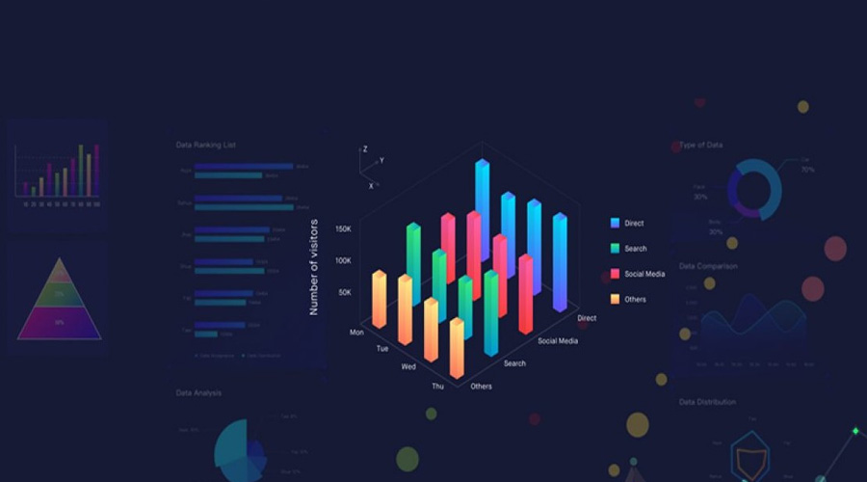
Visualization

Slide 13
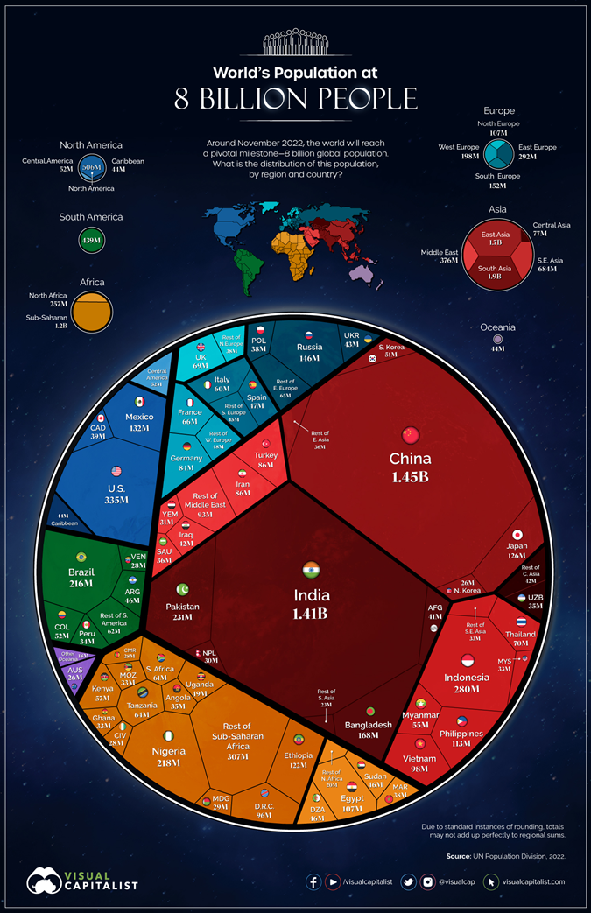

Slide 14
Examples of Visualization
What is data visualization
  https://www.youtube.com/watch?v=YaGqOPxHFkc
World Population
  https://www.biologicaldiversity.org/programs/population_and_sustainability/world_population_video.html

Slide 15
Relating concepts
Data warehousing
  process of collecting and storing data from a variety of sources into a single repository
  makes it easier to access and analyze data from different parts of the business
Business intelligence (BI) tools
  software applications that help businesses to collect, analyze, and visualize data
  can be used to identify trends, make predictions, and improve decision-making
Big data
  massive amounts of data that is generated by businesses and other organizations
  extract insights from this data that would not be possible to obtain with traditional data analysis methods

Slide 16
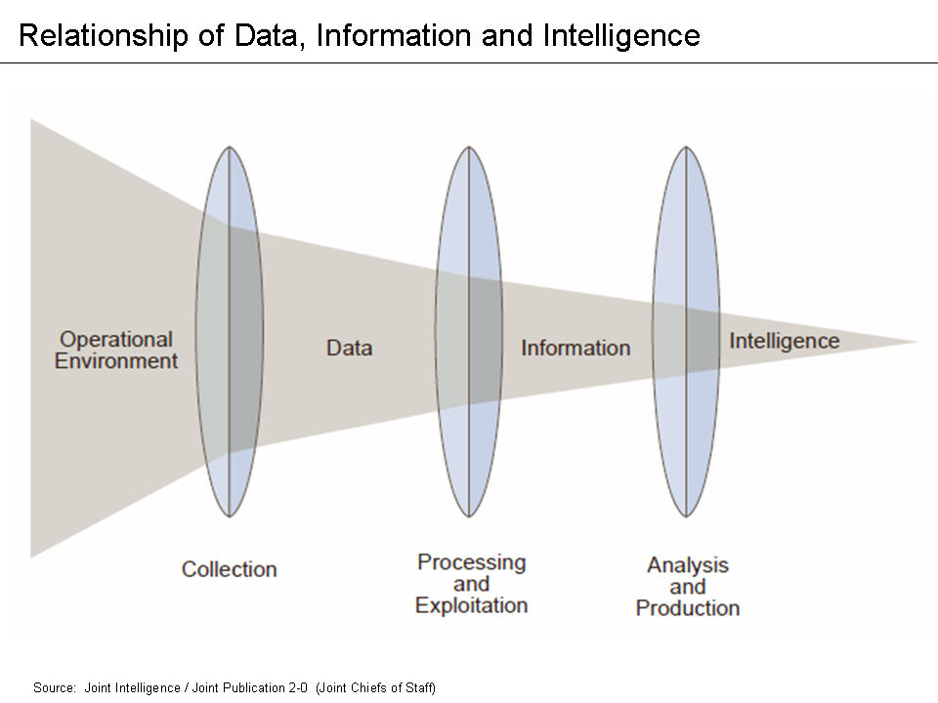

Slide 17
Types of data used in analytics
Structured data
  data that is organized in a regular way, such as in a table or spreadsheet. Structured data is typically easy to process and analyze.
Unstructured data
  data that is not organized in a regular way, such as text, images, and videos
  can be more difficult to process and analyze, but it can also be more valuable
Semi-structured data
  data that is somewhere in between structured and unstructured data

Slide 18
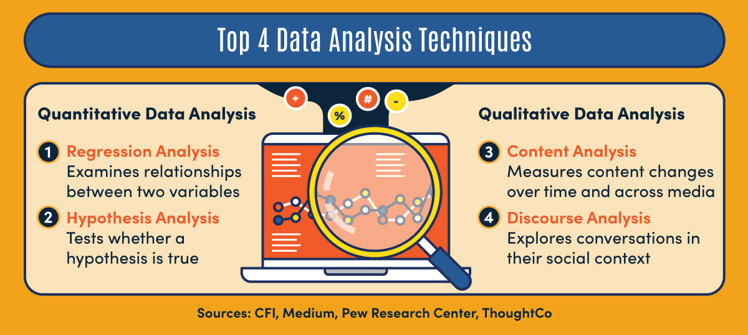
Data Analysis techniques

Slide 19
Web sentiment
The process of extracting and analyzing the opinions and emotions expressed in text data on the web
A variety of sources:
  social media, blogs, product reviews, and news articles
Sentiment analysis can be used to understand how people feel about a particular product, service, or issue
  can be used to improve products and services, make better business decisions, and target marketing campaigns

Slide 20
Techniques
Techniques for web sentiment analysis:
  lexicon of words that have been associated with positive, negative, and neutral sentiment
  text data is then analyzed to identify the words that occur in it
  the frequency of occurrence of these words is then used to determine the overall sentiment of the text

Slide 21
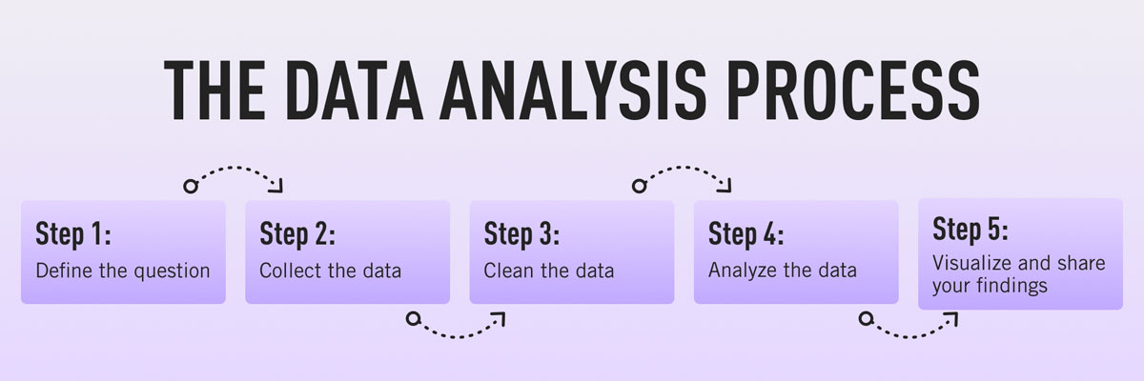
Process of doing business data analytics
Define the business problem
  What do you want to achieve?
  What information do you need to make better decisions?
Collect the data
  The data can come from a variety of sources, such as customer transactions, social media, and surveys
Clean the data
  Removing errors and inconsistencies from the data
Analyze the data
  Using statistical and machine learning techniques to extract insights from the data

Slide 22
Process of doing business data analytics 2
Visualize the data
  Creating charts, graphs, and other visuals to help you communicate the insights that you have found
Share the insights
  Share the insights that you have found with the people who need them
  Include business leaders, marketing teams, or product developers
Take action
  Take action based on the insights that you have found
Review and rework

Slide 23
Data-driven operations
The approach of making decisions and conducting business activities based on data and analysis
  using data to gain insights, identify patterns, and make informed decisions to optimize operations and achieve desired outcomes
  in a data-driven organization, data is collected, processed, and analyzed to drive decision-making across various departments and functions
  allows businesses to rely on objective information rather than relying solely on intuition or past experiences. By leveraging data, organizations can improve efficiency, identify opportunities, mitigate risks, and enhance customer experiences

Slide 24
Data-driven operations ₂
Data-driven operations often involve using advanced analytics, machine learning, and artificial intelligence techniques to extract valuable insights from large volumes of data
It often involve new IT solutions to collect data never collected before

Slide 25
Examples
Fare collections on public transportations (e.g. buses)
Five years ago
  “Peep” on a ride, when entering or exiting a bus
Two decades ago
  Human collection with tickets
Now
  “Peep” when entering and exiting a bus
So what?

Slide 26
Insights can be gained
By time of the day
By day of the week
By traffic among stations
Design of new routes and new time tables

Slide 27
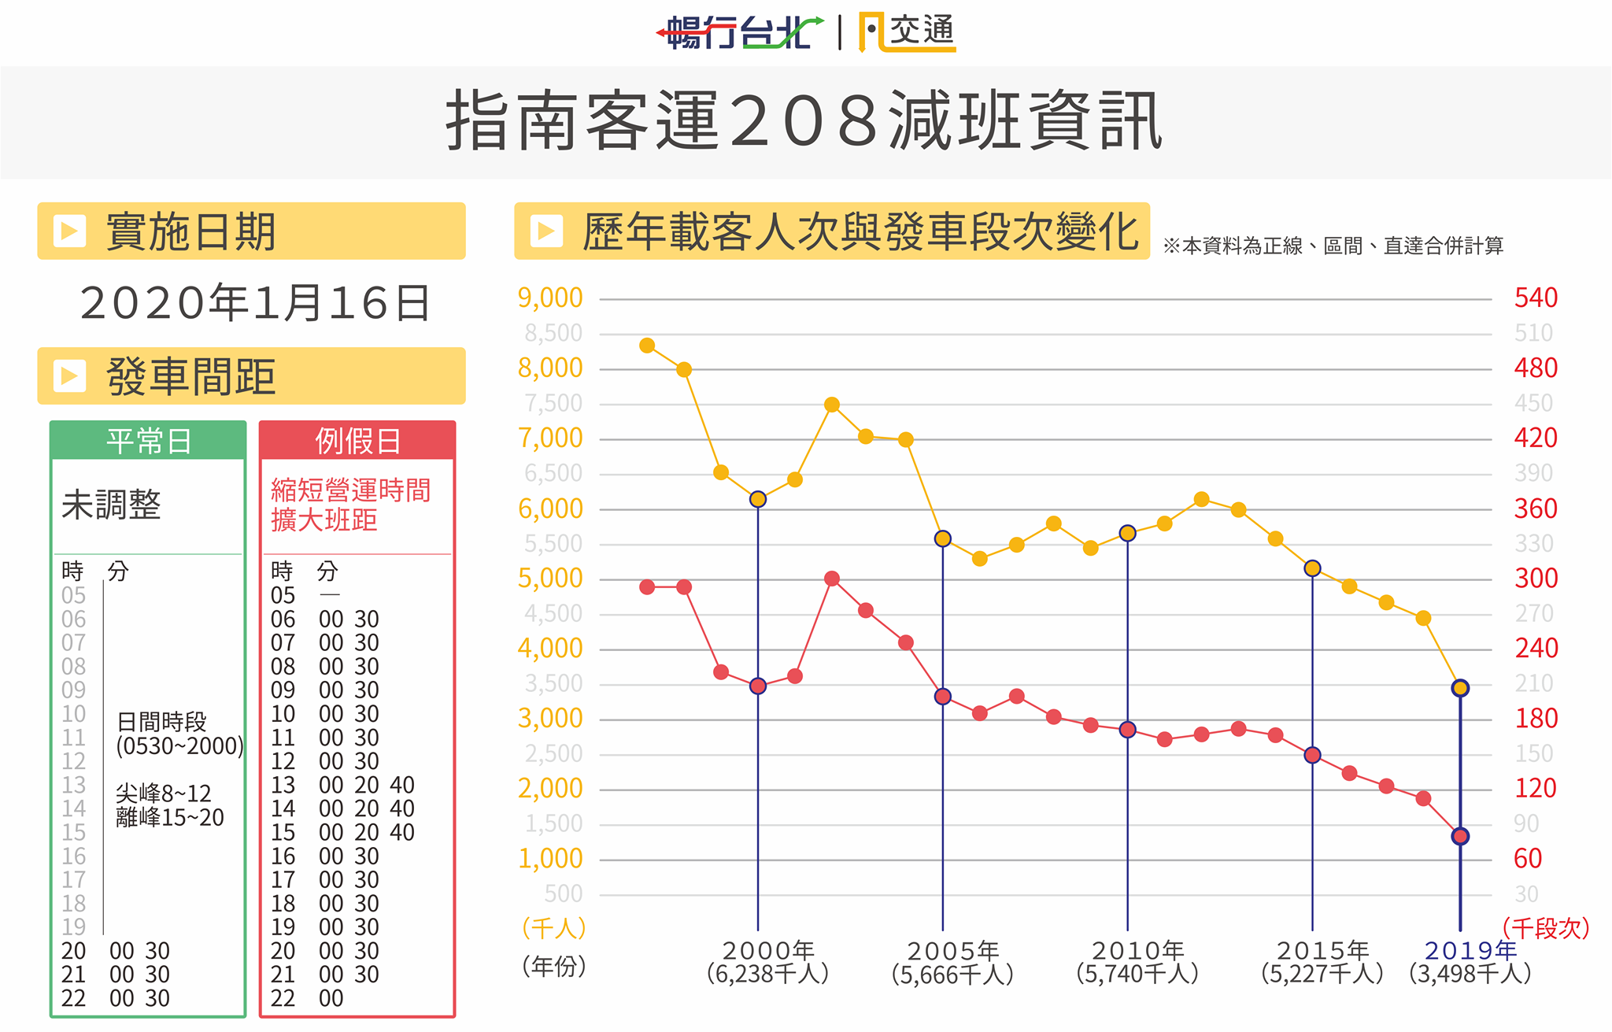
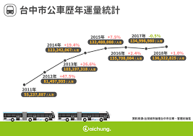
Traditional data collection on bus routes

Slide 28
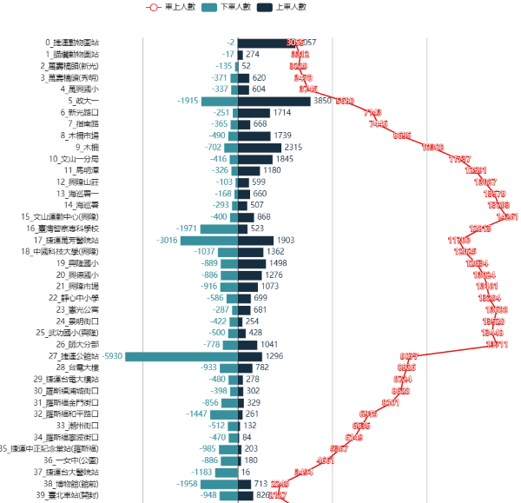
Optimization of bus routes:
Flow statistics across stations

Slide 29
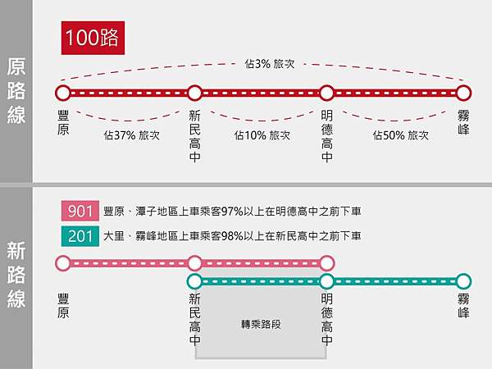
Change of routes:
Splits

Slide 30
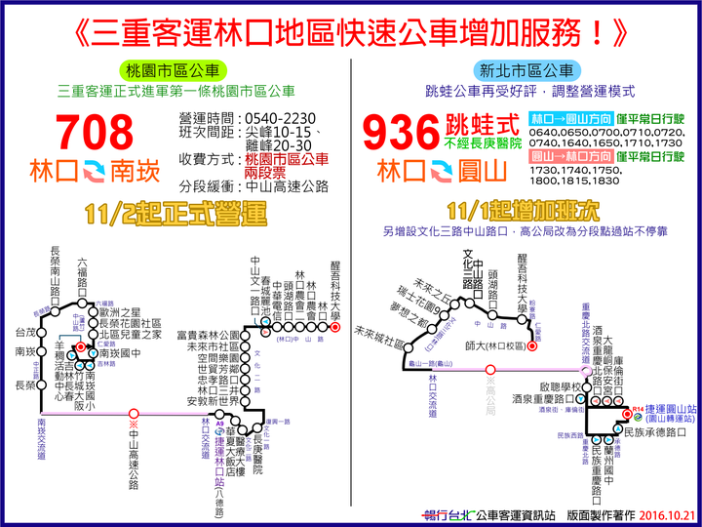
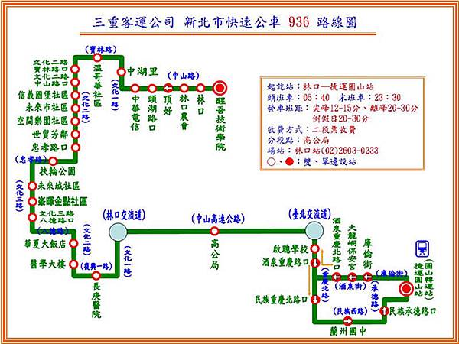
Skipping stations

Slide 31
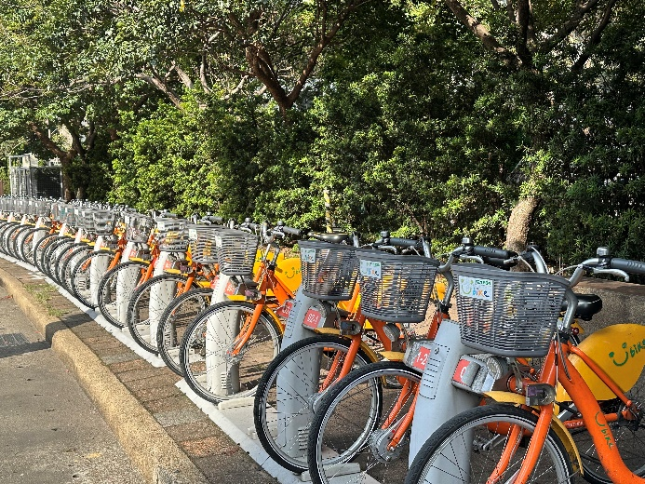
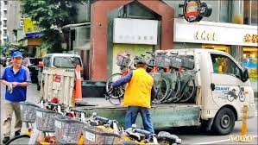
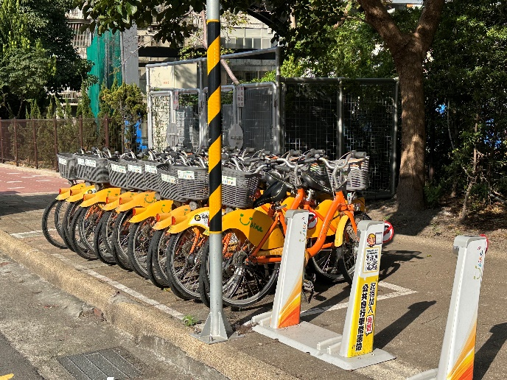
Ubike 經營的困難點
無車可借、無空位還車
需要背後的周轉機制
  大量的實體運輸，緩不濟急
階段
  1. 借還的困境
  2. 利用搬運進行周轉
  3. 預備車

Slide 32
Can we do something about traffic light timings?
What are your proposals?

