Slide 1
Business Data Analytics and CRM— Customer Relationship Management
10
CYCU
Prof. CK Farn
mailto: ckfarn@gmail.com
http://www.mgt.ncu.edu.tw/~ckfarn/cycu
2025.05 Rev

Slide 2
Agenda
CRM: Customer Relationship Management
Sales Funnel
Applications of Data Analytics in CRM
CRM can be to-B or to-C
We focused on the to-C businesses

Slide 3
Actions of CRM
Objectives:
Differentiated marketing and services
Increased customer satisfaction/loyalty
Leading to higher profit
Sales Mgmt
Customer
Mgmt
Marketing Mgmt
Service Mgmt
Database
Mgmt

Slide 4
Why CRM ?
customer churn rate (customer attrition rate) is twice the average
According to research, best 20% customers contribute to 150% of profit, while the bottom 40% customers results in 50% loss in profit
Profit
Lower profit by 50%
1
2
3
4
5
6
7
8
9
10
Customer Segment
Source: Manhattan Consulting Group

Slide 5
Brand owner and Customer
Ads, Brand imaging
Brand Owner
Customer
Low visibility
Ads, Brand imaging
Brand Owner
Channel
Customer
Very Low visibility
Ads, Brand imaging
Brand Owner
Salesman
Channel
Customer
No visibility

Slide 6
Sales triangle
Brand
Owner
Customer
Channel

Slide 7
Do you know your customers?

Slide 8
Key questions
Do you know your customer?
Do you care? Do your competitors care?
Do you know your channel performance?
Salesmen? Regions? Channel partners? Customers?
Do you know your customer’ behavior?
Current customers? Potential customers?
When they have opinion, do you know? Do you care?
How do you know your customers’ requirements?
From channels? From customers?

Slide 9
Three dimensions of CRM
Front-end:
Communication
CRM
Core Ops:
Operational
CRM
Backend:
Analytical
CRM
CTI: Computer
telephony integration
Net Banking
Online sales
Customer Mgmt
Marketing Mgmt
Sales Mgmt
Service Mgmt
Data Mining
OLAP
EIS
ETL
Extraction
Transformation
Loading
Database
Data Mart
Data Warehouse
Demographic Data
Transaction Data
Operational
Database

Slide 10
Customer segmentation
Retain valuable customers to increase profit
Differentiation;
Increase average transaction value (ATV)
Major Accounts
Increase loyalty
Ordinary Accounts
Potential Accounts
Expand customer base

Slide 11
Loyal customers are the best assets
Potential
Customers
Lost
Customers
Marketing
Current
Customers
Sales Service
Loyal
Customers
Active
Service

Slide 12
Loyal customers are the best assets
Characteristics of loyal customers
Very satisfied
Continue purchase
Referals, Recommend to others
Making profit
20/80 rule
20/100 rule
20/120 rule
Very
satisfied
Continue
purchase
Recommend
to others

Slide 13
Importance of customer loyalty
Higher ATV
New customers
referals
Profit
Lower cost of marketing
Buy more
Basic benefits
1
2
3
4
5
6
7
Year
Cost of new customre
The longer customers stay, the more benefits they bring
Source: “Zero Defections: Quality Comes to Services,” by Frederick R. Reichheld and W. Earl Sasser, Jr., September-October 1990.

Slide 14
Sales Funnel
Sales funnel, also known as
purchase funnel
conversion funnel
A visual representation of the customer journey from the initial stage of awareness to the final stage of making a purchase.

Slide 15
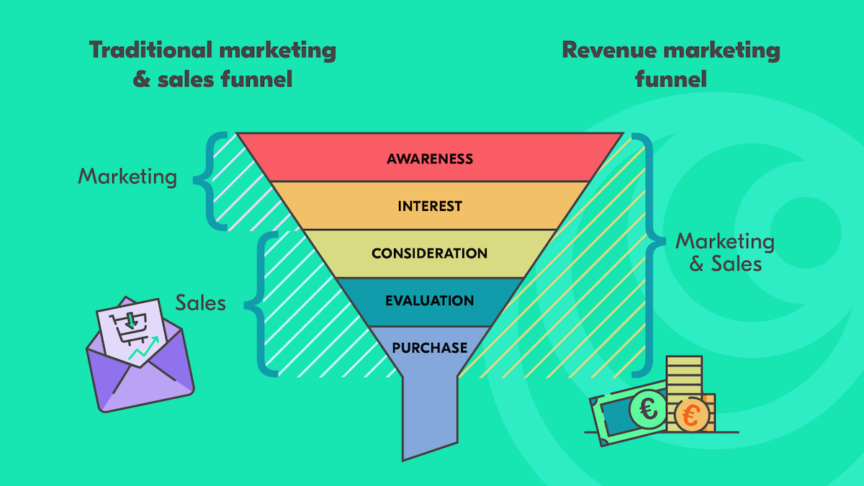
Revenue marketing funnel

Slide 16
Stages ₁
Awareness
Potential customers become aware of your brand, product, or service
may discover your business through various channels such as advertisements, social media, search engines, or word-of-mouth referrals.
Interest
prospects have shown some interest in your offering and are actively seeking more information
may visit your website, read blog posts, watch videos, or download resources to learn more about your product or service.

Slide 17
Stages ₂
Consideration
Evaluating different options and comparing them
considering whether your product or service meets their needs and offers value
read reviews, compare features, or request demos or consultations
Decision
Made the decision to purchase
may take actions like adding items to their shopping cart, subscribing to a service, or signing a contract
Action
Completes the desired action, such as making a purchase, subscribing to a service, or signing a contract

Slide 18
Dropping off
Not all leads who enter the sales funnel will make it to the bottom and become customers
may drop off at various stages due to lack of interest, unsuitability, or other factors
optimizing a sales funnel is to maximize the number of leads that convert into paying customers and minimize the drop-off rate at each stage

Slide 19
Conversion rate
The conversion rate is the proportion of visitors to a website who take action to go beyond a casual content view or website visit, like purchase.
Conversion rate = Number of actions / Number of visits
Important performance metrix in eCommerce
For example: you have a landing page that brought in 5000 visitors and 1237 of them took the desired action
your conversion rate would be 24.74% (1237/5000) x 100
https://acquire.io/blog/what-is-conversion-rate

Slide 20
Use of data analytics in funnel
Data-driven decision-making is highly relevant to the sales funnel
allows businesses to make informed choices based on concrete data and insights rather than relying on assumptions or guesswork
analyzing data at each stage of the sales funnel, businesses can gain valuable insights into customer behavior, preferences, and trends, which can guide their decision-making process and improve the effectiveness of their sales and marketing efforts.

Slide 21
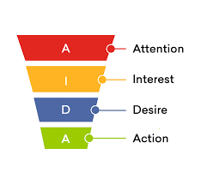
Advertisement charges: A review
Cost per exposure? Cost per impression? CPI, CPM
S1—S2
Cost per click? CPC
S1—S3
Cost per action? Cost per Sales (commission)? CPA, CPS
S1—S4
S1
S2
S3
S4

Slide 22
Marketing funnel expalined
https://www.youtube.com/watch?v=UE-E5DFeF3o
The Marketing Funnel Explained: What Is It & How To Write One
https://www.youtube.com/watch?v=Xx75loJvFhg
https://www.yieldify.com/blog/ecommerce-sales-funnel/

Slide 23
Use of data-driven decision-making with the sales funnel ₁
Tracking and measuring
at each stage of the sales funnel, tracking metrics such as website traffic, conversion rates, click-through rates, engagement levels, lead quality, and customer acquisition costs
businesses can identify areas of improvement, track the performance of marketing campaigns, and make data-backed decisions to optimize their sales funnel
Identifying bottlenecks
help identify bottlenecks or areas of friction within the sales funnel where potential customers are dropping off or losing interest
businesses can pinpoint the stages where conversions are low or where prospects are disengaging
enables businesses to take corrective actions, refine their marketing strategies, and optimize the funnel to increase conversions and improve overall performance

Slide 24
Use of data-driven decision-making with the sales funnel ₂
Personalization and targeting
allows businesses to segment their audience and personalize their marketing messages based on customer preferences and behaviors
businesses can create targeted campaigns, deliver relevant content, and tailor offers to specific customer segments
helps to attract and retain customers throughout the sales funnel by providing a more personalized and engaging experience
Testing and optimization
encourages businesses to run experiments and conduct A/B testing to optimize their sales funnel
By testing different variations of landing pages, calls to action, pricing strategies, or marketing messages, businesses can gather data on which approaches are most effective in driving conversions
this iterative process of testing and optimization helps refine the sales funnel and maximize its performance

Slide 25
Use of data-driven decision-making with the sales funnel ₃
Forecasting and planning
provides businesses with the ability to forecast future sales and plan their resources accordingly
by analyzing historical data and trends, businesses can make informed projections about sales volumes, revenue, and customer acquisition rates
enables them to allocate resources, set realistic targets, and make strategic decisions to achieve their sales goals.

Slide 26
Conversion rate: renewed
With more data analytics, we now have many conversion rates, across each funnel stages
The conversion rate measures the percentage of leads or prospects who successfully complete those desired actions or move from one stage to the next
https://www.mosaic.tech/financial-metrics/sales-funnel-conversion-rate

Slide 27
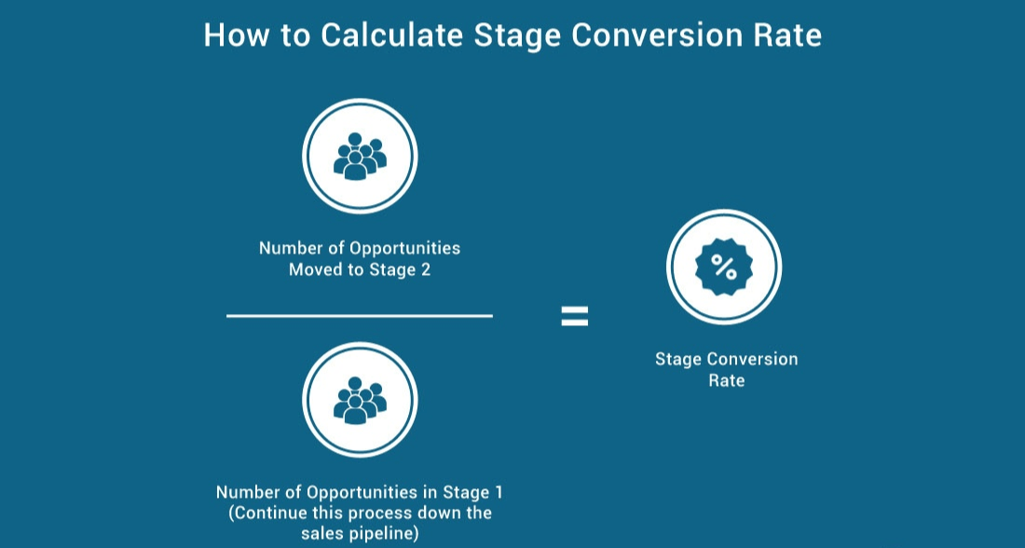
Calculating stage conversion rate

Slide 28
Stage conversion rate
measures the percentage of opportunities or deals that move from one stage to the next
if a rep had 100 opportunities that moved to Stage 1 in the sales process, and 75 of those moved to Stage 2, then the Stage Conversion Rate for Stage 1 to Stage 2 would be 75%.
provide amazing feedback on the health of the process, and where the bottlenecks are

Slide 29
Conversion rate: stages
Website Visit: C₀
Click through rate: C₁
Engagement rate: C₂
Traditional Conversion Rate: C
Final close rate: C₃
C = C₁ x C₂ x C₃

Slide 30
Marketing Funnel for eC
How to Turn Browsers into Buyers with Lessons From 100,000+ Campaigns: The New Ecommerce Conversion Funnel
https://www.convertflow.com/blog/ecommerce-conversion-funnel
What is a conversion funnel? The complete guide
https://www.fullstory.com/conversion-funnels/

Slide 31
Awareness stage conversion rate
Measure how many people who are initially exposed to your brand or product become aware of it
can be measured through metrics such as website visits, social media engagements, or the number of inquiries generated from marketing efforts
The conversion rate here would be the percentage of people who move from being unaware to becoming aware of your business

Slide 32
Interest stage conversion rate
Measures the percentage of leads who show interest and engage further with your brand or product
include actions like signing up for a newsletter, downloading a whitepaper, or watching a product demo
The conversion rate would be the percentage of leads who move from being aware to expressing interest, e.g. click through rate

Slide 33
Consideration stage conversion rate
Measures the percentage of leads who actively consider your product or service as a potential solution to their needs
Measured by actions such as requesting a quote, scheduling a consultation, or engaging in a free trial
Engagement rate
The conversion rate would be the percentage of leads who move from the interest stage to actively considering your offering

Slide 34
Decision stage conversion rate
Measures the percentage of leads who make the decision to purchase or become paying customers
Measured by actions such as completing a purchase, subscribing to a service, or signing a contract
The conversion rate here would be the percentage of leads who move from considering your offering to making a decision to purchase

Slide 35
The rates
By tracking and analyzing conversion rates at each stage of the sales funnel, businesses can identify where they may be losing potential customers and focus on improving those areas
helps in understanding the effectiveness of marketing and sales efforts, optimizing the funnel, and ultimately increasing the overall conversion rate from initial awareness to final purchase
C = C₁ x C₂ x C₃

Slide 36
Optimizing the sales funnel with data analytics
By leveraging data analytics techniques and tools, businesses can gain valuable insights into customer behavior, identify patterns and trends, and make data-driven decisions to improve the performance of their sales funnel
Identifying customer trends
Customer segmentation
Conversion rate optimization
A/B testing
Predictive analytic
Customer journey analysis

